Slide 1




The Universe, Mind and Intelligence without God?
Włodzisław Duch
Katedra Informatyki Stosowanej Uniwersytet Mikołaja Kopernika, Toruń
Google: W. Duch
Debate with Andy McIntosh at NCU Toruń, 10.12.2013

Slide 2

What it is about?
Does God help us to understand the Universe?
Does God help us to understand life?
Does God help us to understand mind?
Why do we believe in anything?

Slide 3
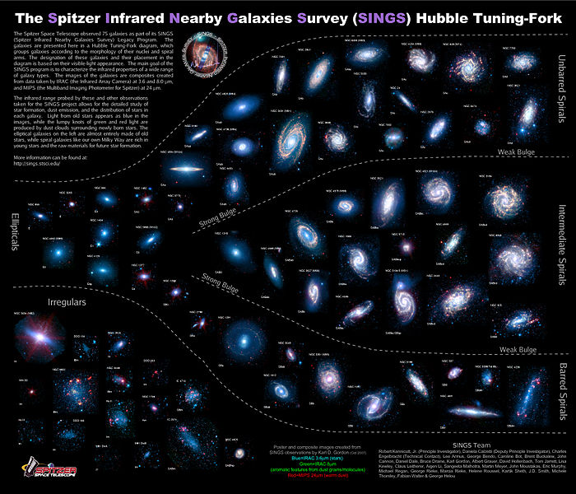
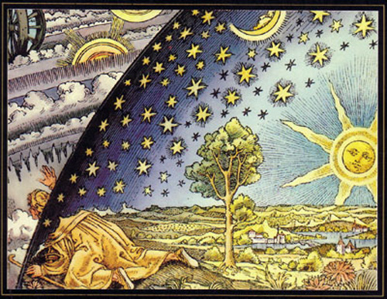
The Universe
Every ancient culture had some ideas about the origin of the universe.
All pre-scientific ideas about astronomy, physics, life and mind were wrong …
Astrophysics gave us incredibly beautiful and complex picture of the world. We know how to calculate orbits of the planets, ask specific questions: types of stars, galaxies, extrasolar planets, the interstellar medium, distribution of the cosmic microwave background, pulsars, supernovas, carbons, heavy metals and calculation of abundance of elements … We are stardust!

Slide 4
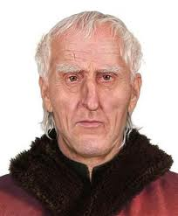
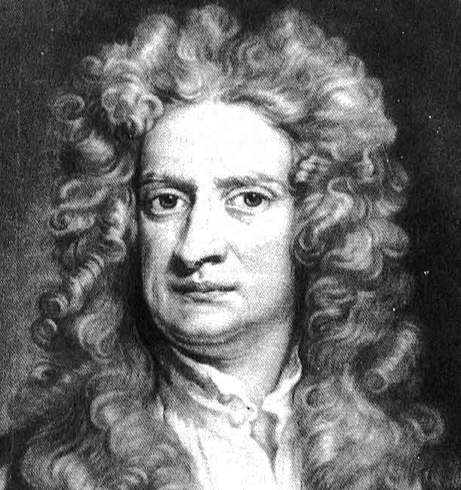
Solar system
Copernicus: movements of the planets should be perfect, worthy of heavens, circular and uniform.
… the universe is spherical. The reason is that, of all forms, the sphere is the most perfect.
Earth should move: As a quality, moreover, immobility is deemed nobler and more divine than change and instability, which are therefore better suited to the earth than to the universe.
The Universe is big, empty, cold, with billions of stars, much bigger than needed for men. Terrible vision that could not be accepted.
Newton: “the Planets move one and the same way in Orbs concentrick, some inconsiderable Irregularities excepted, which may have arisen from the mutual Actions of Comets and Planets upon one another, and which will be apt to increase, till this System wants a Reformation. “The solar system is unstable, and occasional divine interventions are required to restore the well-spaced, nearly circular planetary orbits that we observe today”.

Slide 5
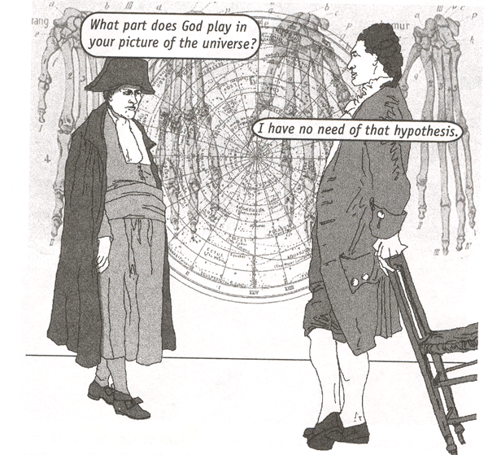
Laplace & Napoleon
Stability of the solar system has been proven in Méchanique céleste by Pierre-Simon Laplace published in 5 volumes (1799-1825).

Slide 6
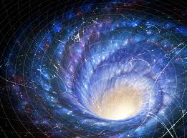

Cosmology
Anthropic Principle: astrophysicist Brandon Carter at the 1973 Kraków symposium honoring Copernicus's 500th birthday stated two forms of the Anthropic Principle: anthropic selection of privileged space-time locations in the universe, and "strong" form which addressed the values of the fundamental constants of physics (Barrow & Tipler 1988).
The fundamental constants fall within the narrow range compatible with life. Physical Universe must be compatible with the conscious life that observes it.
Investigation of the structure of stars in universes with different values of the gravitational constant G, the fine-structure constant α, and a nuclear reaction rate parameter C showed that roughly 25% of this parameter space allows stars to exist (Fred Adams, ).
Rev. prof. Michał Heller got Tempelton prize in 2008.
In „God and Science” book published by the Copernicus Center Press (2013) he explains why we should not invoke God
as an explanation of things we do not understand.
In his view science leads to knowledge, while religion to meaning.

Slide 7
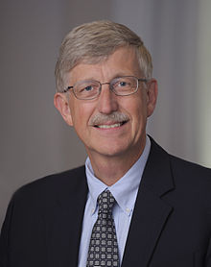
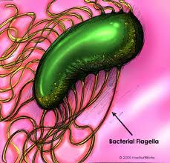
Does God help us to understand life?
Francis S. Collins, physician-geneticist, director of the National Institutes of Health in Bethesda, Maryland, led the Human Genome Project (HGP, 1993-2000).
In “The Language of God: A Scientist Presents Evidence for Belief” he describes his conversion to Christianity.
He believes in evolutionary creation or theistic evolution, calling it BioLogos, the Universe tuned for life.
Collins argues against creationism and intelligent design.
Michael Behe in “Darwin’s black box” (1996) writes about irreducible complexity of bacterial flagellum, composed of 30 proteins, a kind of nanomachine, that could not be created by chance. The origin of flagellum has been explained in: K.R. Miller, The Flagellum Unspun (W.A. Dembski & M. Ruse, ed. Debating Design: From Darwin to DNA, Cambridge 2004, pp. 81-97.
Is the Universe for life, or is life struggling to survive?

Slide 8
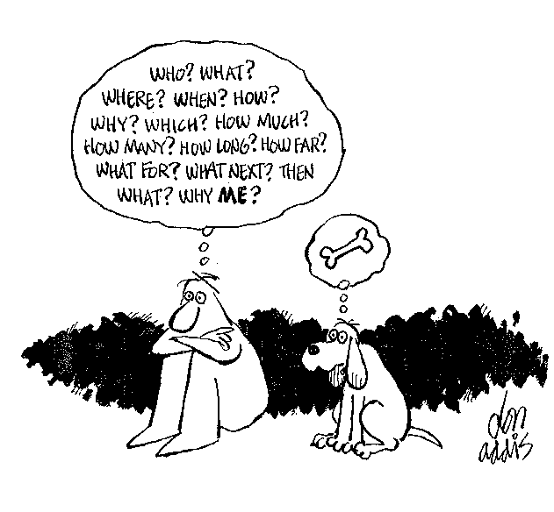
God, mind and intelligence?
Is mind, intelligence, consciousness something that cannot be explained by evolution? We do not have problems with ants, octopus or apes, but human?

Slide 9
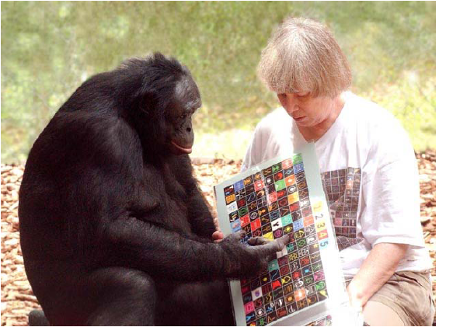
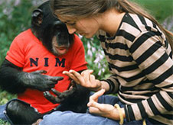
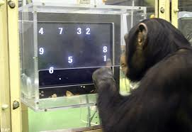
Simple brains, simple minds
Although the primates have 10 x smaller cortex, specialized for action and perception, with small associative areas, they can express their intentions and compose symbols, have better working memory than humans, show complex social behavior, altruism and sense of justice.
Their DNA is almost like ours and their brains have the same structure as ours, but with the small cortex they stay at the level of 2-year old baby.
Humans with brains of chimp size show similar intelligence.

Slide 10
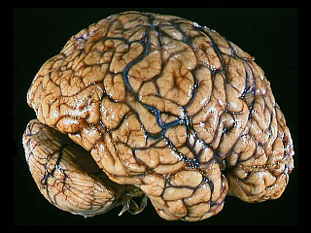
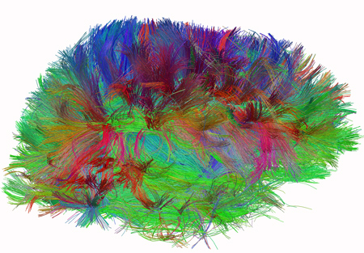

Neural determinism
Our possibilities are limited by genetic and neural determinism.
„Comes to my mind” = neural activity arising in a given context.
Neural determinism is the effect of genetic predisposition and individual experiences, family, social interactions, education.
There is no linear causality here, everything in time/space is one.

Slide 11
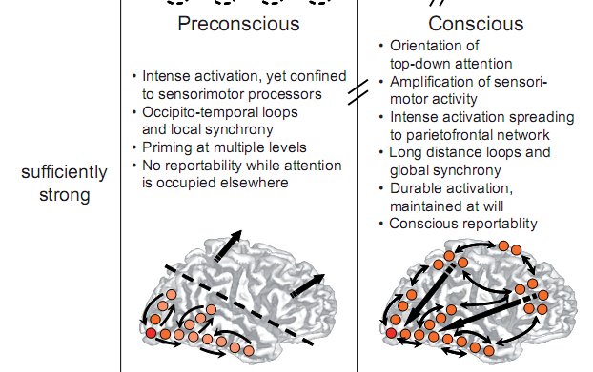
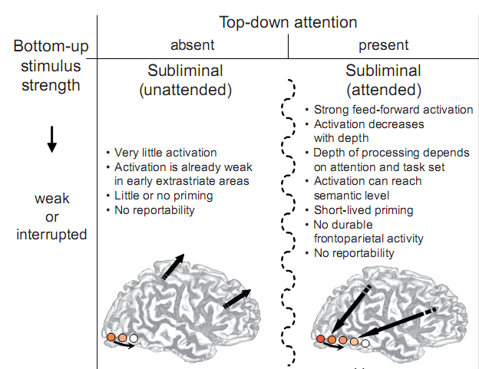
When brain activation is conscious?
Sensory cortex, for example V4 for color, MT for movement.
Bottom-up and top-down activations create resonant states.
C. Gilbert, M. Sigman, Brain States: Top-Down Influences in Sensory Processing.
Neuron 54(5), 677-696, 2007
Cortical & thalamic sensory processing are subject to powerful top-down influences, the shaping of lower-level processes by more complex information.
Dehaene et al, Conscious, preconscious, and subliminal processing, TCS 2006
Bottom-up strength & top-down attention combined leads to 4 brain states with both stimulus and attention required for conscious reportability. No imagery?

Slide 12
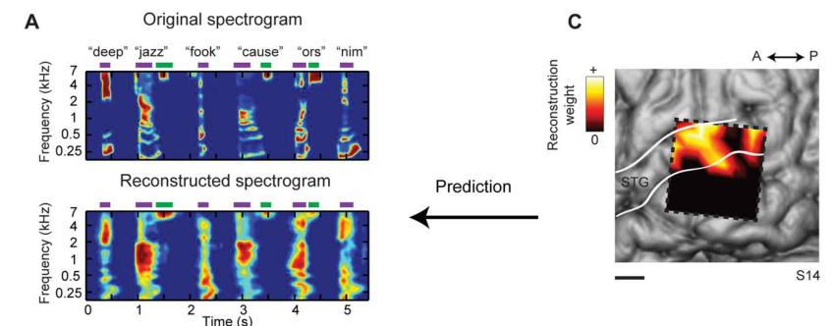
Thought: place, time, frequency, energy.
Pasley et al. Reconstructing Speech from Human Auditory Cortex
PLOS Biology 2012
Brain reading techniques => decoding mental states.
Notes:
Spectrogram reconstruction. (A) Top: spectrogram of six isolated words (deep, jazz, cause) and pseudowords (fook, ors, nim) presented
aurally to an individual participant. Bottom: spectrogram-based reconstruction of the same speech segment, linearly decoded from a set of
electrodes. Purple and green bars denote vowels and fricative consonants, respectively, and the spectrogram is normalized within each frequency
channel for display. (B) Single trial high gamma band power (70–150 Hz, gray curves) induced by the speech segment in (A). Recordings are from four
different STG sites used in the reconstruction. The high gamma response at each site is z-scored and plotted in standard deviation (SD) units. Right
panel: frequency tuning curves (dark black) for each of the four electrode sites, sorted by peak frequency and normalized by maximum amplitude.
Red bars overlay each peak frequency and indicate SEM of the parameter estimate. Frequency tuning was computed from spectro-temporal receptive
fields (STRFs) measured at each individual electrode site. Tuning curves exhibit a range of functional forms including multiple frequency peaks
(Figures S1B and S2B). (C) The anatomical distribution of fitted weights in the reconstruction model. Dashed box denotes the extent of the electrode
grid (shown in Figure 1). Weight magnitudes are averaged over all time lags and spectrogram frequencies and spatially smoothed for display.
Nonzero weights are largely focal to STG electrode sites. Scale bar is 10 mm.
doi:10.1371/journal.pbio.1001251.g002

Slide 13
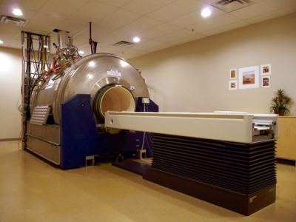
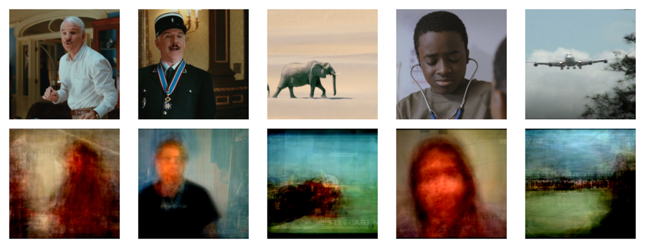
Looking inside
Scanner fMRI 4 Tesla
S. Nishimoto et al. Current Biology 21, 1641-1646, 2011

Slide 14
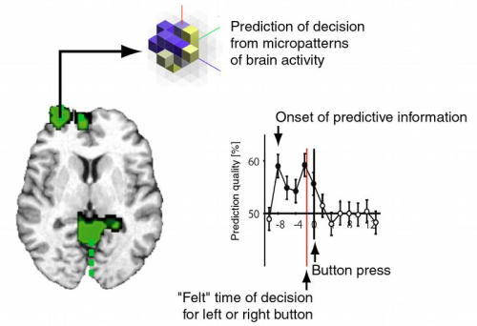
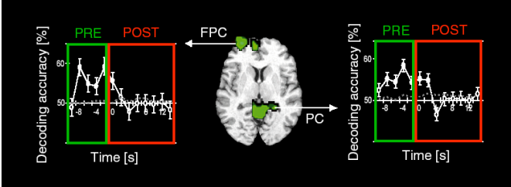
10 seconds delay!
C.S. Soon et al, Unconscious determinants of free decisions in the human brain. Nature Neuroscience, 2008.
We found that the outcome of a decision can be encoded in brain activity of prefrontal and parietal cortex up to 10 sec before it enters awareness. This delay presumably reflects the operation of a network of high-level control areas that begin to prepare an upcoming decision long before it enters awareness.

Slide 15
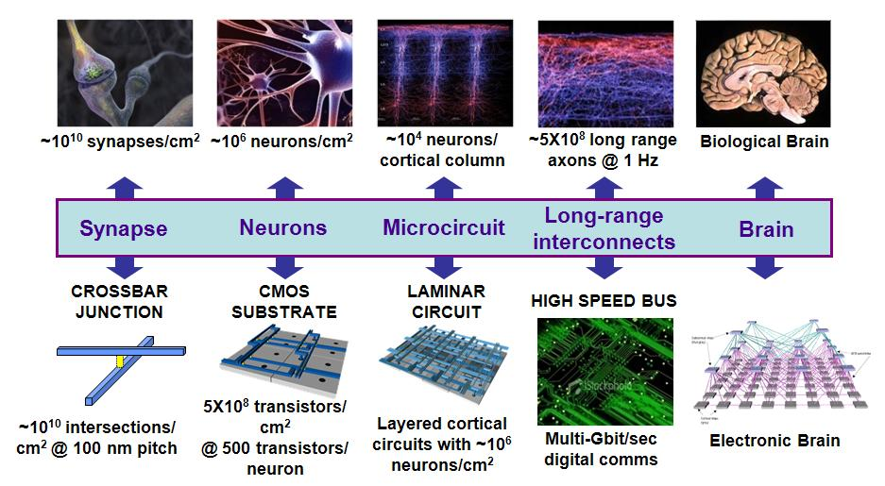
From brains to machines
Source: DARPA Synapse project

Slide 16
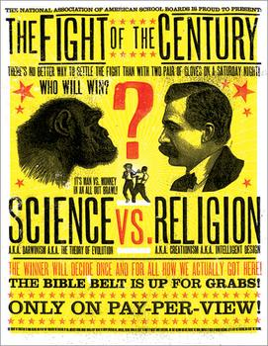
Theology and science
Andrew Dickinson White, History of the Warfare of Science with Theology in Christendom, published in 1895! A. White (president of the American Historical Association and Cornell Univ.) wrote: My conviction is that Science … will go hand in hand with Religion; and in the love of God and of our neighbor, will steadily grow stronger and stronger.
He has shown how people tried to draw conclusions from the Bible and how they have failed in all possible fields: astronomy, anthropology, biology, economics, physics, hermeneutics, history, geography, geology, linguistics, medicine, meteorology, sociology, zoology and other areas.
Ancient philosophers got almost all things wrong, and made a few systematic observations and experiments, relaying on naïve introspection.
Some of the ancient illusions are still with us. Simple advices like boiling water and washing hands when babies were delivered could save millions … but we do not find them in sacred texts.

Slide 17

Faith is the answer to …?
Gale Encyclopedia of Religion has 15 volumes, 11000 pages. Christianity alone has over 40 major divisions, over 40000 denominations, drawing different conclusions from the same texts.
Encyclopedia of New Religious Movements (2008) contains over 400 new religious movements, some with millions of supporters.
Even movements that are clearly science fiction (scientology for example) are followed by millions of adherents.
Why people have invented so many religions?
Evidently this is how brains work … having an explanations helps to save energy, accepting simple answers to complex questions leaves us satisfied.
Neurobiology of religion, neurotheology: factors that correlate with religiosity include the dopamine-based reward system that controls learning and exploration circuits, depends on receptors in PFC and striatum, controlled by COMT gene and DARPP-32 gene, respectively.
It is certainly much more complex than that …

Slide 18
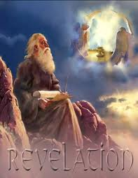


Be careful with beliefs
End of the world is coming!
2000: many people in the USA prepare shelters, buy food and guns waiting for the end.
Last big ends of the world: 2012 (Maya calendar),
before that 21 of May and October 2011
(Harold Camping, Familyradio.com).
Worlds Last Chance Team firmly believes that the end of all things will be in the next few years.
List of hundreds of dates predicted for apocalyptic events in the past and in the future.
Most are professed by Christian and Islam-related groups.
In Poland a group of MPs believes that approval by the Parliament of a proclamation that will be the only chance to save the country from complete obliteration.

Slide 19
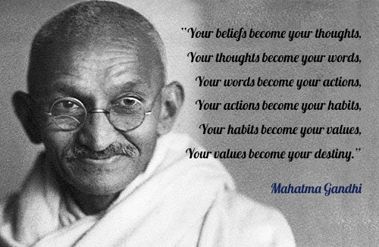
Gandhi’s advice

Slide 20
I have focused on the question: will invoking God help us? What leads to progress in science and better understanding. Have there been any progress along the lines propose by prof McIntosh? Anything positive except criticizing?
500 years ago there were no educated people in the West except Christians
I must have made a bad job explaining that. I am nonreductive physicalist.
I quoted Le Doux you are your synapses, and Francis Crick, to criticize it.
Polanyi wrote it 43 years ago.
Understanding the neurons is not understanding the mind, we need infromation but also we need a substrated in which the mind may emerge.
DNA decoding is quite different near volcanos.
Mind is nonmaterial, it is information! We create meaning.
Nonmaterial mind is an illusion. It is nonmaterial although it needs material support.
What is a machine? Are data flow systems machines?
What is knowledge? Rationality from irrationality?

Slide 21
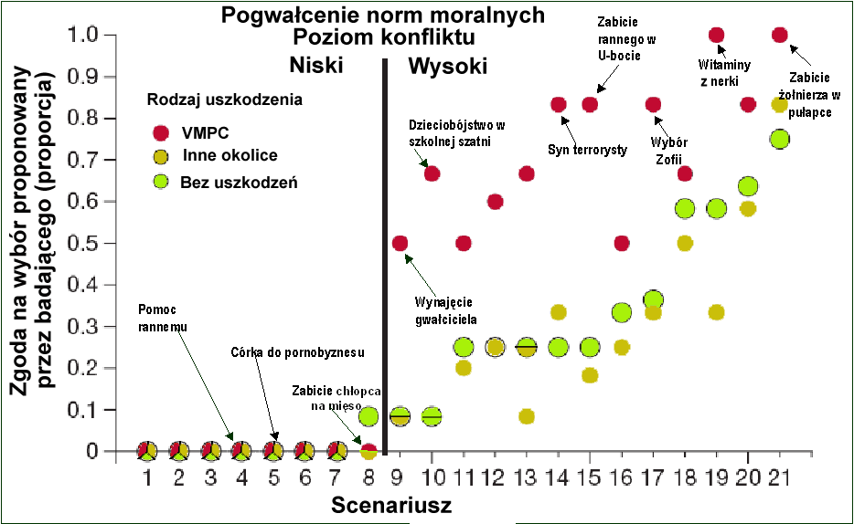
Uszkodzenia VMPC i moralność
Notes:
Damage to the prefrontal cortex increases utilitarian moral judgements.
Michael Koenigs, Liane Young, Ralph Adolphs, Daniel Tranel, Fiery Cushman, Marc Hauser & Antonio Damasio, Nature 2007
1. Transplant Mean emotion rating: 6.0 Low-conflict
9. Hired Rapist Mean emotion rating: 6.5 Low-conflict
Would you hire a man to rape your wife so that she will appreciate you as you comfort her?
11. Infanticide Mean emotion rating: 6.7 Low-conflict
You are a fifteen-year-old girl who has become pregnant. You are sure that you are not prepared to care for this baby. You think to yourself that it would be such a relief to simply clean up the mess you’ve made in the locker room, wrap the baby in some towels, throw the baby in the dumpster behind the school, and act as if nothing had ever happened. Would you throw your baby in the dumpster in order to move on with your life?
16. Submarine Mean emotion rating: 5.3 High-conflict
The remaining oxygen is not sufficient for the entire crew to make it to the surface. The only way to save the other crew members is to shoot dead the injured crew member so that there will be just enough oxygen for the rest of the crew to survive.
20. Would you forcibly remove this man’s kidney in order to save the lives of the six vitamin-deficient people?

