Slide 1
Support Feature Machines:
Support Vectors are not enough
Tomasz Maszczyk
and
Włodzisław Duch
Department of Informatics,
Nicolaus Copernicus University, Toruń, Poland
WCCI 2010

Slide 2
Plan
Main idea
SFM vs SVM
Description of our approach
Types of new features
Results
Conclusions

Slide 3
Main idea I
SVM is based on LD and margin maximization.
Cover theorem: extended feature space
= better separability of data, flat decision borders.
Kernel methods implicitly create new features localized around SV (for localized kernels), based on similarity.
Instead of the original input space, SVM works in
the "kernel space“ without explicitly constructing it.

Slide 4
Main idea II
SVM does not work well when there is complex logical structure in the data (ex. parity problem).
Each SV may provide a useful feature.
Additional features may be generated by: random linear projections; ICA or PCA derived from data; various projection pursuit algorithms (QPC).
Define appropriate feature space => optimal solution.
To do be the best, learn from the rest (transfer learning, from other models): prototypes; linear combinations; fragments of branches in DT etc.
The final classification model in enhanced space may not be so important if appropriate space is defined.

Slide 5
SFM vs SVM
SFM generalize SVM approach by explicitly building feature space: enhance your input space adding
kernel features z_{i} (X)=K(X;SV_{i})
+ any other useful types of features.
SFM advantages comparing to SVM:
LD on explicit representation of features = easy interpretation.
Kernel-based SVM ⬄ SVML in explicitly constructed kernel space.
Extend input + kernel space => improvement

Slide 6
SFM vs SVM
How to extend the feature space, creating SF space?
Use various kernels with various parameters.
Use global features obtained from various projections.
Use local features to handle exceptions.
Use feature selection to define optimal support
feature space.
Many algorithms may be used in SF space to generate
the final solution.
In the current version three types of features are used.

Slide 7
SFM feature types
Projections on N randomly generated directions in the original input space (Cover theorem).
Restricted random projections (aRPM) on a random direction z_{i}(x) = w_{i}·x may be useful in some range of z_{i} values is large pure cluster are found in some intervals [a,b]; this creates binary features h_{i}(x)ϵ{0,1}; QPC is used to optimize w_{i} and improve cluster sizes.
Kernel-based features: here only Gaussian kernels with the same β for each SV k_{i}(x)=exp(-βΣ|x_{i}-x|²)
Number of features grows with number of training vectors; reduce SF space using simple filters (MI).

Slide 8
Algorithm
Fix the values of α, β and η parameters
for i=0 to N do
Randomly generate new direction w_{i} ϵ [0,1]^{n}
Project all x on this direction z_{i} = w_{i}·x (features z)
Analyze p(z_{i}|C) distributions to determine if there are pure clusters,
if the number of vectors in cluster H_{j}(z_{i};C) exceeds η then
Accept new binary feature h_{ij}
end if
end for
Create kernel features k_{i}(x), i=1..m
Rank all original and additional features f_{i} using Mutual Information
Remove features for which MI(k_{i},C)≤α
Build linear model on the enhanced feature space
Classify test data mapped into enhanced space

Slide 9
SFM - summary
In essence SFM algorithm constructs new feature space, followed by a simple linear model or any other learning model.
More attention is paid to generation of features than to the sophisticated optimization algorithms or new classification methods.
Several parameters may be used to control the process of feature creation and selection but here they are fixed or set in an automatic way.
New features created in this way are based on those transformations of inputs that have been found interesting for some task, and thus have meaningful interpretation.
SFM solutions are highly accurate and easy to understand.

Slide 10
Features description
X - original features
K - kernel features (Gaussian local kernels)
Z - unrestricted linear projections
H - restricted (clustered) projections
15 feature spaces based on combinations of these different type of features may be constructed:
X, K, Z, H, K+Z, K+H, Z+H, K+Z+H, X+K, X+Z, X+H, X+K+Z, X+K+H, X+Z+H, X+K+Z+H.
Here only partial results are presented (big table).
The final vector X is thus composed from a number of
X = [x₁..x_{n,} z₁.., h₁.., k₁..] features.
In the SF space linear discrimination is used (SVML),
although other methods may find better solution.

Slide 11
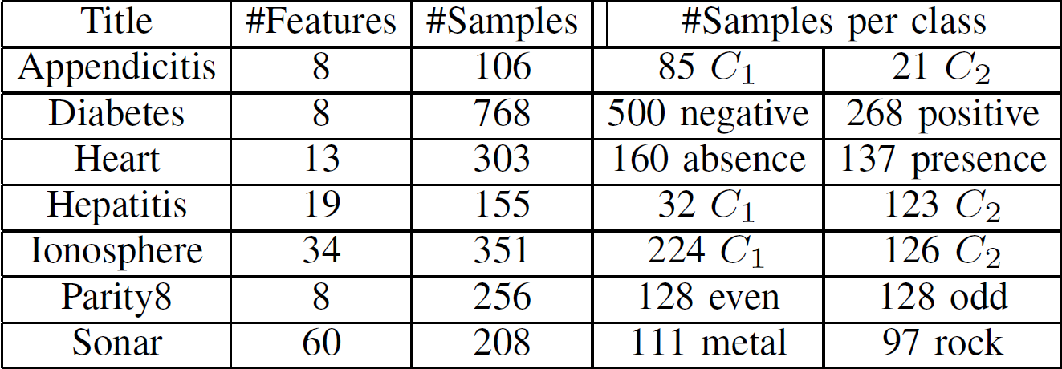
Datasets
Notes:
The usefulness of support feature machines has been tested on several UCI benchmark datasets, selected to cover different types of problems.

Slide 12
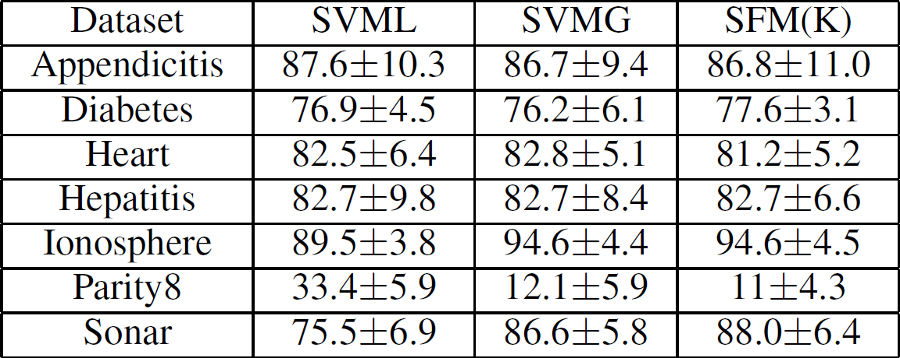
Results
(SVM vs SFM in the kernel space only)
Notes:
To compare SFM with four popular classification methods 10-fold crossvalidation test results have been collected in tables, with accuracies and standard deviations given for each dataset. For the kNN classifier the number of nearest neighbors has been automatically selected from the 1-20 range using crossvalidation estimation. The SVM parameters (C and sigma for Gaussian kernels) have been fully optimized on the original data in an automatic way using crossvalidation estimations.

Slide 13
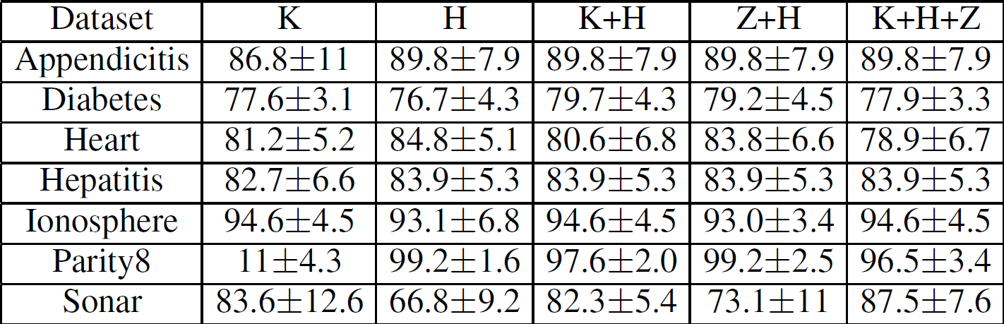
Results
(SFM in extended spaces)

Slide 14
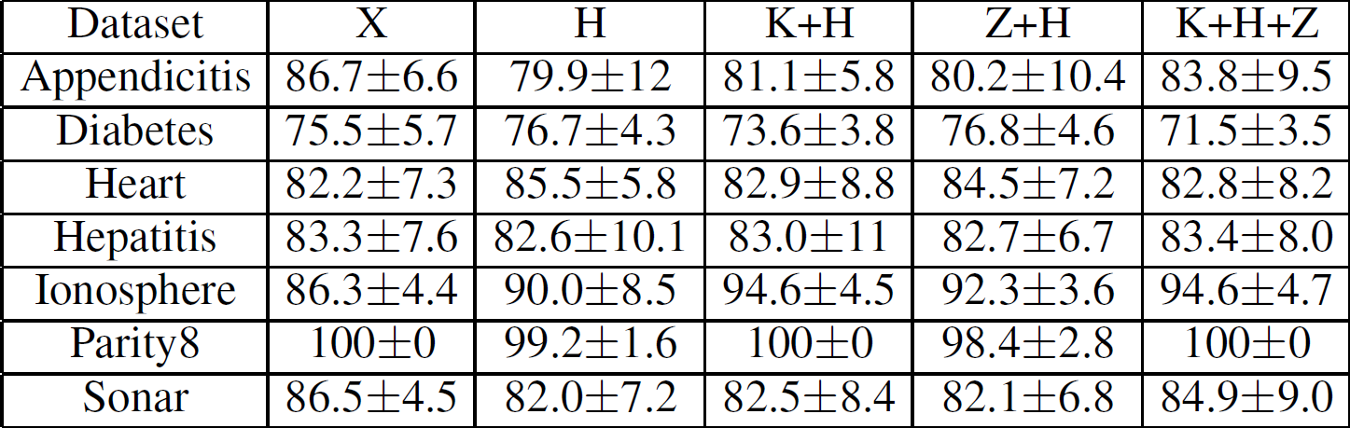
Results
(kNN in extended spaces)

Slide 15
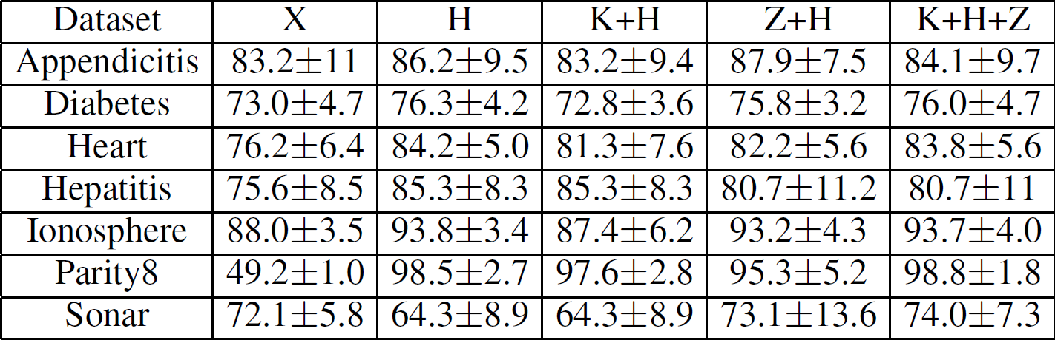
Results
(SSV in extended spaces)

Slide 16
Conclusions
SFM is focused on generation of new features, rather
than optimization and improvement of classifiers.
SFM may be seen as mixture of experts; each expert is a simple model based on single feature: projection, localized projection, optimized projection, various kernel features.
For different data different types of features may be important => no universal set of features, but easy to test and select.

Slide 17
Conclusions
Kernel-based SVM is equivalent to the use of kernel features combined with LD.
Mixing different kernels and different types of features: better feature space than single-kernel solution.
Complex data require decision borders with different complexity. SFM offers multiresolution (ex: different dispersions for every SV).
Kernel-based learning implicitly project data into high-dimensional space, creating there flat decision borders and facilitating separability.

Slide 18
Conclusions
Learning is simplified by changing the goal of learning to easier target and handling the remaining nonlinearities with well defined structure.
Instead of hiding information in kernels and sophisticated optimization techniques features based on kernels and projection techniques make this explicit.
Finding interesting views on the data, or constructing interesting information filters, is very important because combination of the transformation-based systems should bring us significantly closer to practical applications that automatically create the best data models for any data.

Slide 19
Thank You!

