Slide 1


The challenge of neurodegenerative disease: neural network models.
Włodzisław Duch
Department of Informatics, Nicolaus Copernicus University, Toruń, Poland
School of Computer Engineering,
Nanyang Technological University, Singapore
Google: W. Duch
ICAISC, 4/2012

Slide 2
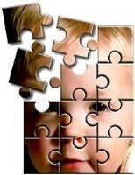
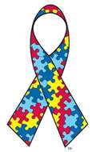
Plan:
How can we understand neurodegenerative disease, such as autism, ADHD or epilepsy?
Who is in the best position to do it?
Theories, mistaking symptoms for causes.
What do we hope for?
Computational experiments.
Experimental evidence, genetics
Some ideas for neurorehabilitation & ICNT.
April is celebrated as the autism awareness month since 1970.

Slide 3
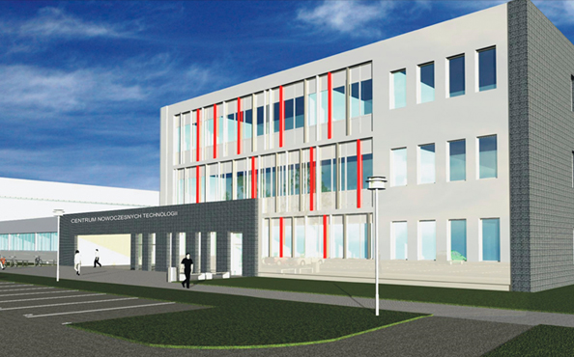
Interdisciplinary Center of
Innovative Technologies
Why am I interested in this?
ICIT in construction,
end of 2012?
Neurocognitive lab,
5 rooms, many
projects requiring experiments.
Working on EU grant.
Understanding brain plasticity, mind states.

Slide 4
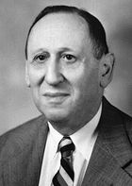
A bit of ASD history
ASD: Autism Spectrum Disorder, includes many forms of autism.
Described for the first time in 1943 by Leo Kanner:
“extreme aloneness from the beginning of life and anxiously obsessive desire for the preservation of sameness.”
“… these children have come into the world with innate inability to form the usual, biologically provided affective contact with people … ”.
Common deficit: lack of the theory of mind.
Initial theories:
bad parents, refrigerator mothers ...
a behavioral syndrome … a developmental syndrome ...
multiple disease entities, multiple etiologies, including metabolic and immune system deregulation, genetics.
2008: However, as in many areas of neuroscience, we are ‘‘data rich
and theory poor’’ (Zimmerman, Autism – current theories).

Slide 5


ASD
Autism Spectrum of Disorders includes:
Autism, Asperger syndrome, pervasive developmental disorder not otherwise specified (PDD-NOS), atypical forms of childhood disintegrative disorder, Rett syndrome, Infantile Autistic Bipolar Disorder (IABD), purine autism.
4-5 times more boys than girls.
CDC estimates: average about 1%, boys about 2%.
Autistic Savants:
few percent of people with ASD learn unusual memory
or motor skills, but are impaired in many other ways.

Slide 6
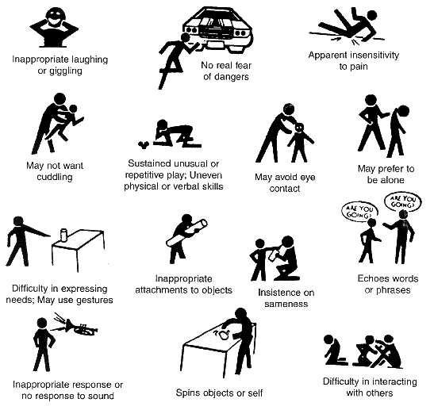
Autism Symptoms ...
Epidemics?
Not clear why: more attention, better diagnostics?
Very diverse,
not a single disease,
but more like dementia.
Genetic component,
but search for “autism genes” not too successful, too many are involved.
Genetics cannot explain recent rapid increase.

Slide 7

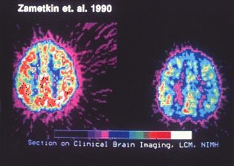
ADHD
Attention Deficit Hyperactivity Disorder, 3-5% of population (also adults).
Problems with attention: usually impulsive-hyperactive, inattentive (ADD)
Lack of impulse control, easily distracted,
miss details, forget things, frequently switch
between activity, can’t focus on one thing …
Motor restlessness, run non-stop, lose things,
are very impatient, display strong emotions,
act without thinking about consequences.
Bored quickly, daydream, difficulty in learning
new things, complete homework.
ADHD involves functional disconnections between frontal and occipital cortex (A. Mazaheri et al, Biological Psychiatry 67, 617, 2010);
psychologist talk about deficit in "top-down" attention control.
In many respects it is the opposite of ASD.

Slide 8
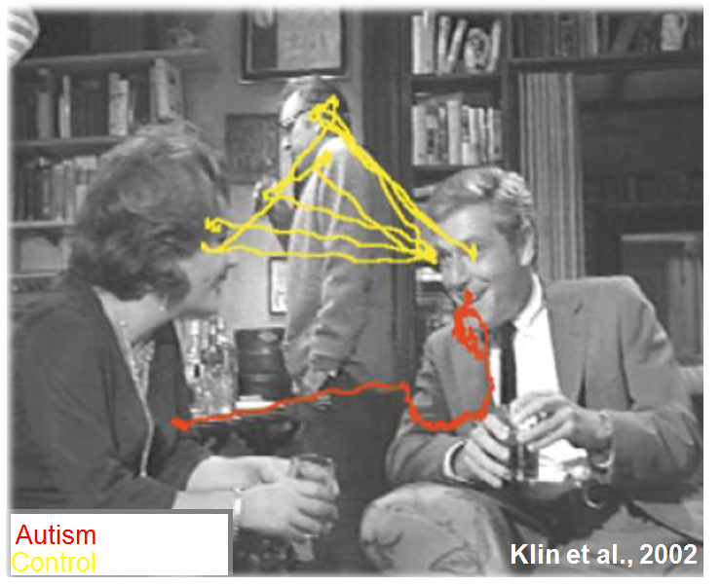
Eye saccades

Slide 9
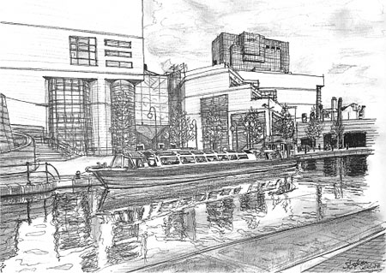

Autism: hiperspecificity
Steven Wiltshire,
http://www.stephenwiltshire.co.uk
See also: Grandin Temple, Thinking in pictures and Other Reports from My Life with Autism (Vintage Books, 1996)

Slide 10
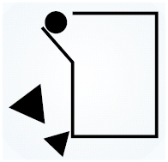
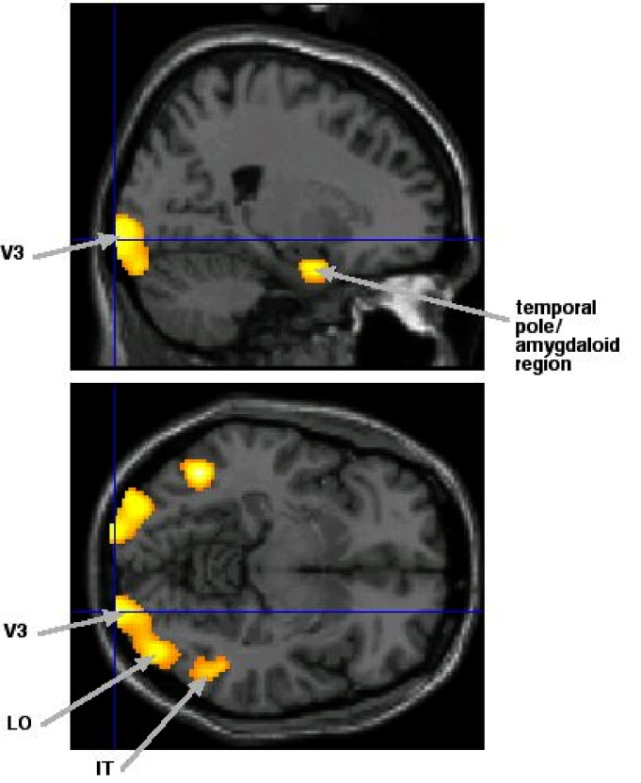
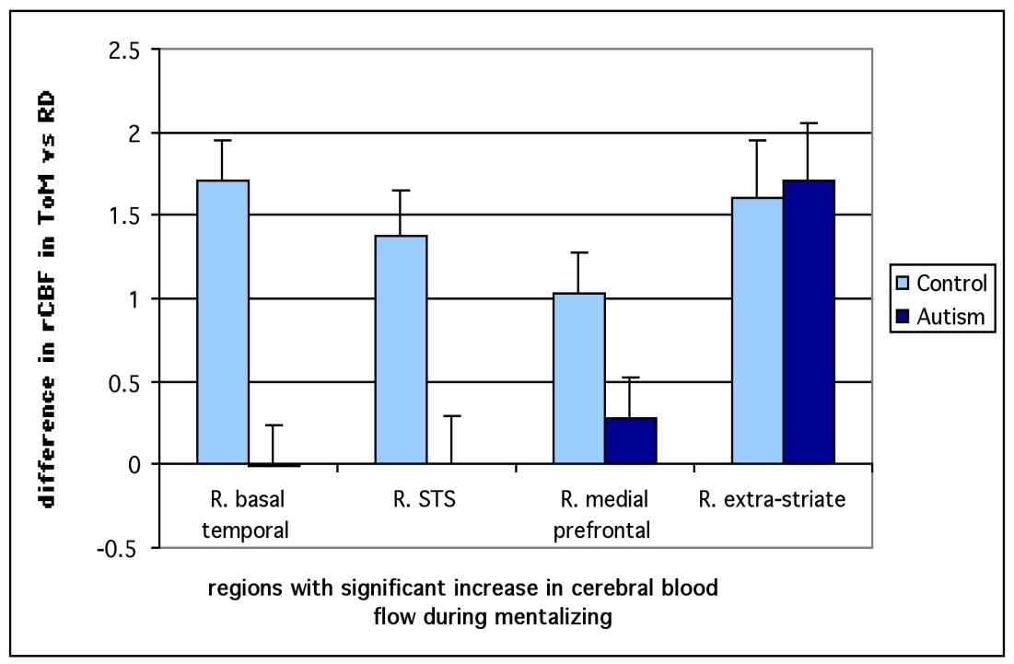
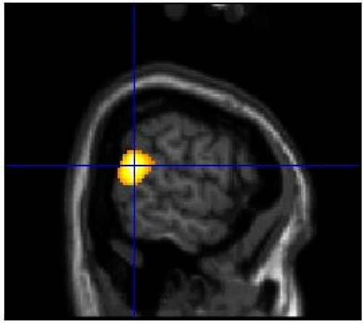
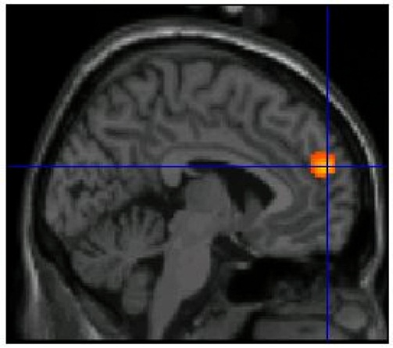
Reading intentions
Animation shows the circle as a victim,
Small triangle tries to help, big one is aggressive.
Autism, Asperger syndrome and brain mechanisms for the attribution of mental states to animated shapes. F. Castelli & et al. Brain 2002, 125 : 1839-49

Slide 11
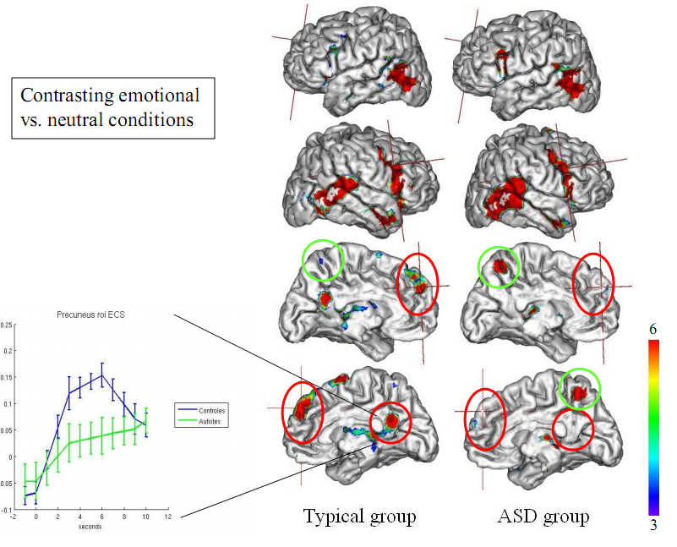
Source: Bruno Wicker (CNRS)

Slide 12
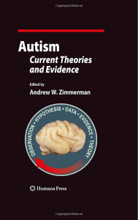
Theories, theories
Best book on ASD so far:
Andrew W. Zimmerman (Ed.)
Autism; current theories and evidence.
Humana Press 2008.
20 chapters divided into six sections:
Molecular and Clinical Genetics (4 chapters);
Neurotransmitters and Cell Signaling (3 chapters);
Endocrinology, Growth, and Metabolism (4 chapters);
Immunology, Maternal-Fetal Effects, and Neuroinflammation (4 chapters);
Neuroanatomy, Imaging, and Neural Networks (3 chapters);
Environmental Mechanisms and Models (2 chapters).
Other: Grossberg ART model. At which level can we understand not just correlations, but real mechanisms responsible for behavioral symptoms?
(genes, proteins, biochemistry, ion channels, synapses, membranes)
⬄ (neural properties, networks) ⬄ (behavior, syndromes, disease).

Slide 13
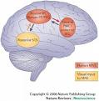
Mirror Neuron System
MNS: observing action elicits similar motor activations as if it had been performed by oneself; visuo-motor neurons.
This helps to understand actions of others, modeling behavior via embodied simulation of their actions, intentions, and emotions.
MNS theory of autism (Williams et al, 2001): distortion in the development of the MNS interferes with the ability to imitate, leads to social impairment and communication difficulties.
Correlations between reduced MNS activity and severity of ASD are strong.
Problems:
In ASD abnormal brain activation is seen in many other circuits; performance of autistic children on various imitation tasks may be normal.
MNS is used to explain almost everything in social neuroscience, but MNS is not really a special subsystem, just multimodal neurons.

Slide 14
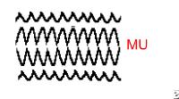
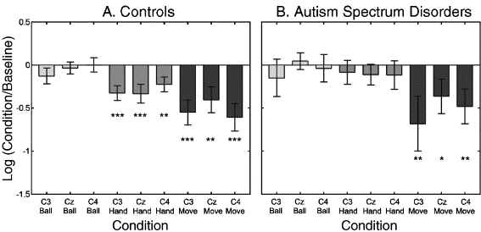
MNS EEG
EEG on controls and autistics on 4 different tasks, comparing mu rhythms. Baseline: large amplitude mu oscillations in synchrony. Seeing an action causes mu rhythms to fire asynchronously resulting in mu suppression.
Mu wave suppression reflects activity of the mirror neuron system.
In autistics mu is suppressed for own hand movements (Oberman 2005), but not for the observed hand movements of others (hand vs. move).

Slide 15
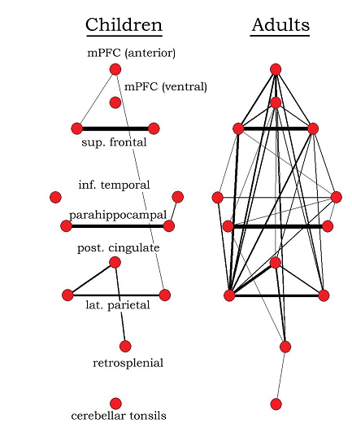
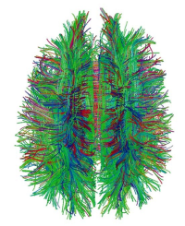
Reduced functional connectivity
The underconnectivity theory of autism is based on the following:
Excess of low-level (sensory) processes.
Underfunctioning of high-level neural connections and synchronization,
fMRI and EEG study suggests that adults with ASD have local overconnectivity in the cortex and weak functional connections between the frontal lobe and the rest of the cortex.
Underconnectivity is mainly within each hemisphere of the cortex and that autism is a disorder of the association cortex.
Patterns of low function and aberrant activation in the brain differ depending on whether the brain is doing social or nonsocial tasks.
“Default brain network” involves a large-scale brain network (cingulate cortex, mPFC, lateral PC), shows low activity for goal-related actions; it is active in social and emotional processing, mindwandering, daydreaming.
Activity of the default network is negatively correlated with the “action network” (conscious goal-directed thinking), but this is not the case in autism – perhaps disturbance of self-referential thought?

Slide 16
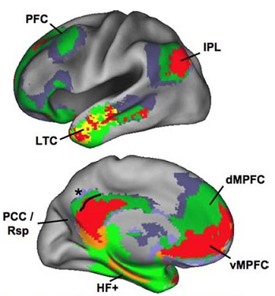
Reduced functional connectivity
The underconnectivity theory of autism is based on the following:
Excess of low-level (sensory) processes.
Underfunctioning of high-level neural connections and synchronization,
fMRI and EEG study suggests that adults with ASD have local overconnectivity in the cortex and weak functional connections between the frontal lobe and the rest of the cortex.
Underconnectivity is mainly within each hemisphere of the cortex and that autism is a disorder of the association cortex.
Patterns of low function and aberrant activation in the brain differ depending on whether the brain is doing social or nonsocial tasks.
“Default brain network” involves a large-scale brain network (cingulate cortex, mPFC, lateral PC), shows low activity for goal-related actions; it is active in social and emotional processing, mindwandering, daydreaming.
Activity of the default network is negatively correlated with the “action network” (conscious goal-directed thinking), but this is not the case in autism – perhaps disturbance of self-referential thought?

Slide 17
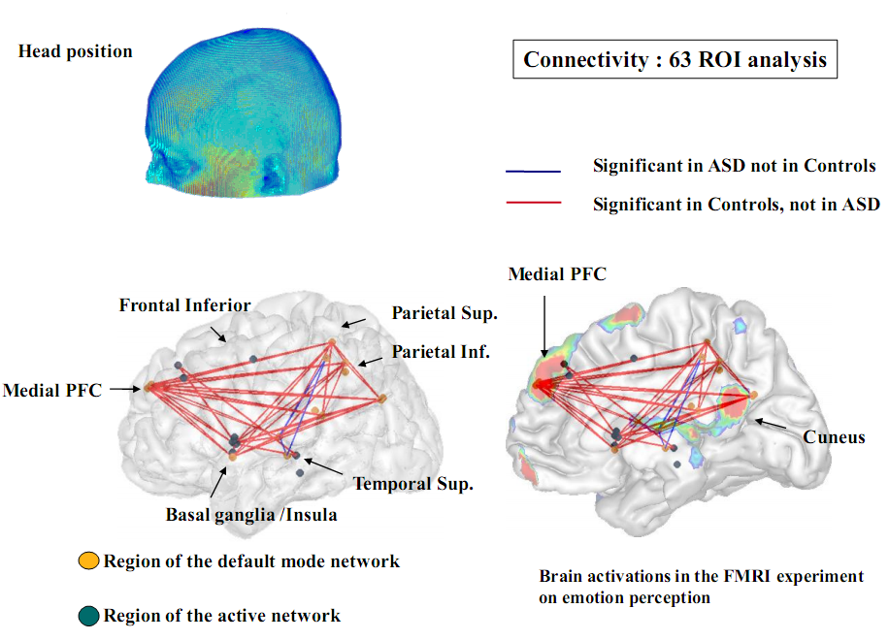

Slide 18
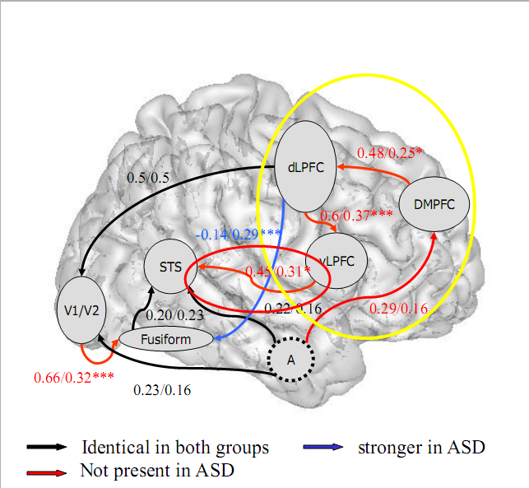
Effective brain connections
B. Wicker et al.
SCAN 2008

Slide 19
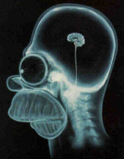
Executive dysfunction
Hypothesis: autism results mainly from deficits in working memory, planning, inhibition, and other executive functions.
Executive processes do not reach typical adult levels, resulting in stereotyped behavior and narrow interests.
But executive function deficits have not been found in young autistic children.
Weak central coherence theory hypothesizes that a limited ability to see the big picture underlies the central disturbance in autism.
This predicts special talents in performance of autistic people.
Enhanced perceptual functioning theory focuses more on the superiority of locally oriented and perceptual operations in autistic individuals.
These theories agree with the underconnectivity theory of autism.
Social cognition theories poorly address autism's rigid and repetitive behaviors, while the nonsocial theories have difficulty explaining social impairment and communication difficulties.

Slide 20

Function connectivity theory
Model developed over 20 years (Nancy J. Minshew): autism as widespread disorder of association cortex, development of connectivity, only secondarily as a behavioral disorder. Fine, but still quite general.
Abnormalities in genetic code for brain development
↓
Abnormal mechanisms of brain development
↓
Structural and functional abnormalities of brain
↓
Cognitive and neurologic abnormalities
↓
Behavioral syndrome
Goal: understand the pathophysiology from gene to behavior, eventually the influence of etiologies on this sequence, ultimately support the development of interventions at multiple levels of the pathophysiologic sequence.

Slide 21
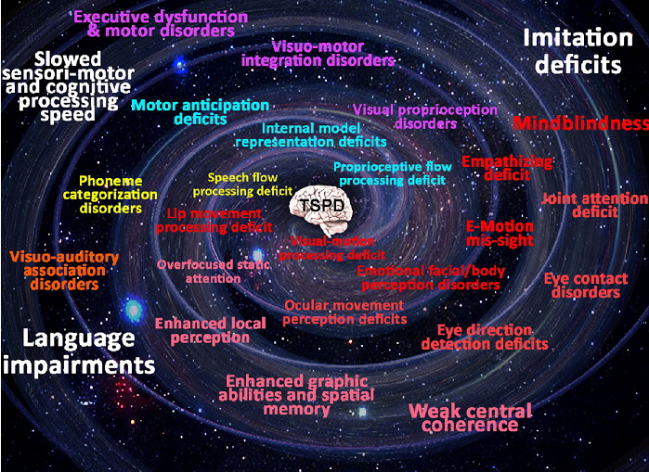
Temporo-spatial processing disorders
B. Gepner, F. Feron, Autism: A world changing too fast for a mis-wired brain? Neuroscience and Biobehavioral Reviews (2009).

Slide 22
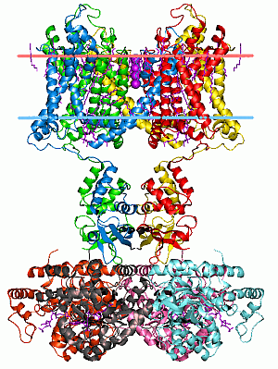
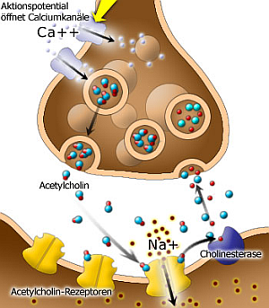
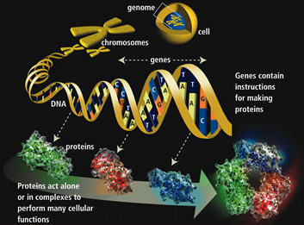
From Genes to Neurons
Genes => Proteins => receptors, ion channels, synapses
=> neuron properties, networks, neurodynamics
=> cognitive phenotypes, abnormal behavior, syndromes.

Slide 23
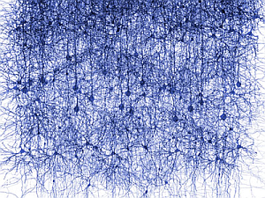
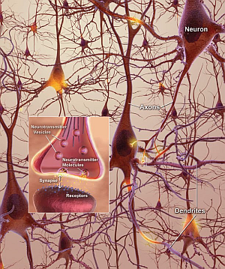


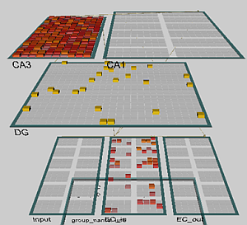
From Neurons to Behavior
Genes => Proteins => receptors, ion channels, synapses
=> neuron properties, networks
=> neurodynamics => cognitive phenotypes, abnormal behavior!

Slide 24
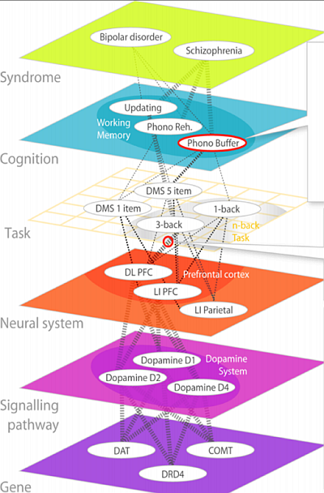
Neuropsychiatric
Phenomics Levels
According to
The Consortium for Neuropsychiatric Phenomics (CNP)
http://www.phenomics.ucla.edu
From genes to molecules to neurons and their systems to tasks, cognitive subsystems and syndromes.
Neurons and networks are right in the middle of this hierarchy.

Slide 25
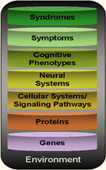
Strategy for Neurophenomics Research
The Consortium for Neuropsychiatric Phenomics: bridge all levels,
one at a time, from environment to syndromes.
Our strategy: identify biophysical parameters of neurons
required for normal neural network functions and leading to
abnormal cognitive phenotypes, symptoms and syndromes.
Start from simple neurons and networks, increase complexity.
Create models of cognitive function that may reflect some of the
symptoms of the disease, for example problems with attention.
Test and calibrate the stability of these models in a normal mode.
Determine model parameter ranges that lead to similar symptoms.
Relate these parameters to the biophysical properties of neurons.
Result: mental events at the network level are described in the language of neurodynamics and related to low-level neural properties.
Example: relation of ASD/ADHD symptoms to neural accommodation.

Slide 26
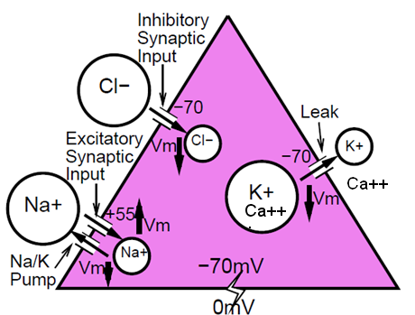
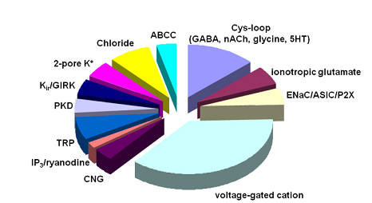
Computational Models
Models at various level of detail.
Minimal model includes neurons with 3 types of ion channels.
Models of attention:
Posner spatial attention;
attention shift between visual objects.
Models of word associations:
sequence of spontaneous thoughts.
Models of motor control.
Critical: control of the increase in intracellular calcium, which builds up slowly as a function of activation.
Initial focus on the leak channels,
2-pore K⁺, looking for genes/proteins.

Slide 27
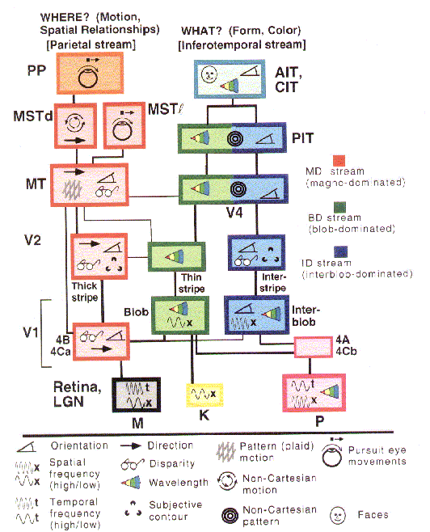
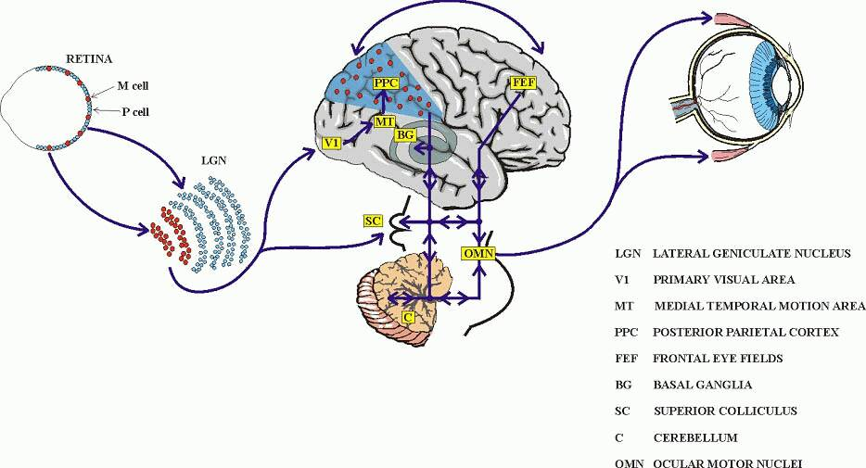
Vision
From retina through lateral geniculate body, LGN (part of thalamus) information passes to the primary visual cortex V1 and then splits into the ventral and dorsal streams.

Slide 28
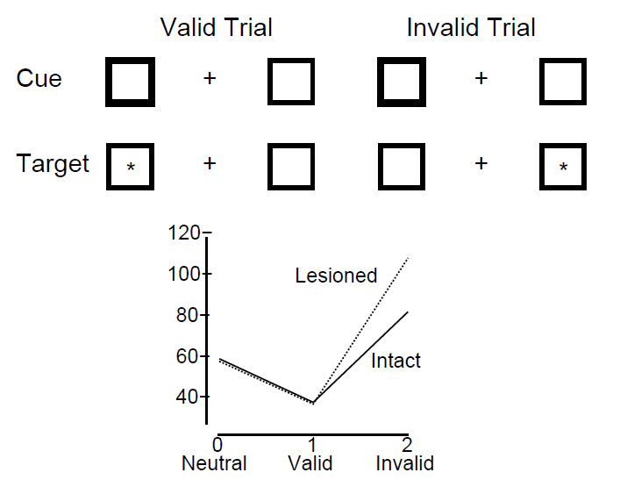
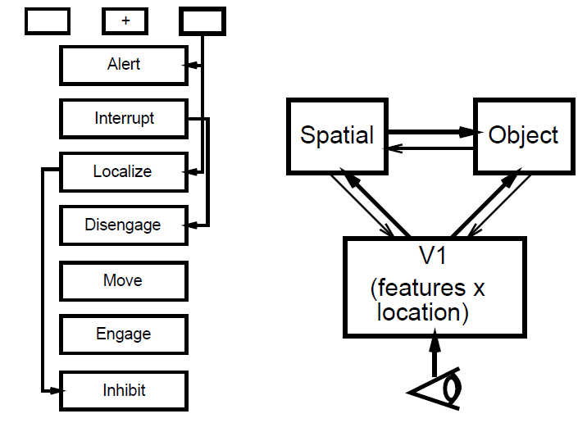
Simple model of Posner experiments
Cue (bright box) is in the same position as target (valid trial), or in another position (invalid trial), or there is no cue (neutral), just target.
Test of the object recognition/localization.

Slide 29
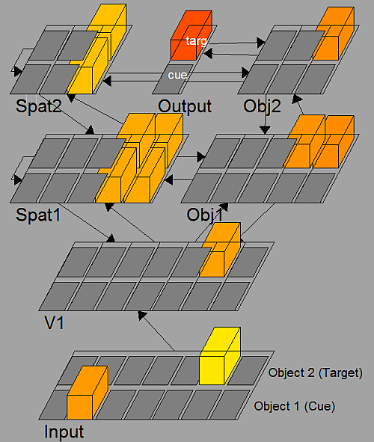
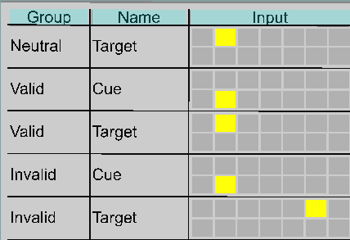
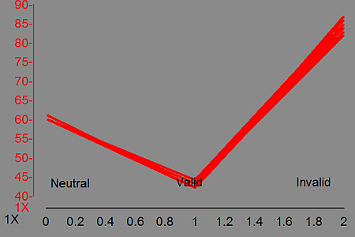
Posner spatial attention
Cue (bright box) is in the same position as target (valid trial), or in another position (invalid trial), or there is no cue (neutral).

Slide 30
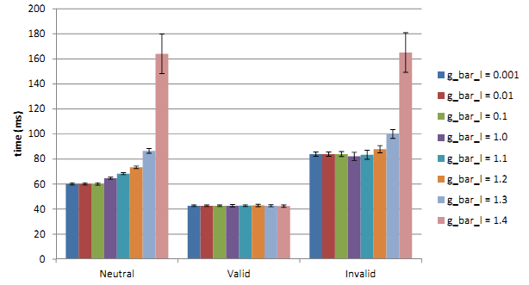
Posner spatial attention
More complex cue = stronger local attractor => can bind ASD longer?
Cue pulsating with different frequencies may create resonances?
What changes in the network will lead to faster attention shifts?
Broadening of attractor basins => helps to decrease symptoms?
Diagnostic value?
Explains fever effects?
Suggest
pharmacotherapy?
Model in GENESIS
is inconclusive.
Spatial attention shifts in Posner experiments as a function of leak channel conductance change between 20-120 ms.

Slide 31
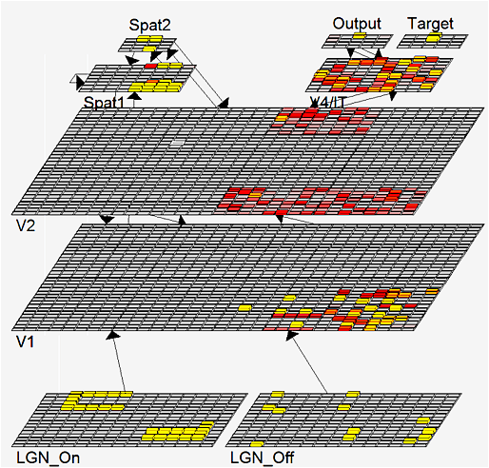
Recognition of many objects
Vision model including LGN, V1, V2, V4/IT, V5/MT
Two objects are presented.
Connectivity of these layers:
Spat1 ⬄ V2, Spat 2
Spat1 ⬄ V2, Spat 2
Spat2 ⬄ V2.
Spat1 has recurrent activations and inhibition, focusing on a single object.
In normal situations neurons desynchronize and synchronize on the second object = attention shift.

Slide 32

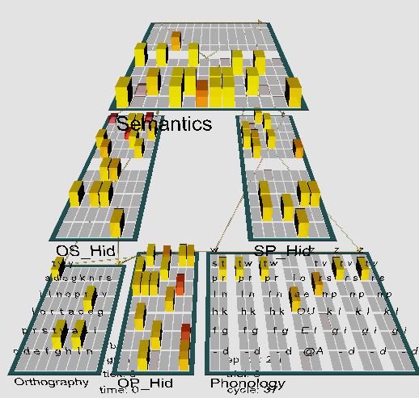
Model of reading
Emergent neural simulator:
Aisa, B., Mingus, B., and O'Reilly, R. The emergent neural modeling system. Neural Networks,
21, 1045-1212, 2008.
3-layer model of reading:
orthography, phonology, semantics, or distribution of activity over 140 microfeatures of concepts.
Hidden layers in between.
Learning: mapping one of the 3 layers to the other two.
Fluctuations around final configuration = attractors representing concepts.
How to see properties of their basins, their relations?

Slide 33
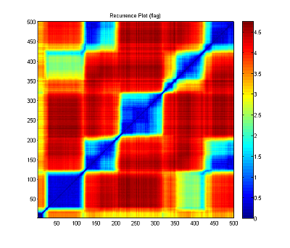
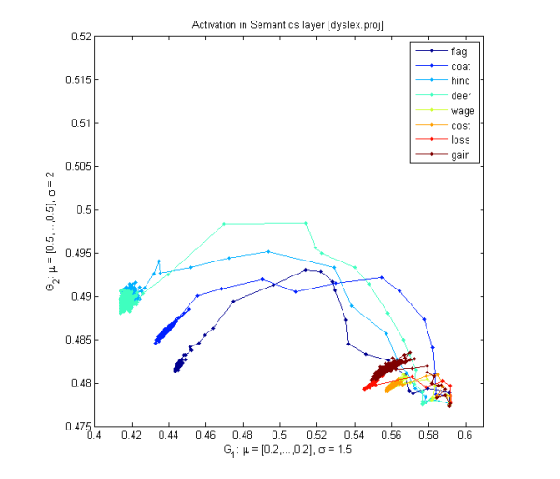
Fuzzy Symbolic Dynamics (FSD)
Trajectory of dynamical system (neural activities), using recurrent plots (RP):
RP plots S(t,t₀) values as a matrix.
FSD shows trajectories in 2D or 3D: find reference centers μ₁, μ₂ , μ₃ on standardized data and optimize their position to see clearly important features of trajectories despite reduced dimensionality.
This creates localized membership functions y_{k}(t;W).
Sharp indicator functions => symbolic dynamics; x(t) => strings of symbols.
Soft membership functions => fuzzy symbolic dynamics, dimensionality reduction Y(t)=(y₁(t;W), y₂(t;W)) => visualization of high-D data.
Dobosz K, Duch W, Neural Networks 23, 487-496, 2010;
Cognitive Neurodynamics 5(2), 145-160, 2011

Slide 34

Neurodynamics
Trajectories show attention effects as a property of neurodynamics,
it depends on:
synaptic connections: inhibitory competition, bidirectional interactive processing, multiple constraint satisfaction;
neural properties: thresholds, accommodation, ion channels …
Input activations => basins of attractors => object recognition
Normal case: relatively large basins, generalization, average dwell time, moving to other basin of attraction, exploring the activation space.
Without accommodation (inactive outward rectifying ion channels): deep, narrow basins, hard to move out of the basin, associations are weak.
Accommodation: basins of attractors shrink and vanish because neurons desynchronize due to the neural fatigue. This allows other neurons to synchronize on new stimuli, guided by Spat => V2 => V1 feedback.
This leads to sudden spontaneous weakly related chains of thoughts.

Slide 35
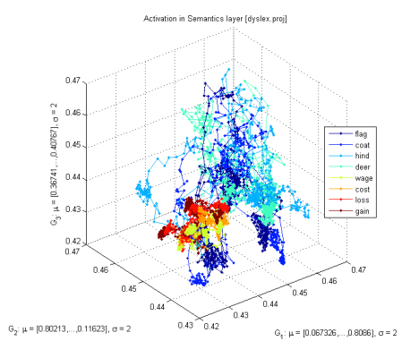
Attractors for words
Model for reading includes phonological, orthographic and semantic layers with hidden layers in between.
Non-linear visualization of activity of the semantic layer with 140 units.
Cost and rent have semantic associations, attractors are close to each other, but without accommodation transitions between basins of attractions are hard.
Will it manifest in verbal priming tests? Free associations?
Will broadening of phonological/written form representations help?
For example, will training ASD children with characters that vary in many ways (shapes, colors, size, rotations) help them?

Slide 36
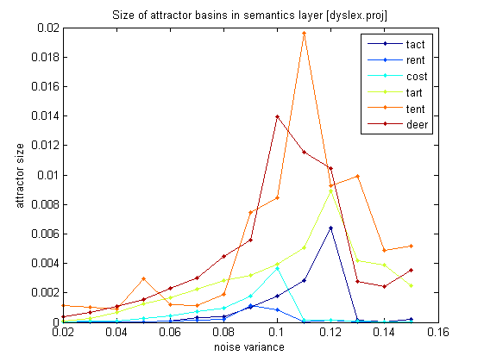
How strong are attractors?
Variance around the center of a cluster grows with synaptic noise; for narrow and deep attractors it will grow slowly, but for wide basins it will grow fast.
Jumping out of the attractor basin reduces the variance due to inhibition of desynchronized neurons.
More varied encoding
of concrete nouns seems to
help creating larger attractor
basins, but abstract concepts
show narrow and deep basins.

Slide 37
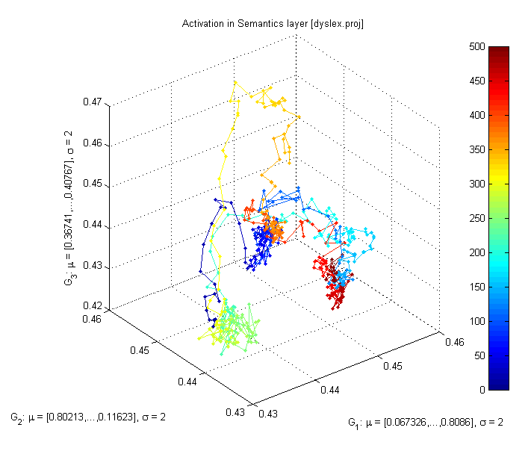

Normal-ADHD
All plots for the flag word, different values of b_inc_dt parameter in the accommodation mechanism. b_inc_dt = 0.01 & b_inc_dt = 0.02
b_inc_dt = time constant for increases in intracellular calcium which builds up slowly as a function of activation.
http://kdobosz.wikidot.com/dyslexia-accommodation-parameters

Slide 38

Normal-Autism
All plots for the flag word, different values of b_inc_dt parameter in the accommodation mechanism. b_inc_dt = 0.01 & b_inc_dt = 0.005
b_inc_dt = time constant for increases in intracellular calcium which builds up slowly as a function of activation.
http://kdobosz.wikidot.com/dyslexia-accommodation-parameters

Slide 39




Inhibition
Increasing
g_{i} from 0.9 to 1.1 reduces the attractor basin sizes and
simplifies trajectories.
Strong inhibition,
empty head …

Slide 40


Connectivity
With small synaptic noise (var=0.02) the network starts from reaching an attractor and moves to another one (frequently quite distant), creating a “chain of thoughts”.
Same situation, with stronger recurrent connections within layers; fewer but larger attractor basins are created, and more time is spent in each basin.

Slide 41


Recurrence plots
Starting from the word “flag”, with small synaptic noise (var=0.02), the network starts from reaching an attractor and moves to another one (frequently quite distant), creating a “chain of thoughts”.
Same trajectories displayed with recurrence plots, showing roughly 5 larger basins of attractors and some transient points.

Slide 42

Probability of recurrence
Probability of recurrence may be computed from recurrence plots,
allowing for evaluation how strongly some basins of attractors capture neurodynamics.

Slide 43


Fast transitions
Attention is focused only for a brief time and than moved to the next attractor basin, some basins are visited for such a short time that no action may follow, corresponding to the feeling of confusion and not being conscious of fleeting thoughts.

Slide 44

Some speculations
Attention shifts may be impaired due to several factors:
Deep and narrow attractors that entrap dynamics – due to leak channels?
Explains overspecific memory in ASD, unusual attention to details,
the inability to generalize visual and other stimuli,
also fever effects?
Accommodation: voltage-dependent K⁺ channels (~40 types) do not decrease depolarization in a normal way, attractors do not shrink.
This effect should also slow down attention shifts and reduce jumps to unrelated thoughts or topics relatively to average person – neural fatigue will temporarily switch them off preventing activation of attractors that code significantly overlapping concepts.
What behavioral changes are expected?
How to tests it?

Slide 45

Research/diagnostic consequences
Many problems at genetic/molecular level may lead to the same
behavioral symptoms => problems for statistically-oriented research methods.
Genetic mutation should give weak signals: in a given population of autistic patients only small fraction will have a given mutation.
Inconclusive results on diet: several studies show some improvement, other studies show no effect.
Pharmacological and other treatments will have limited success.
Need for a better diagnostics at molecular/genetic level!
Strategy: behavior <= neural properties;
find neural parameters that affect behavior in a specific way;
try to relate them to molecular properties in synapses, various receptors, ion channels (pore forming proteins), membrane properties;
try to find markers for specific abnormalities.

Slide 46

Behavioral consequences
Deep, localized attractors are formed; what are the consequences?
Problems with disengagement of attention;
hyperspecific memory for images, words, numbers, facts, movements;
strong focus on single stimulus, absorption, easy sensory overstimulation;
gaze focused on simple stimuli, not faces, contact is difficult;
echolalia, repeating words without understanding (no associations);
nouns are acquired more readily than abstract words like verbs;
play is schematic, fast changes are not noticed (stable states cannot arise);
play with other children is avoided in favor of simple toys;
generalization and associations are quite poor; integration of different modalities that requires synchronization is impaired, connections are weak;
normal development – theory of mind, MNS, relations – is impaired.
Simple basic deficit => host of problems, many insights from simple mechanism.
Expect great diversity, depending on local expression and severity.

Slide 47

Experimental evidence: behavior
Kawakubo Y, et al. Electrophysiological abnormalities of spatial attention in adults with autism during the gap overlap task. Clinical Neurophysiology 118(7), 1464-1471, 2007.
“These results demonstrate electrophysiological abnormalities of disengagement during visuospatial attention in adults with autism which cannot be attributed to their IQs.”
“We suggest that adults with autism have deficits in attentional disengagement and the physiological substrates underlying deficits in autism and mental retardation are different.”
Landry R, Bryson SE, Impaired disengagement of attention in young children with autism. Journal of Child Psychology and Psychiatry 45(6), 1115 - 1122, 2004
“Children with autism had marked difficulty in disengaging attention. Indeed, on 20% of trials they remained fixated on the first of two competing stimuli for the entire 8-second trial duration.”
Several newer studies: Mayada Elsabbagh.

Slide 48

Experimental evidence: behavior
D.P. Kennedy, E. Redcay, and E. Courchesne,
Failing to deactivate: Resting functional abnor- malities in autism. PNAS 103, 8275-8280, 2006.
Default network in autism group failed to deactivate brain regions, strong correlation between a clinical measure of social impairment and functio- nal activity within the ventral MPF.
Mistaking symptoms for real problems:
We speculate that the lack of deactivation in the autism group is indicative of abnormal internally directed processes at rest.

Slide 49

Mistaking symptoms for causes
Various brain subsystems develop in an abnormal way:
1. Abnormal functional connectivity between extra striate and temporal cortices during attribution of mental states, and executive tasks such as memory for or attention to social information (Castelli et al., 2002 ; Just et al., 2004, 2007; Kana et al., 2007a, b; Dichter et al., 2007; Kleinhans et al., 2008).
2. Underconnectivity: working memory, face processing (Just et al., 2007; Koshino et al., 2008; Bird et al., 2006), cortico-cortical connectivity (Barnea-Goraly et al., 2004; Herbert et al., 2004; Keller et al., 2007).
3. Default mode network: “Results revealed that while typically developing individuals showed enhanced recall skills for negative relative to positive and neutral pictures, individuals with ASD recalled the neutral pictures as well as the emotional ones. Findings of this study thus point to reduced influence of emotion on memory processes in ASD than in typically developing individuals, possibly owing to amygdala dysfunctions.”
C. Deruelle et al., Negative emotion does not enhance recall skills in adults with autistic spectrum disorders. Autism Research 1(2), 91–96, 2008

Slide 50

Experimental evidence: molecular
What type of problems with neurons create these types of effects?
Neural self-regulation mechanisms lead to fatigue or accommodation of neurons through leaky K⁺ channels opened by high Ca⁺⁺ concentration,
or longer acting GABA-B inhibitory synaptic channel.
This leads to inhibition of neurons that require stronger activation to fire.
Neurons accommodate or fatigue and become less and less active for the same amount of excitatory input.
Dysregulated calcium signaling, mainly through voltage-gated calcium channels (VGCC) is the central molecular event that leads to pathologies of autism.
http://www.autismcalciumchannelopathy.com/
Calcium homeostasis in critical stages of development may be perturbed by genetic polymorphism related to immune function and inflammatory reactions and environmental influences (perinatal hypoxia, infectious agents, toxins).
Genetic mutations => proteins building incorrect potassium channels
(CASPR2 gene) and sodium channels (SCN2A gene).

Slide 51

Genes & functions
http://www.sciencebasedmedicine.org/?p=5662
Pinto, D. + 180 coauthors ... (2010). Functional impact of global rare copy number variation in autism spectrum disorders Nature DOI: 10.1038/nature09146

Slide 52


Questions/Ideas
Neurodynamics is a new useful language to speak about mental processes.
There are many parameters characterizing biophysical properties of neurons and their connections within different layers that control behavior.
How does depth/size of basins of attractors depend on these parameters?
How to measure and/or visualize attractors?
Stability of detailed neural models, real effects or artifacts?
How do attractors depend on the dynamics of neuron accommodation? Noise? Inhibition strength, local excitations, long-distance synchronization?
How will symptoms differ depending on specific brain areas?
For example, mu suppression may be due to deep attractors …
What are precise relations to ion channels and proteins that build them?
How can they be changed by pharmacological interventions?

Slide 53
More questions/ideas
How learning procedures may influence formation of basins of attractors?
For example, learning to read may depend on the variability of fonts, handwriting may be much more difficult etc.
Slow broadening of attractor basins?
Spontaneous thoughts, local energy with low neural accommodation?
Can one draw useful suggestions how to compensate for such deficits?
Spatial attention shifts in Posner experiments – resonances depending on the timing, masking effects, flickering with different frequencies?
Precise diagnostics, what type of problems at genetic/molecular level?
Compensation effects: what changes in the network will lead to faster attention shifts?
Will it help in diagnostics/therapy? Neurofeedback?
We need to finish computational simulations and then do real test of some predictions.

Slide 54





4 CS conferences in 2013: Homo communicativus,
Neuromania, and Neurohistory of art in May/June 2013;
Trends in interdisciplinary studies 8-10.11.2013
http://www.kognitywistyka.umk.pl

Slide 55


Thank you for lending your ears
Google: W. Duch
=> papers, talks, lecture notes …

