Slide 1
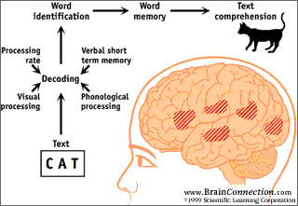
Advanced Topic in Cognitive
Neuroscience and Embodied Intelligence
Lab 8
Language
CE7427

Slide 2
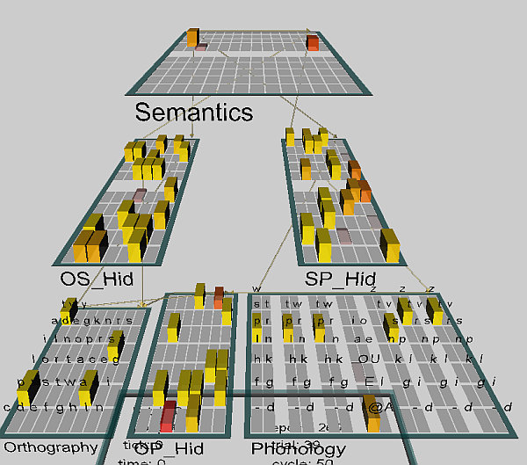
Dyslexia project
Project dyslex.proj
This network has been trained for 250 epochs on 40 words.
Training: randomly select one of the 3 layers (O, P, S) for input, use the remaining two layers as outputs, 1=>2 mapping.
kWTA = 25% for the hidden layers.
40 words for training.
Step: selects consecutive words
first is tart – should read from the camera and pronounce loud …
LeabraCycleTest: step shows how the activation flows in the network.
BatchTestOutDat: concrete (Con) and abstract (Abs) words.
Displays trial_name = input, closest_name, type of error.

Slide 3
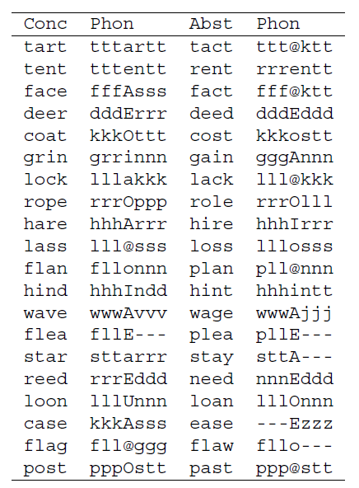
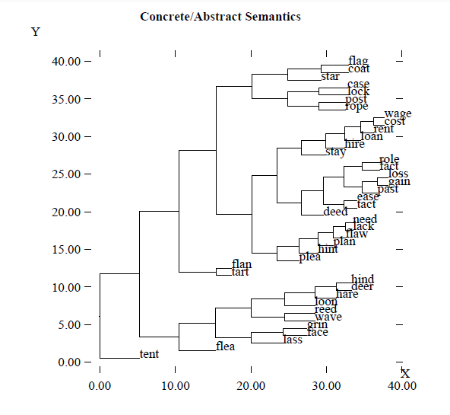
Words to read
40 words, 20 abstract & 20 concrete; dendrogram shows similarity in phonological and semantic layers after training.
All phonological reps activate 7 input units.

Slide 4
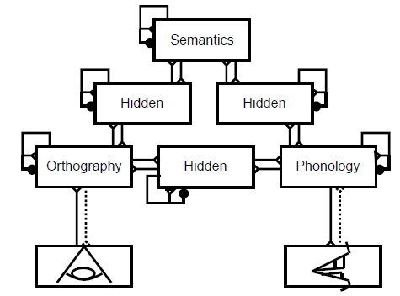
Dyslexia in the model
Phonological dyslexia: difficulty reading nonwords (nust or mave). Damage to the direct O-P pathway creates difficulty for mapping spelling to sound according to learned regularities that can be applied to nonwords. No activation of semantics.
Deep dyslexia: a more severe form of phonological dyslexia, visual errors
reflecting misperception of the word inputs (e.g, dog as dot); may also lead to semantic substitutions for words, ex. orchestra as symphony.
Severe damage to O-P => semantic layer has stronger activations spreading to associated representations and semantically related word => P, liked dog as cat.
Surface dyslexia: access to semantics is impaired (Wernicke's aphasia), nonword reading is intact; resulting from a lesion in the semantics pathway. Pronunciation of exception words (e.g., "yacht") is impaired. Semantic pathway helps to pronounce rare words like yacht, direct path is used for regular words.

Slide 5
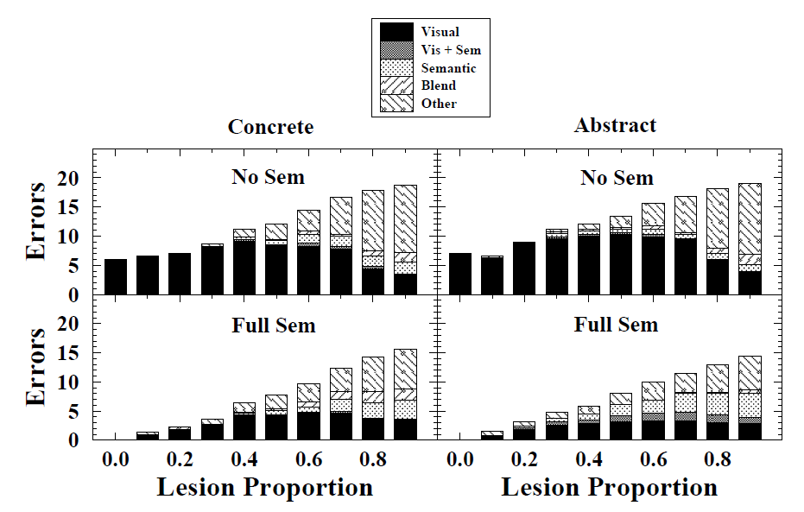
Direct pathways lesions
Partial direct pathway lesions in the dyslexia model, either with or without an intact semantic pathway (Full Sem vs. No Sem, respectively). The highest levels of semantic errors (i.e., deep dyslexia) are shown with Full Sem in the abstract words, consistent with the simpler results showning this pattern with a full lesion of the direct pathway.

Slide 6
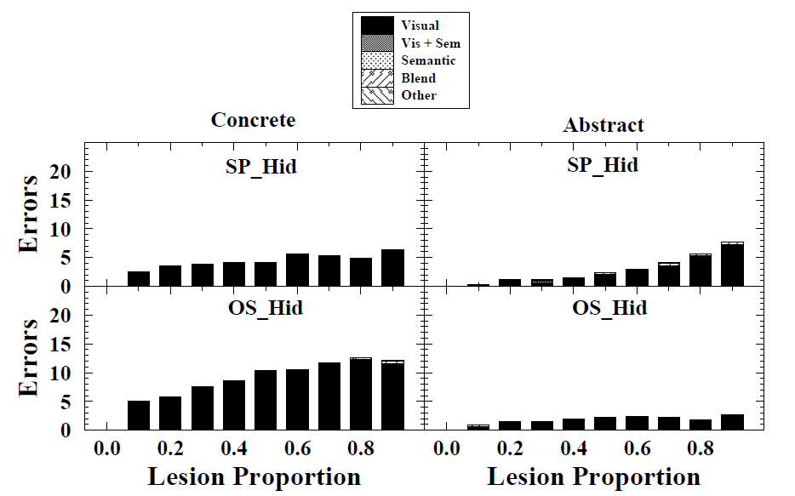
Semantic pathway lesions
Partial semantic pathway lesions in the dyslexia model, with an intact direct pathway. Only visual errors are observed, deed=>need, hire=>hare, plea=>flea.
Damage to the orthography to semantics hidden layer (OS_Hid) have more impact than the semantics to phonology (SP_Hid) layer,.

Slide 7
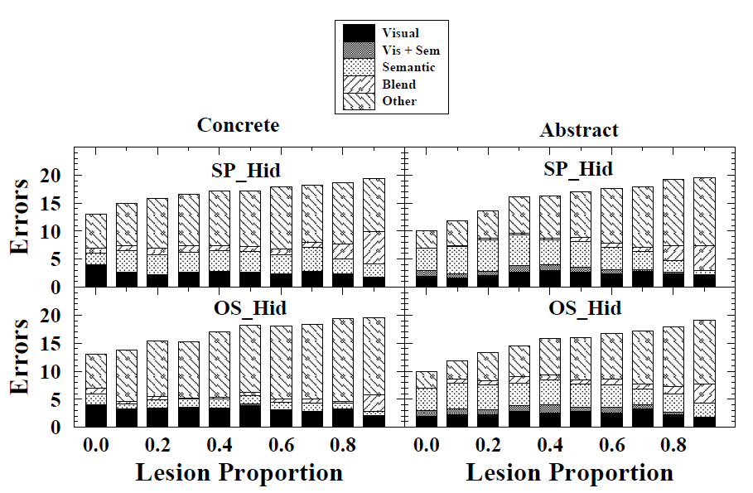
Partial semantic pathway lesions
Partial semantic pathway lesions with complete direct pathway lesions. The 0.0 case shows results for just a pure direct O-P lesion. Relative to this, small levels of additional semantic pathway damage produce slightly higher rates of semantic errors.

Slide 8
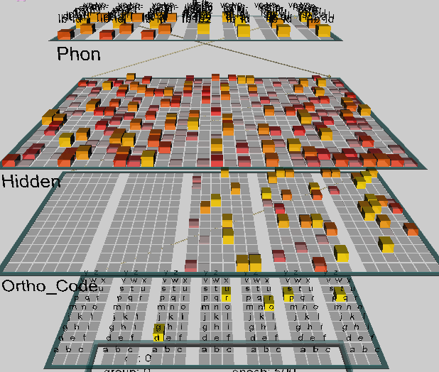
Spelling to Sound Mappings
Project ss.proj, chap. 10.4.2
English has few absolute rules for pronunciation, which is determined by a complex context Why hint/hind or mint/mind or anxious, anxiety?
Net: 7 blocks 3*9 = 189 inputs,
5*84 = 420 in orthography,
600 hidden, 7 blocks with
2*10=140 phonological elements.
Word codes:
H=high freq; R=regular
I=inconsistent
AM=ambiguous
EX=exception; L=low freq
ex: LEX = Low freq exception
Input: 3000 words, each complemented to have 7 letters, ex. best = bbbestt.
This avoids sequences that depend on time.

Slide 9
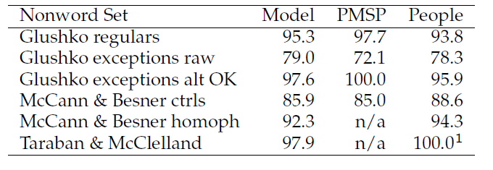
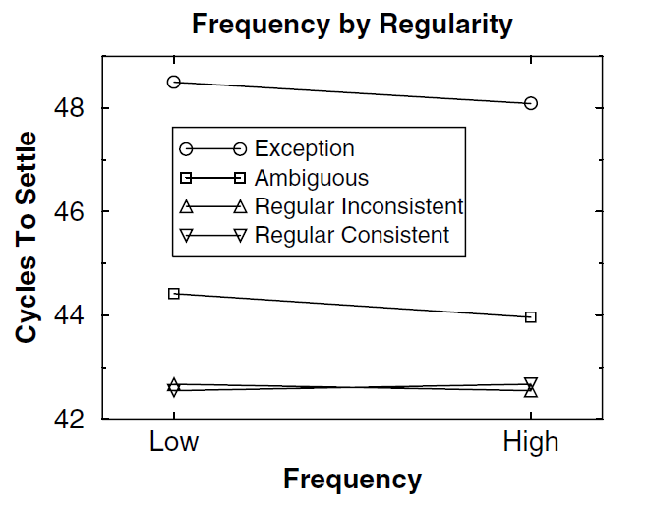
Words regularities
Gluszko list contains regular non words and exceptions.
PMSP = Plaut model results.
Pseudo-homophones
phyce => Choyce
Time required to settle the network as a function of frequency and typicality of words.
Quality/speed of reading by the model and by people shows strong similarity. In fact if alternative pronunciation is allowed there are no errors!

Slide 10
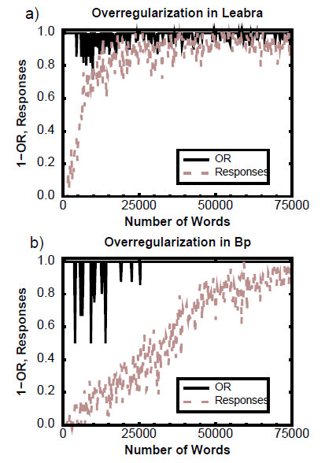
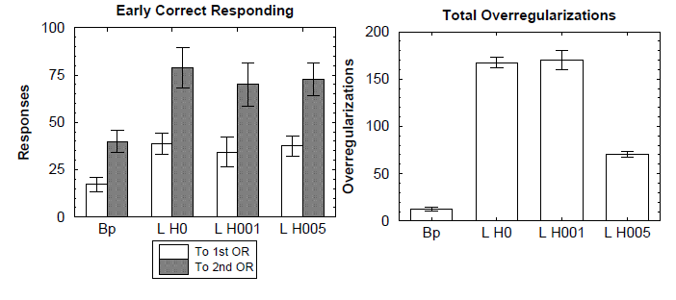
Leabra model results
At the beginning of learning all exceptions are remembered but later an attempt to regularize many words is observed, with final correct behavior.
Tendency to over-regularize persist relatively long, BP networks do not show correct beahvior here.
Responses = % of correct phonology.

Slide 11
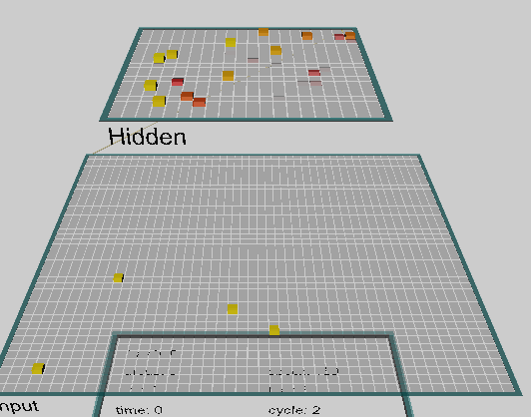
Simple mindless network
Inputs = 1920 specific words, selected from a 500 pages book (O'Reilly, Munakata, Explorations book, this example is in Chap. 10).
20x20=400 hidden elements, with sparse connections to inputs, each hidden unit trained using Hebb principle, learns to react to correlated lexical items.
For example, a unit may point to synonyms: act, activation, activations.
Compare distribution of activities of hidden elements for two words A, B, calculating cos(A,B) = A*B/|A||B|.
Activation of units corresponding to several words:
A=“attention”, B=“competition”, gives cos(A,B)=0.37.
Collocation A=“binding attention” gives cos(A+C,B)=0.49.
This network used to answer multiple choice test gets 60-80% correct answers!

Slide 12
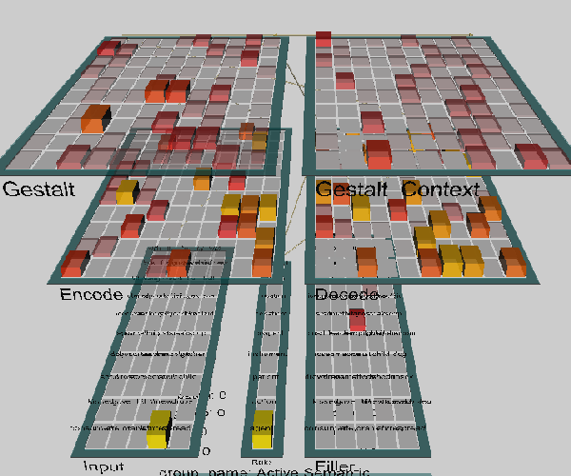
Network for sentences
Project sg.proj, chapter 10.7.2
Input represents words, localized representations, in the Encode layers reps are distributed, integrated in time as the words come in, and in the Gestalt + Gestalt_Context layer questions are linked to roles (agent, patient, instrument ...), network is decoding these representations providing output in the Filler layer.
Ex. bat (animal) and bat (baseball) need to be distinguished.

Slide 13
Q8.1
Please answer these questions given here for each unit.
Dyslexia: Normal and Disordered Reading
Question 10.6
(a) Is there evidence in the model for a difference between concrete and abstract words in the number of semantic errors made?
(b) Explain why this occurs in terms of the nature of the semantic representations in the model for these two types of words (recall that concrete words have richer semantics with more overall units).

Slide 14
Q8.2
Please answer these questions given here for each unit.
Semantic Representations from Word Co-Occurrences and Hebbian Learning
Do the “Distributed Representations of Multiple Words: exercise and answer the question:
Question 10.12
Think of another example of a word that has different senses (that is well represented in this textbook), and perform an experiment similar to the one we just performed to manipulate these different senses.
Document and discuss your results.

Slide 15
Q8.3
Please answer these questions given here for each unit.
The Sentence Gestalt Model
Question 10.13
We have discussed a mechanism for using partial cues to retrieve an original stored memory.
Explain the network's role elaboration performance in terms of this mechanism.

