Slide 1
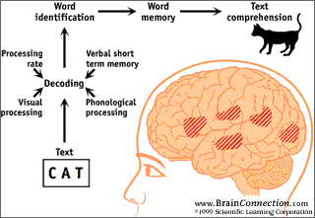
Advanced Topic in Cognitive
Neuroscience and Embodied Intelligence
Week 8
Language
CE7427

Slide 2

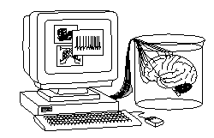
What it will be about
How are the words and concepts represented in the brain?
Model of speech and reading.
Language impairments.
Gestalt of sentences
Advanced models of meaning.
Oct. 6, most important date in the XXI century?

Slide 3
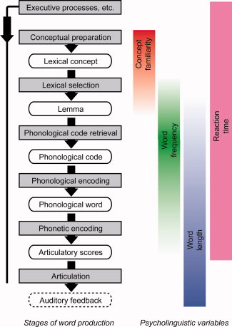
Symbolic representations in the brain
Mechanisms must be the same, all that we have in the brain are spiking neurons and biochemical processes, only outputs and inputs may differ.
Understanding speech requires many processing levels: phonetic encoding (elementary sounds, phonemes), phonology (syllables), selecting lexical concepts (words), understanding concepts, phrases, sentences, episodes, stories.
Reading requires visual perception of glyphs, graphemes, word-forms, creating information in the brain that may then internally enter the auditory stream.
Understanding language requires associative memory and this process spreads neural activation to all brain areas.

Slide 4
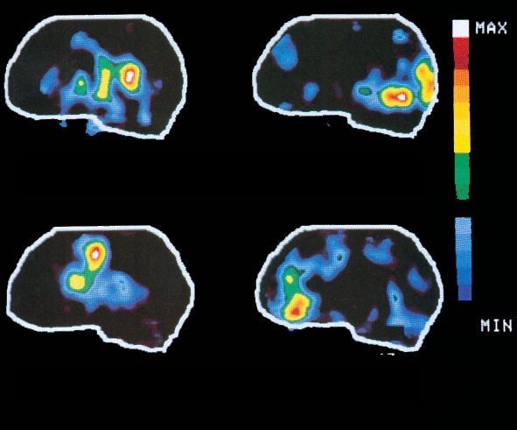
Listening Reading
Talking Thinking
All these areas are active, this is only contrast showing only specific activity.

Slide 5
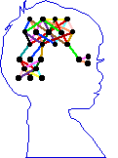
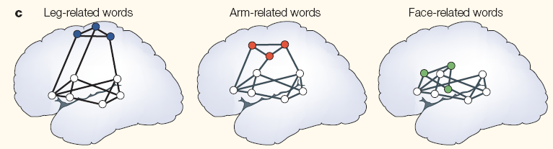
Words in the brain
Psycholinguistic experiments show that most likely categorical,
phonological representations are used, not the acoustic input.
Acoustic signal => phoneme => words => semantic concepts.
Phonological processing precedes semantic by 90 ms (from N200 ERPs).
F. Pulvermuller (2003) The Neuroscience of Language. On Brain Circuits of Words and Serial Order. Cambridge University Press.
Action-perception networks inferred from ERP and fMRI
Left hemisphere: precise representations of symbols, including phonological components; right hemisphere? Sees clusters of concepts.

Slide 6
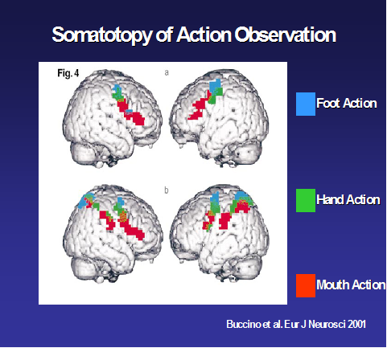
Words in the brain
Psycholinguistic experiments show that most likely categorical,
phonological representations are used, not the acoustic input.
Acoustic signal => phoneme => words => semantic concepts.
Action-perception networks inferred from ERP and fMRI

Slide 7
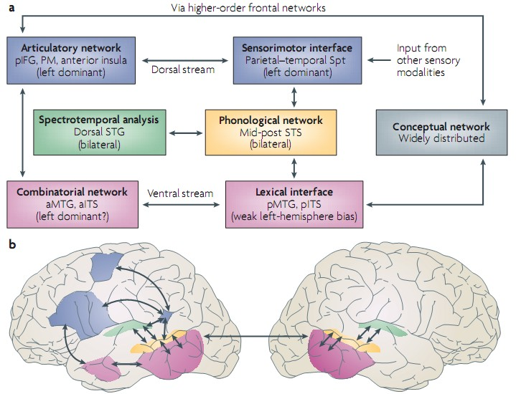
Anatomy of language
How should a meaning of the concept be represented?

Slide 8
Neuroimaging words
Predicting Human Brain Activity Associated with the Meanings of Nouns,
T. M. Mitchell et al, Science, 320, 1191, May 30, 2008
Clear differences between fMRI brain activity when people read, think or view about different nouns.
Reading words and seeing the drawing invokes similar brain activations, presumably reflecting semantics of concepts.
Although individual variance is significant similar activations are found in brains of different people, a classifier may still be trained on pooled data.
Model trained on ~60 fMRI scans + very large corpus (10¹²) predicts brain activity for nouns not used for training for which fMRI has been done.
25 semantic features that refer to action/perception.
Sensory: fear, hear, listen, see, smell, taste, touch
Motor: eat, lift, manipulate, move, push, rub, run, say
Actions: approach, break, clean, drive, enter, fill, near, open, ride, wear

Slide 9
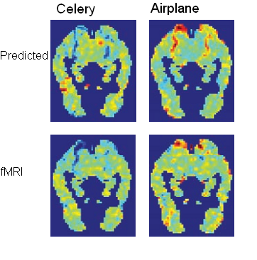
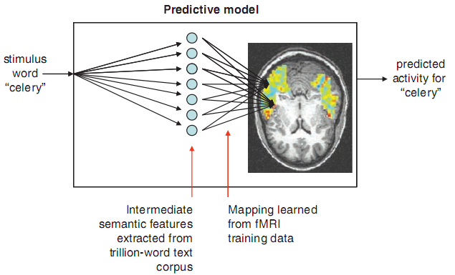
Neuroimaging words
Fro each word S create semantic vector V(S), calculating correlation of this word with 25 selected features, in a big lexical corpus (10¹²).
Map V(S) vectors to fMRI scans (~30.000 voxels), take 58 for training and predict additional 2 as test. Average accuracy is 77%, errors are reasonable.

Slide 10
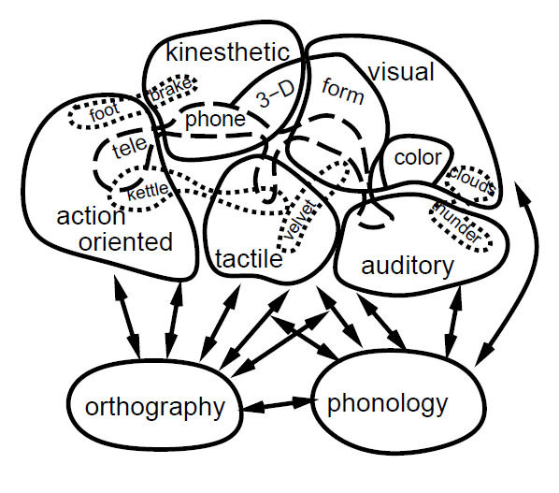
Word semantics
The meaning of concepts is a result of correlated, distributed activations of many brain areas.
Simplest model: strong Hebbian correlations between words, similar to strong correlations between elements of images or phonemes.
Latent Semantic Analysis (LSA) is in fact PCA approach to text documents, showing most common combination of words in different categories of documents; this can be modeled using Hebbian learning with conditional PCA.

Slide 11
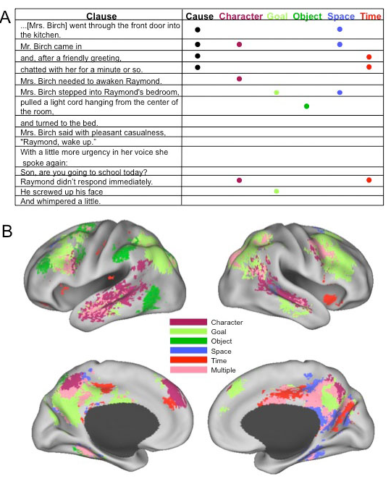
Nicole Speer et al.
Reading Stories Activates Neural Representations of Visual and Motor Experiences.
Psychological Science
20(8), 989-999, 2009
Meaning of concepts is always slightly different, depending on the context, but still may be clustered into relatively small number of distinct meanings.
Meaning = distribution of brain activity, predisposing the brain to make associations and actions.

Slide 12
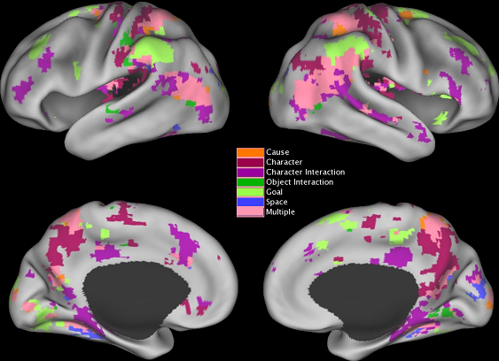
Segmenting experience
Our experience is a sequence of rapid synchronization of the brain, transition states are fast. J.M. Zacks, N.K. Speer et al. The brain’s cutting-room floor: segmentation of narrative cinema. Frontiers in human neuroscience, 2010.
Automatic segmentation of experience is the basis of perception, facilitates planning, memory, association of information.
Transitions between segments result from important observations in the current episode, entering new objects, places, goals, interactions, like in a movie.

Slide 13
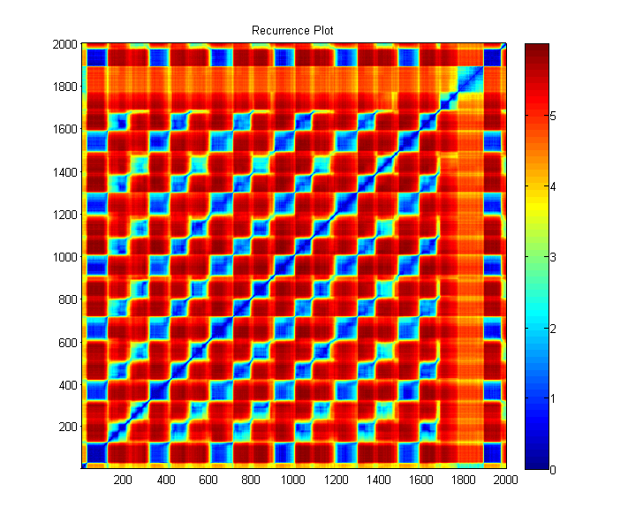
RP display of segmentation
Color = distance scale, blue areas similar activations, lasting for brief periods and changing, but coming back to similar but a bit different brain states many times.

Slide 14
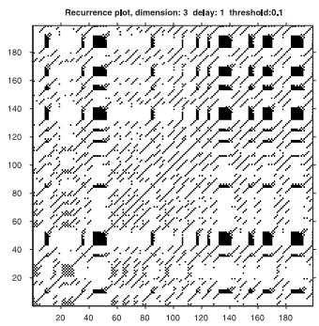
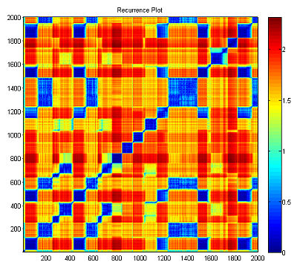
Recurrence Plots
Trajectory of dynamical system (in our case neural activities) may be “seen” using recurrence plots (RP), plotting rescaled similarities between vectors at two moments of time, either black/white after thresholding, or using a color scale for similarity; diagonal points are always at 0 distance:

Slide 15
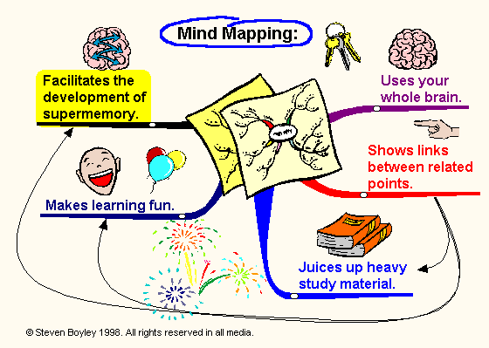
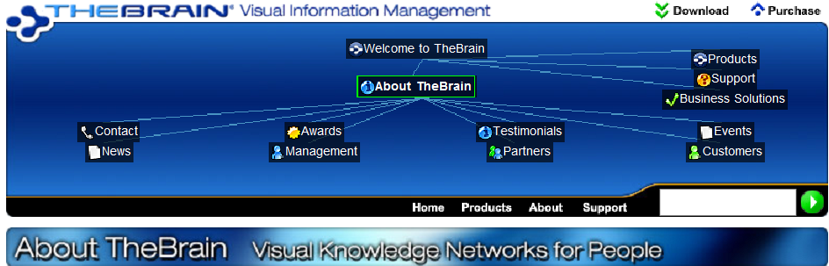
Mind maps
Popular idea: show organization of information as a graph linking concepts, inspired by brain processes.
Many books and software packages to create such maps, great examples of maps are at IQmatrix.com.
TheBrain (www.thebrain.com) interface making hierarchical maps of Internet links.

Slide 16
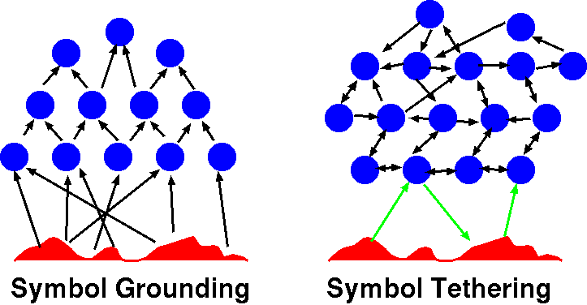
Where is the meaning?
How should the meaning of concepts be represented in models?
No representations, only senso-motoric embodiment (robotics).
Only some concepts have shared meaning through embodiment.
Aaron Sloman (2007): only simple concepts come from our “being in the world” experience, others are compounds, abstract.
David Hume gave good example: “golden mountain”.
Not symbol grounding but symbol tethering, meaning from mutual interactions.

Slide 17
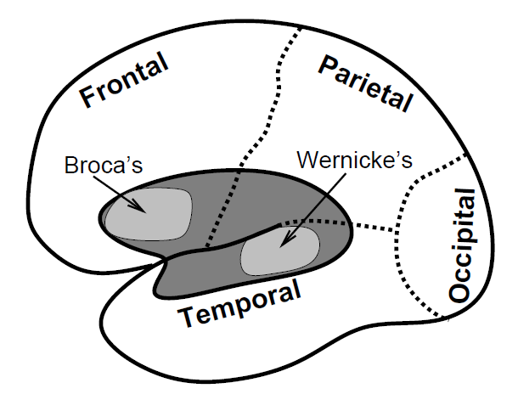
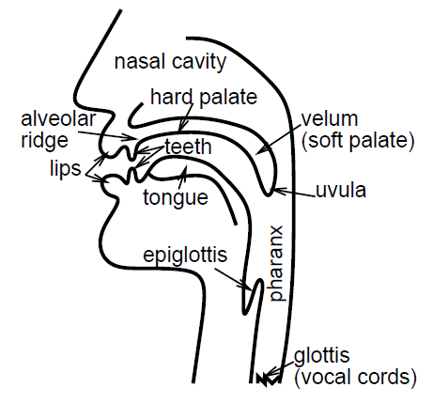
Speech basics
Control of vocal apparatus is responsible for correct pronunciation of phonemes. This is mainly a function of Borca’s area in the frontal lobe, while deeper analysis of the grammar is a function of superior temporal cortex. Simplification:
Broca’s area: surface lexical representation,
Wernicke’s area: deep lexical representation.

Slide 18
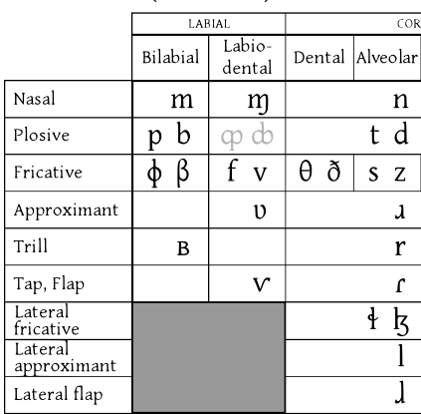
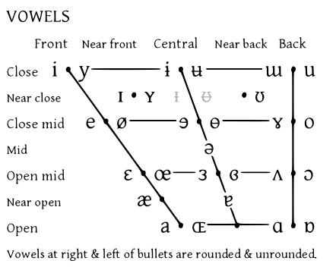
Phonological organization
International Phonetic Alphabet (IPA) for vowels is organized as a function of two variables: tongue positions (front vs. back, horizontal direction in figure), and lips shape (vertical axis); the space of consonant sounds is much more complex, a small part is shown to the right.

Slide 19
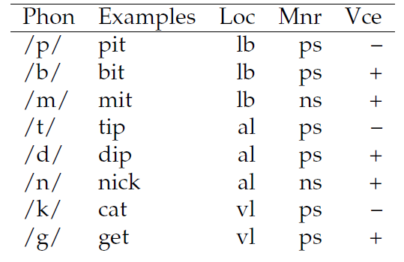
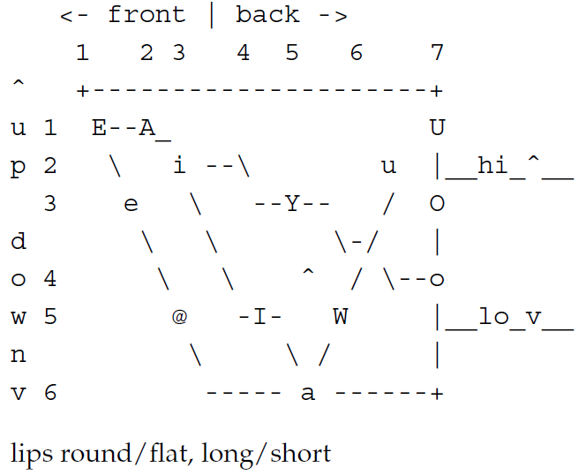
Phonological representation
Consonants: 3 dimensions, Loc, Mnr, Vce.
Coding: 7 location positions (loc, lb=labial), 5 for manner (Mnr, ps=plosive etc), and 2 for voicng (Vce, yes/no).
Vowels need 4 dimensions:
tong positions - front/back (7 values) and up/down (6 values), lip shape (rounded, flat) and length of vowel (short, long).

Slide 20

A few interesting questions
Using computer simulations a few questions about the use
of language may be answered:
Where is the meaning of the word coming from?
Why children tend to invent new word-forms, over-regularize verbs saying „I goed” instead of „I went”?
How can the reading process be modeled und understood?
Which processes are responsible for reading?
How is phonological mapping done for well-known words (cat, yacht) and for novel words (nust) when it has to be invented?
Why sometimes various form of reading problems (dyslexia) appear?
How to go from understanding of words and concepts to sentences and question answers?

Slide 21

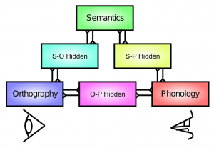
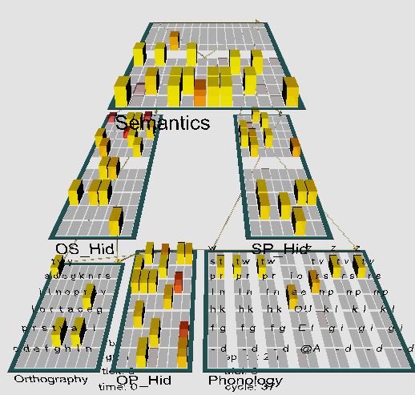
Model of reading & dyslexia
3-way or triangle model of reading:
orthography – visual perception, phonology – spoken (motor) output, semantics – meaning as distributed activity over 140 microfeatures.
Hidden layers are between each.
Visual input (orthography) => speech output directly via projections to phonology or indirectly via projections to semantics => phonology.
Word representations are distributed across different pathways.
Damage to different pathways can account for properties of acquired dyslexia. Learning: mapping one of the 3 layers to the other two.

Slide 22
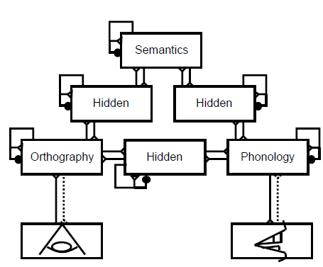
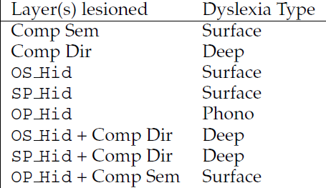
Simulation of dyslexia
Dyslexia: depending on the severity of lesion and pathway various forms of dyslexia symptoms may be produced, similar to phonological, deep or surface dyslexia. Of course real dyslexia may have other form and involve other brain areas.
LesionType = Semantics (10 types)
Turns of the whole layer.
Average results after 25 runs with lesion.
need, loan, flow, past => coat
Hire and coat are frequently mistaken.
Ease => wage ???
Phonological distance:
cos(S₁,S₂) = S₁*S₂/|S₁||S₂|∈ [0.1]

Slide 23
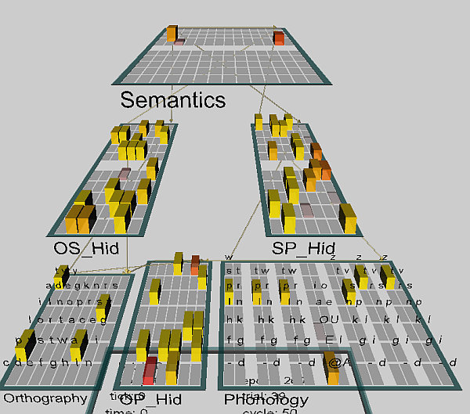
Dyslexia project
Project dyslex.proj
This network has been trained for 250 epochs on 40 words.
Training: randomly select one of the 3 layers (O, P, S) for input, use the remaining two layers as outputs, 1=>2 mapping.
kWTA = 25% for the hidden layers.
40 words for training.
Step: selects consecutive words
first is tart – should read words using the camera and pronounce them loud …
LeabraCycleTest: step shows how the activation flows in the network.
BatchTestOutDat: concrete (Con) and abstract (Abs) words.
Displays trial_name = input, closest_name, type of error.

Slide 24
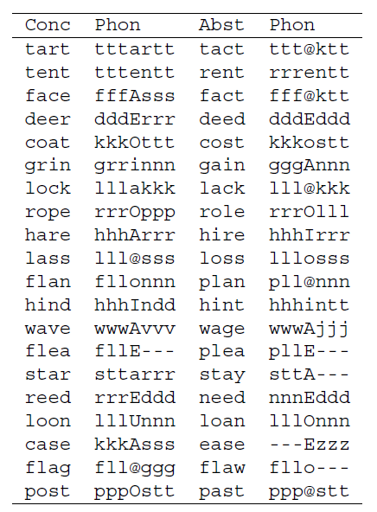
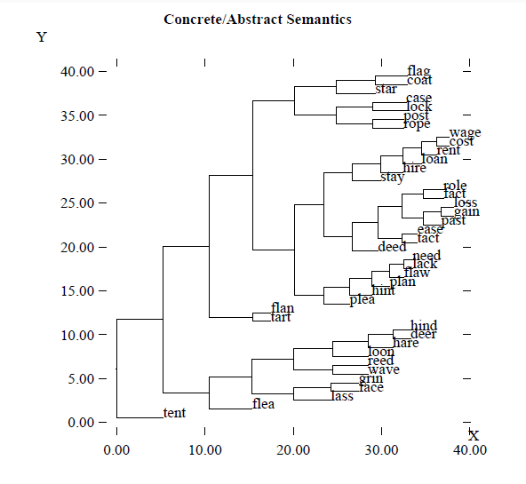
Words to read
40 words, 20 abstract & 20 concrete; dendrogram shows similarity in phonological and semantic layers after training.
All phonological reps activate 7 input units.

Slide 25
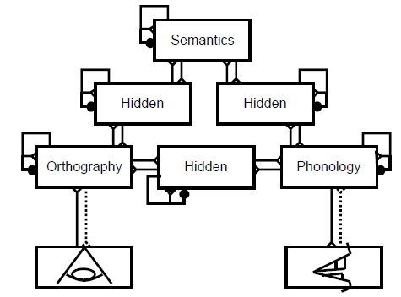
Dyslexia in the model
Phonological dyslexia: difficulty reading nonwords (nust or mave). Damage to the direct O-P pathway creates difficulty for mapping spelling to sound according to learned regularities that can be applied to nonwords. No activation of semantics.
Deep dyslexia: a more severe form of phonological dyslexia, visual errors
reflecting misperception of the word inputs (e.g, dog as dot); may also lead to semantic substitutions for words, ex. orchestra as symphony.
Severe damage to O-P => semantic layer has stronger activations spreading to associated representations and semantically related word => P, like dog => cat.
Surface dyslexia: access to semantics is impaired (Wernicke's aphasia),
nonword reading is intact; resulting from a lesion in the semantics pathway. Pronunciation of exception words (e.g., "yacht") is impaired. Semantic pathway helps to pronounce rare words like yacht, direct path is used for regular words.

Slide 26
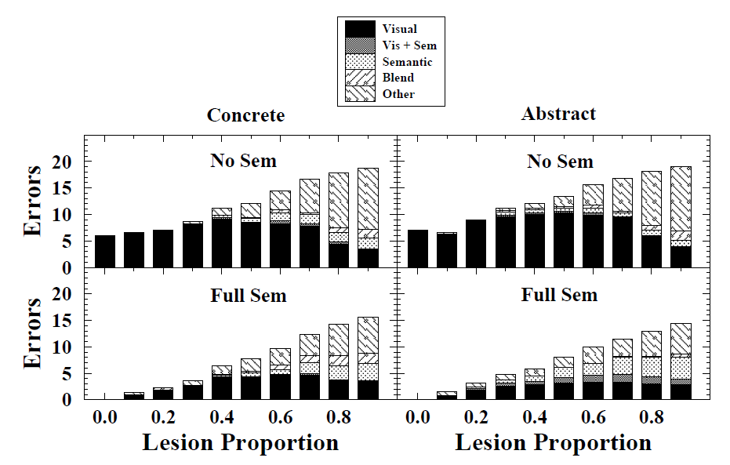
Direct pathway lesions
Partial direct pathway lesions in the dyslexia model, either with or without an intact semantic pathway (Full Sem vs. No Sem, respectively). The highest levels of semantic errors (i.e., deep dyslexia) are shown with Full Sem in the abstract words, consistent with the simpler results showing such patterns with a full lesion of the direct pathway.

Slide 27
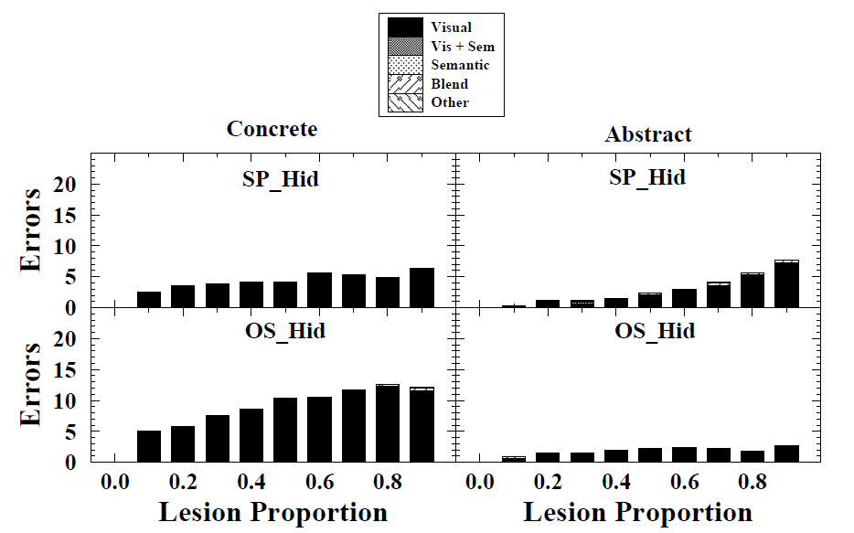
Semantic pathway lesions
Partial semantic pathway lesions in the dyslexia model, with an intact direct pathway. Only visual errors are observed, deed=>need, hire=>hare, plea=>flea.
Damage to the orthography => semantics hidden layer (OS_Hid) have more impact than the semantics => phonology (SP_Hid) layer,.

Slide 28
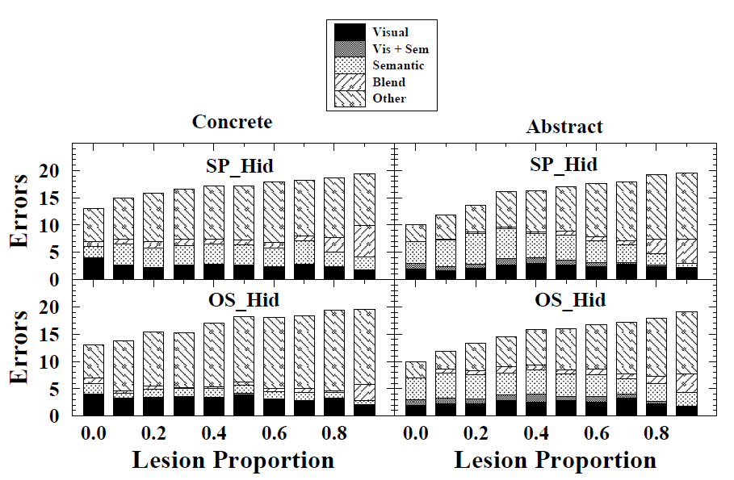
Partial semantic pathway lesions
Partial semantic pathway lesions with complete direct pathway lesions. The 0.0 case shows results for just a pure direct O-P lesion. Relative to this, small levels of additional semantic pathway damage produce slightly higher rates of semantic errors.

Slide 29
Fuzzy Symbolic Dynamics (FSD) Plots
How to see what network does? RP plots S(t,t₀) values as a matrix.
Symbolic Dynamics: space is partitioned to regions R₁, R₂, … R_{n}, and trajectory is changed into a sequence of symbols R_{i} R_{i+1}R_{i+2} … followed by statistical analysis.
Fuzzy Symbolic Dynamics: will associate a membership function with each region R_{i}, and replace trajectory by a sequence of their values.
FSD finds 2-3 reference points to plot distances
Standardize data.
Find cluster centers (e.g. by k-means algorithm): μ₁, μ₂ ...
Use non-linear mapping to reduce dimensionality:
Dobosz K, Duch W. (2010) Understanding Neurodynamical Systems via Fuzzy Symbolic Dynamics. Neural Networks Vol. 23 (2010) 487-496

Slide 30
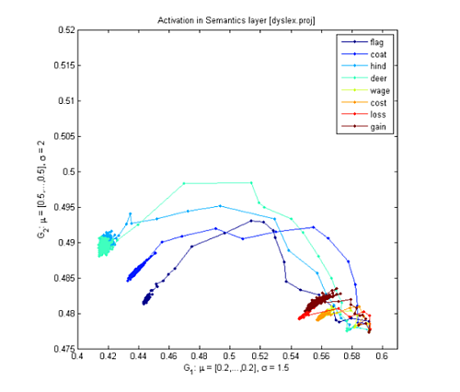
Fuzzy Symbolic Dynamics (FSD)
Localized membership functions y_{k}(t;W):
sharp indicator functions => symbolic dynamics;
x(t) => strings of symbols;
soft membership functions
=> fuzzy symbolic dynamics,
dimensionality reduction
Y(t)=(y₁(t;W), y₂(t;W))
=> visualization of high-D data.
In 2D one can follow
trajectories from initialization
to basins of attractors, in nD one can look at membership functions for n regions using color coding.
This shows complementary information to RPs.

Slide 31
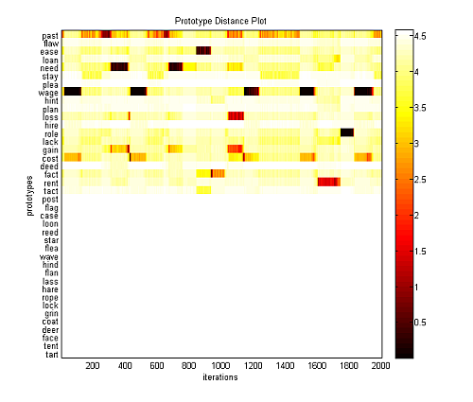
Fuzzy Symbolic Dynamics (FSD)
Localized membership functions y_{k}(t;W):
sharp indicator functions => symbolic dynamics;
x(t) => strings of symbols;
soft membership functions
=> fuzzy symbolic dynamics,
dimensionality reduction
Y(t)=(y₁(t;W), y₂(t;W))
=> visualization of high-D data.
In 2D one can follow
trajectories from initialization
to basins of attractors, in nD one can look at membership functions for n regions using color coding.
This shows complementary information to RPs.

Slide 32
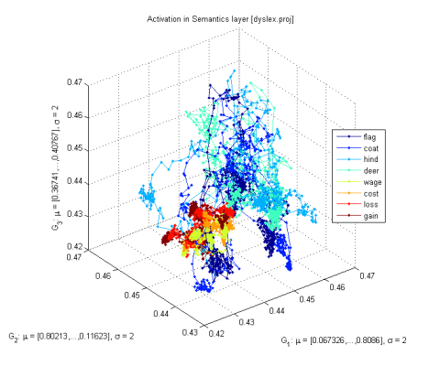
Attractors for words
Non-linear visualization of activity of the semantic layer with 140 units in the model of dyslexia.
If 2 or 3 reference points are selected then each value [S(t,t₁), S(t,t₂), S(t,t₃)] may be displayed in 3D.
Cost and rent have semantic associations, attractors are close to each other, but without noise +neuron accommodation transitions their basins of attractions are hard.
Will it manifest in verbal priming tests? Free associations?
Will broadening of phonological/written form representations help?
For example, training ASD children with characters that vary in many ways (shapes, colors, size, rotations).

Slide 33
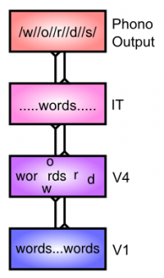
Spelling to Sound Mappings
English has few absolute rules for pronunciation, which is determined by a complex context.
Why hint/hind or mint/mind or anxious, anxiety?
How can such complex system be captured?
Take into account a range of context around a given letter in a word, all the way up to the entire word itself.
Object recognition builds up increasingly complex combinations of features, while also developing spatial invariance, over multiple levels of processing in the hierarchy
from V1 through IT. Word recognition should do similar processing.
Words show up in different locations in the input, next level of processing
(~ V4) extracts more complex combinations of letters, developing more invariant representations that integrate individual letters or multi-letter features over multiple different locations. The IT level representation of the word is fully spatially invariant, distributed representation integrating over individual letters and letter groups, providing phonological output.

Slide 34
English spelling is a mess …
Famous ghoti example.
fish, because
gh, pronounced /f/ as in tough /tʌf/;
o, pronounced /ɪ/ as in women /ˈwɪmɪn/;
ti, pronounced /ʃ/ as in nation /ˈne͡ɪʃən/.
ghoti can be a silent word, because
gh as in though (/ðoʊ/) ;
o as in people (/'piːpəl/) ;
t as in ballet (/'bæleɪ/) ;
i as in business (/'bɪznəs/)

Slide 35
but brains can still manage!
cnduo't bvleiee taht I culod aulaclty uesdtannrd waht I was rdnaieg.
Unisg the icndeblire pweor of the hmuan mnid, aocdcrnig to rseecrah at Cmabrigde Uinervtisy, it dseno't mttaer in waht oderr the lterets in a wrod are, the olny irpoamtnt tihng is taht the frsit and lsat ltteer be in the rhgit pclae. The rset can be a taotl mses and you can sitll raed it whoutit a pboerlm. Tihs is bucseae the huamn mnid deos not raed ervey ltteer by istlef, but the wrod as a wlohe. Aaznmig, huh? Yaeh and I awlyas tghhuot slelinpg was ipmorantt! See if yuor fdreins can raed tihs too.
Part of this ability to read such scrambled text comes from activation of the most probable units coding sequences of syllables, starting from the correct letter.

Slide 36
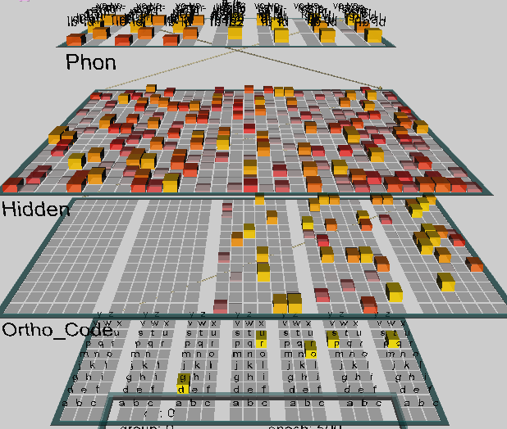
Spelling to Sound Mappings
Project ss.proj, chap. 10.4.2
English has few absolute rules for pronunciation, which is determined by a complex context Why hint/hind or mint/mind or anxious, anxiety?
Net: 7 blocks 3*9 = 189 inputs,
5*84 = 420 in orthography,
600 hidden, 7 blocks with
2*10=140 phonological elements.
Word codes:
H=high freq; R=regular
I=inconsistent
AM=ambiguous
EX=exception; L=low freq
ex: LEX = Low freq exception
Input: 3000 words, each complemented to have 7 letters, ex. best = bbbestt.
This avoids sequences that depend on time.

Slide 37
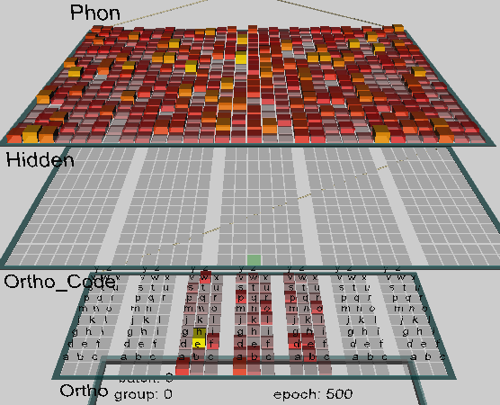
Network structure
Ortho_code blocks receive inputs from triples of letters through Ortho inputs.
Coding is invariant, independent of position; some units respond to the same letter in different positions, some units respond to whole sequences, coding more complex features, as the V2 layer in vision.
Elements of the hidden unit layer respond to all inputs (as V4/IT).
These units code pronunciation including wider context.
The network learns representations that allow for generalization (as in the model of object recognition), invariances and grouping of elements.
Interpretation may not be easy, some results from co-occurrence.
Test: regular words and exceptions (Glushko, 1979).
Are artificial word homophones easier to pronounce?
Lists of artificial words have been published (McCann & Besner, 1987).

Slide 38
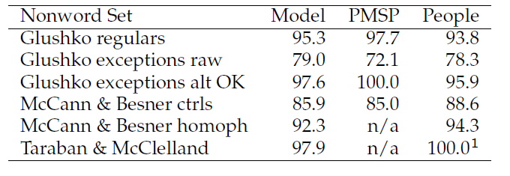
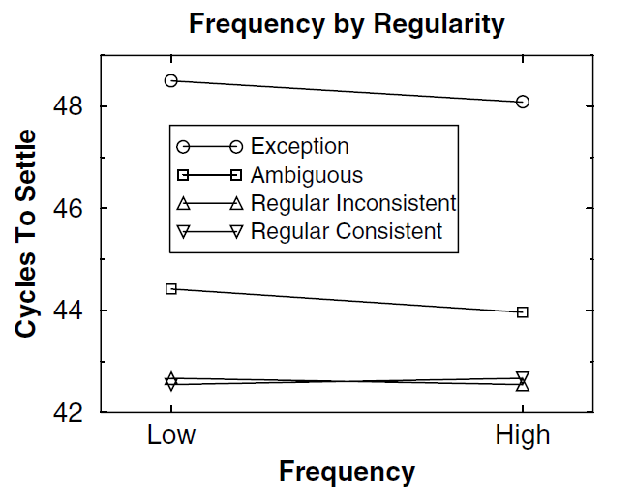
Words regularities
Gluszko list contains regular non words and exceptions.
PMSP = Plaut model results.
Pseudo-homophones
phyce => Choyce
Time required to settle the network as a function of frequency and typicality of words.
Quality/speed of reading by the model and by people shows strong similarity. In fact if alternative pronunciation is allowed there are no errors!

Slide 39
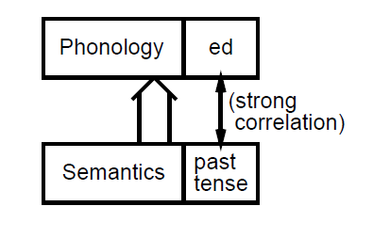
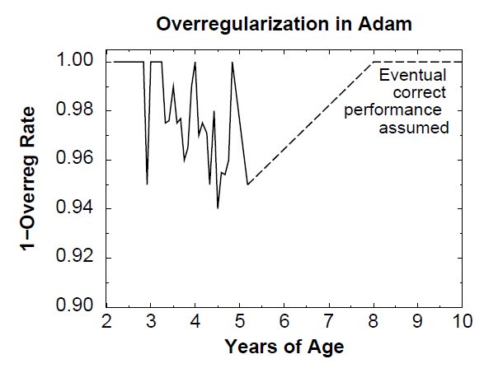
Irregular inflections
Project pt.proj, chap 10.
Interactions between phonology and semantics. Initially babies simply memorize things, then show a tendency to regularize all words, learning exceptions as they grow older, so there is w kind of U-shape learning curve.
The network is initially trained on words with irregular and then regular inflections. This simulates changing learning environment, initially everything is new and needs to be memorized, later brains try to compress information discovering regularities.

Slide 40
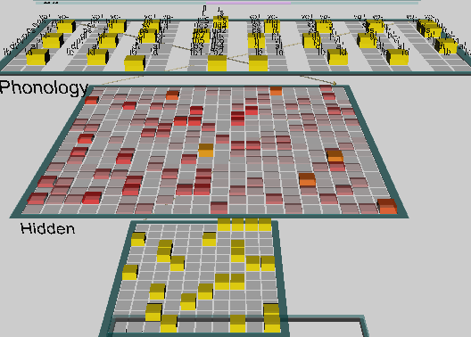
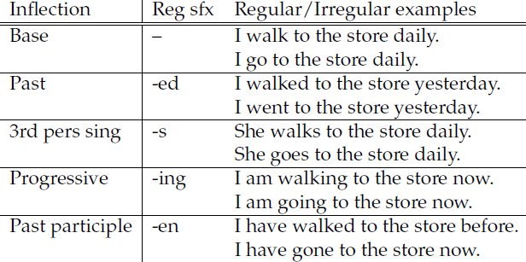
Leabra model of past tense inflections
Network: semantic input layer,
hidden layer + phonological layer.
Data: 389 verbs, including 90 irregular in future tense, with 4 regular inflections:
-ed, -en, -s, -ing, a total of 1945 examples.
kWTA in hidden layer 7.5% for 400 units.
Cooperation + competition + Hebbian correlation learning, helps the network to reach dynamical balance for mapping regular and irregular verbs, in agreement with human learning.
Priming may change the network behavior after a few presentations, explaining irregularities.

Slide 41
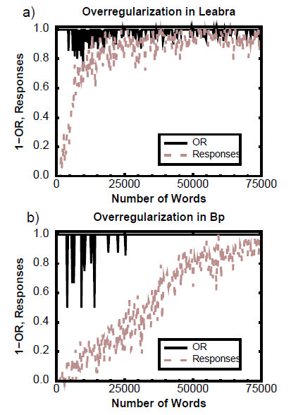
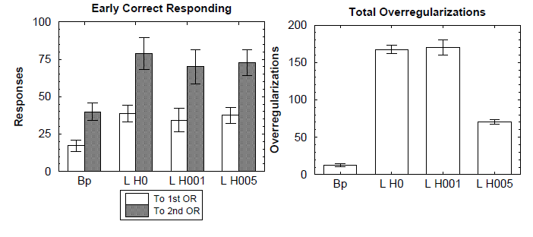
Leabra model results
At the beginning of learning all exceptions are remembered but later an attempt to regularize many words is observed, with final correct behavior.
Tendency to over-regularize persist relatively long, BP networks do not show correct beahvior here.
Responses = % of correct phonology.

Slide 42

A more detailed model
Garagnani et al. Recruitment and consolidation of cell assemblies for words by way of Hebbian learning and com-petition in a multi-layer neural network, Cognitive Comp. 1(2), 160-176, 2009.
Primary auditory cortex (A1), auditory belt (AB), parabelt (PB, Wernicke’s area), inferior pre- frontal (PF) and premotor (PM, Broca), primary motor cortex (M1).

Slide 43
Garagnani et al. conclusions
“Finally, the present results provide evidence in support of the
hypothesis that words, similar to other units of cognitive processing (e.g. objects, faces), are represented in the human brain as distributed and anatomically distinct action-perception circuits.”
“The present results suggest that anatomically distinct and distributed action-perception circuits can emerge spontaneously in the cortex as a result of synaptic plasticity. Our model predicts and explains the formation of lexical representations consisting of strongly interconnected, anatomically distinct cortical circuits distributed across multiple cortical areas, allowing two or more lexical items to be active at the same time.
Crucially, our simulations provide a principled, mechanistic explanation of where and why such representations should emerge in the brain, making predictions about the spreading of activity in large neuronal assemblies distributed over precisely deﬁned areas, thus paving the way for an investigation of the physiology of language and memory guided by neurocomputational and brain theory.”

Slide 44

Multiple-choice Quiz
This quiz is based on the information from the O'Reilly and Munakata book, Computational Explorations in Cognitive Neuroscience (our main textbook).
Each questions has 3 choices. Can a network learn to answer correctly?
A simple network may only give an intuitive answer, based purely on associations, for example what is the purpose of “transformation”: A, B or C?

Slide 45

Simple mindless network
Inputs = 1920 specific words, selected from a 500 pages book (O'Reilly, Munakata, Explorations book, this example is in Chap. 10).
20x20=400 hidden elements, with sparse connections to inputs, each hidden unit trained using Hebb principle, learns to react to correlated lexical items.
For example, a unit may point to synonyms: act, activation, activations.
Compare distribution of activities of hidden elements for two words A, B, calculating cos(A,B) = A*B/|A||B|.
Activation of units corresponding to several words:
A=“attention”, B=“competition”, gives cos(A,B)=0.37.
Collocation A=“binding attention” gives cos(A+C,B)=0.49.
This network used to answer multiple choice test gets 60-80% correct answers!

Slide 46

Remarks about the model
The network has been trained on a simplified text in which only 1920 words are left, all rare ones (<5x) and very common (the, and, it, his, can …), have been removed as they are not useful for simple associations.
eccn_lg_f5.cln file shows the text are filtering, sem_filter.lg.list removed words.
Words are composed of morphemes, prefixes and suffixes, but morphology has not been used here, preprocessing will make input layer smaller.
This network ignores word order, LSA also ignores word order.
Hidden units use all input words as features that define their activity; this activity is proportional to the probability of finding the words in the same paragraph, so it can be estimated by statistical correlation measures; there is no relational structure between words.
An approach called “structured vector space approach” can handle relations.
Several words presented at the same time do not lead to additive activations, adding more words increases probabilities only by small amount.
Can such network capture the sense of a whole sentence?

Slide 47

Meaning of sentence
Traditional approach to sentence understanding is based on parsing using grammatical rules. Is it what brains do?
Alternative approach: distributed representations, “gestalt” of the sentence.
There is no central representation, as with visual perception of scenes.
For modeling we need a small world to define some semantics: sentences that contain names of people, active and passive activities, objects and places.
Roles of people: busdriver, teacher, schoolgirl, pitcher.
Actions: eat, drink, stir, spread, kiss, give, hit, throw, drive, rise.
Objects: spot (the dog), steak, soup, ice cream, crackers, jelly, iced tea, kool aid, spoon, knife, nger, rose, bat (animal), bat (baseball), ball, ball (party), bus, pitcher, fur.
Locations: kitchen, living room, shed, park.

Slide 48

Example of sentences
These sentences have simple structure: agent (person) – action – object.
Roles and modifiers: co-agent, places, adjectives, recipient of „give”, instruments of actions, adverbs.

Slide 49

Network for sentences
Project sg.proj, chapter 10.7.2
Input represents words, localized representations, in the Encode layers reps are distributed, integrated in time as the words come in, and in the Gestalt + Gestalt_Context layer questions are linked to roles (agent, patient, instrument ...), network is decoding these representations providing output in the Filler layer.
Ex. bat (animal) and bat (baseball) need to be distinguished.

Slide 50

Testing sentence comprehension
Role assignment, word disambiguation, examples of the use of concepts, specific roles, conflict resolution.
Small world: all sentences refer to people, activity, location, objects, passive and active interactions.

Slide 51

Verb similarity
Cluster plot over the gestalt layer of patterns associated with the different verbs, showing that these distributed representations capture the semantic similarities of the words.

Slide 52

Noun similarity
Cluster plot over the gestalt layer of patterns associated with the different nouns, showing that these distributed representations capture the semantic similarities of the words (much as in the LSA-like semantics model explored in the previous section).

Slide 53

Sentence gestalt patterns
Cluster plot over the gestalt layer of patterns associated with a set of test sentences designed to test for appropriate similarity relationships.
sc = schoolgirl; st = stirred;
ko = kool-aid;
te = teacher; bu= busddriver; pi = pitcher;
dr = drank; ic = iced-tea;
at = ate; so = soup;
st = steak;

Slide 54

Computational creativity
Creating novel words by Random Variation Selective Retention (RVSR): construct words from combinations of phonemes, pay attention to morphemes, flexion etc.
Creativity = space + imagination (fluctuations)
+ filtering (competition)
Space: neural tissue providing space for infinite patterns of activations.
Imagination: many chains of phonemes activate in parallel both words and non-words reps, depending on the strength of synaptic connections.
Filtering: associations, emotions, phonological/semantic density.
Start from keywords priming phonological representations in the auditory cortex; spread the activation to concepts that are strongly related.
Use inhibition in the winner-takes-most to avoid false associations.
Find fragments that are highly probable, estimate phonological probability.
Combine them, search for good morphemes, estimate semantic probability.

Slide 55

Ring your brain
Context will decided which semantics to attach to r-i-n-g series of phonemes that you hear or letters that you read.

Slide 56
Creativity with words
The simplest testable model of creativity:
create interesting novel words that capture some features of products;
understand new words that cannot be found in the dictionary.
Model inspired by the putative brain processes when new words are being invented starting from some keywords priming auditory cortex.
Phonemes (allophones) are resonances, ordered activation of phonemes will activate both known words as well as their combinations; context + inhibition in the winner-takes-most leaves only a few candidate words.
Creativity = network + imagination (fluctuations) + filtering (competition)
Imagination: chains of phonemes activate both word and non-word representations, depending on the strength of the synaptic connections. Filtering: based on associations, emotions, phonological/semantic density.
discoverity = {disc, disco, discover, verity} (discovery, creativity, verity)
digventure ={dig, digital, venture, adventure} new!
Check the BrainGene server and invent some good passwords today!

Slide 57
Some language related Q/A
What brain processes are involved in reading and why they sometimes fail (dyslexia)?
Lexical representations are distributed, there are interactions between recognition of letters, orthographical, phonological and semantic layers.
What is the difference between reading proper words like cat, yacht, and non-words like nust?
Context-activated representations form continuum between regular and exceptional words, showing word-frequency effects.
Why children first learn correctly and than say I goed instead of I went?
There is dynamical balance between mapping regular and irregular forms.
Where does the meaning of the words come from? Co-occurence statistics with other words, and embodiment in sensory related brain activations.
How to understand the meaning of sentences? With the gestalt model.
How to use it in large scale natural text understanding? It is still an open question … a job for you!

