Slide 1
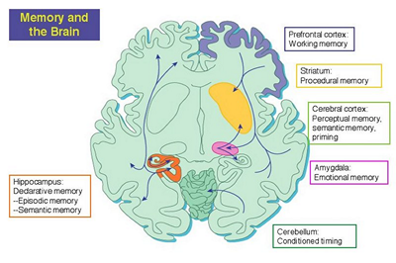
Advanced Topic in Cognitive
Neuroscience and Embodied Intelligence
Lab Week 7
Memory
CE7427

Slide 2
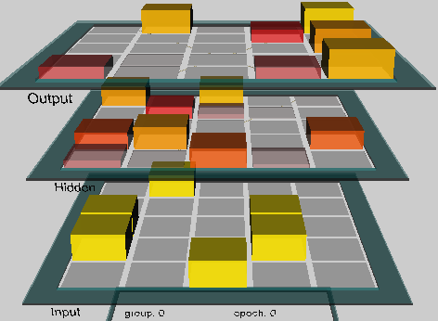
Model of priming
Project wt_priming.proj, chapter 9, simulates one-to-many mapping paradigm by learning to associate 2 different output patterns with a given input pattern.
Small weight changes => preferences for different answers.
Is a single presentation of input pattern sufficient to bias answer based on a long term memory implemented in parietal cortex synaptic connections?
Associations are of A-B, A-C types, for example homophones, although no specific presentation is assumed here.
Network: 3 layers 5x5 each.
Learning: associate A-B₀, A-B₁
After training the network prompted with patter A replies B₀ or B₁ about the same number of times; additional presentation will change it.

Slide 3
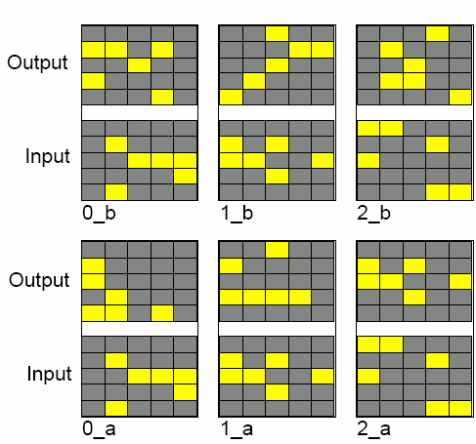
Priming 1
View Events: events have the same input patterns i_a=i_b, but different outputs
i_a, i_b, for i = 0..12.
In total 13 pairs x 2 outputs
= 26 pairs i_a – i_b.
Leaning: Leabra needs about 45 epochs.
Why it can learn it? BP will blend the two outputs, but a combination of kWTA + Hebb + CHL is able to learn it.
A small noise (random activations) added to the membrane potential is added to break impasses, decreasing the stability of memorized pattern associations.
After training the network selects one of the two answers randomly.

Slide 4
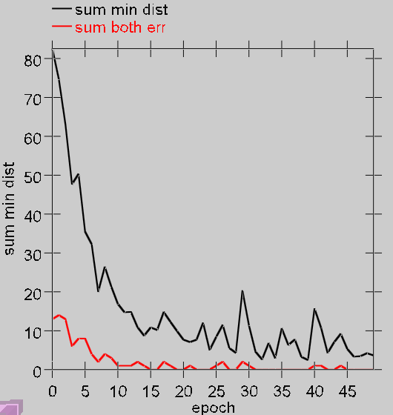
More on the priming model
Evaluation of the training results:
Check the minimal distance to the closest pattern, sum this over all 13 patterns (black line, sum min dist). Decreasing distance shows convergence.
Error=0 if one of the two possible outputs is selected, 1 if another one is selected (red line, sum both err), reaches zero before the distance is zero.
Test_logs: check if there are some biases already, then check if there is any bias after a pair (i_a, i_b) has been presented.

Slide 5
Priming tests
Check if this additional exposition will change anything
WtPrimeTest makes one step or run goes through the whole epoch.
1. Statistics: closest_name is either i_a or i_b, and name_err =0 or 1 randomly, but both_err=0, that is correctly = one of the two o_a or o_b.
In AllTrialTestOutputData table individual decisions are displayed,
in EpochTestOutputData results before and after priming a and b.
Roughly about half (~7) is a and half is b, but some fluctuations are possible.
2. WtPrimeTest shows the trained network only once (i_a, o_a), checks statistics sum_name_err showing on the input i_a; than repeats the same training with (i_b, o_b) and testing, with 4 tests in total.
3. For a there may be fro example 10, and after priming 4 errors (b 9, 5), nex time 8,1 and 12,6, so the bias to give the same answer grows.
Conclusion: parietal cortex may be responsible for long-term priming.

Slide 6
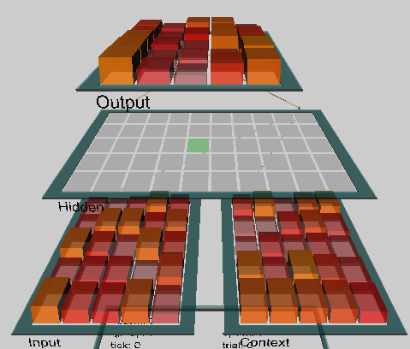
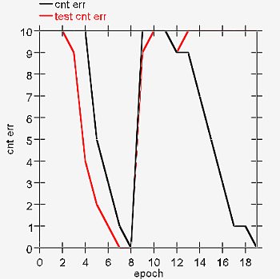
AB-AC Model
Project ab_ac_interference.proj
View Events_AB, Events_AC,
Output: B or C, but the context variable
= list 1 or list 2 helps to remember.
Context = change of 1 or 2 patterns.
Catastrophic forgetting:
Results: EpochOutputDataGraph, black line
= errors during AB training, red line = test on AB/AC after each epoch.
10 patterns, batch will repeat it 5 times.
This test shows that after learning AC (8 epochs) the network has completely forgotten associations AB, because many hidden units take part in learning of both lists.

Slide 7
AB-AC Model
BatchOutputData shows, that when AB list has been learned and AC is being learned the number of errors goes to 10 each time, everything is forgotten.
Can one learn both lists?
Perhaps less hidden units should be active at the same time?
Changing hid_kwta 12=>4 does not help, still there is catastrophic forgetting.
Changing variance of initial values wt_var 0.25=>0.4
Stronger influence of contex fm_context 1=>1.5
Stronger Hebbian learning hebb 0.01=>0.05
Slower learning, decreasing learning rate lrate => 0.1, Batch
Although the catastrophe may be a bit weaker it does not work …
Clearly another system is needed for fast learning:
one fast and one slow, and this is based on the cortex and hippocampus.

Slide 8
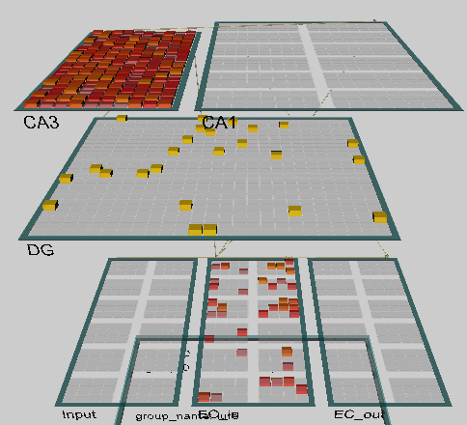
Hippocampus model
Project hip.proj
Input signals pass through the EC_in (entorhinal input), to the DG (dentate gyrus) and to CA3 part of hippocampus.
DG has also influence on CA3, with sparse representations, that allow for clear discrimination of input signals.
CA3 has strong recurrent connections.
CA1 has more distributed representations with output to => EC_out.
EC: 144 el = 4*36; all 1/4 gets activated.
DG: 625 el, CA3: 240 el
CA1: 384 el = 12 kol * 32 el
CA3 discriminates, in CA1 columns conjunctions of features from 3 EC columns

Slide 9
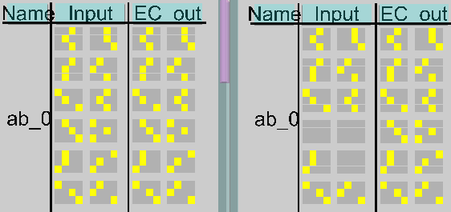
Training data
This model should enable fast learning of AB – AC lists without interference.
Autoassociation: EC_in = EC_out, invertible transformations
+ completion of B, C in association tests.
BuildNet, View_Train_Trial_Log shows statistics.
Input includes information about input and output patterns (A-B or A-C) and the context (which list is used for training).
Input consists of 2x6 groups of activations: context is in the upper half, left lower 3 elements code A concept, upper B;
for test B is empty. Next B is replaced by C.

Slide 10
Exploration of the hippo model
BuildNet, View_Train_Trial_Log shows statistics.
TrainInit, Step: shows (A,B,Cont), activation flow from
EC_in ⇒ DG ⇒ CA3 ⇒ CA1, sparse rep. in CA3 associates CA1 ⇒ EC_out.
Units selected in previous step have white borders, they are mainly in the EC_in, CA1, less in CA3 and nothing in DG.
Training epoch: after 10 elements + 3 test sets: AB, AC, new “lure items” are presented to see how unknown inputs will be treated. 1-3 epochs!
train step prog = LeabraEpoch, Step first raining than test.
TrialTestOutputData has 10 rows for each AB, AC, new + sum of results; stim_err_on = % wrong activations on output B; stim_err_off = % wrongly non-activated fro B; threshold is ~1/3 to assume rmbr=1, or remembered;
Sum: from top lure, ab, ac, in ab not more than 1 error.
Chaing to train ac, then test shows 0.9 and 0.8 for both lists, 0 for lure.

Slide 11
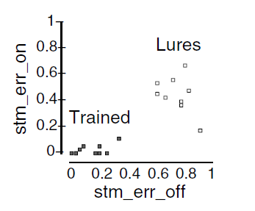
Further exploration
Targ in Network shows which pattern is used for training, act ⬄ targ
In TextLog:
stim_er_on = fraction of units that should not be active in EC_out but are,
stim_er_off = fraction of units that should be active EC_out, but are not.
In Trial_1_GraphLog after each test you can see
to numbers, small for known patterns, recalled
in a correct way, while they are big for unknown
paterns, with on ~0,5, off ~0.8.
Confabulation (phantasy recall) is rare.
Change the list to AC: turn off Test_updt = Trial_updt (or no_updt)
and do StepTest until in text_log the value epc_ctrl is 1, signifying events from the AC list: they are not recognized yet (rmbr=0) as the network has not learned them so far.
Train_Epcs=5, train_env=Train_AC, Run and check results.

Slide 12
Active short term memory
Short term priming: attention and shorter reaction times.
Except for short time memory content and effects resulting from stimulus similarity are similar to the long term priming.
Project act_priming.proj.
Stem completion or homophony, but without training, just residual activations.
Network is trained on associations of i_a=i_b with o_a and o_b.
Test has a series of patterns and outputs A and B, when show A at the input,
the network should respond with A; after presenting pattern B, with only feedforward information transmitted, the network will respond sometimes with A, and sometimes with B, so the statistics of A/B answers may be estimated.
Correlations of previous A - B answers depend on the time of activation decay;
if act_decay 1 => 0 activation does not immediately vanish and there is a bias towards A left, and if the decay is fast there will be random change.
Test_log contains information that will show it.

Slide 13
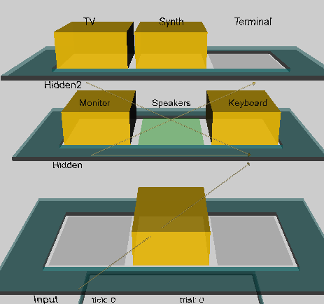
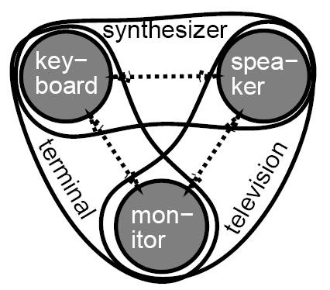
Memory maintenance model
Project act_maint.proj.
3 objects, 3 elements (features).
We want to compare various situations observing the network after presentation of input stimuli: can it still remember if the input vanishes? Does it have imagery or inner life?
There are 3 networks here: distributed, with input and output and lateral connections between elements in each layer; network with additional hidden layer, and network with isolated representations.

Slide 14
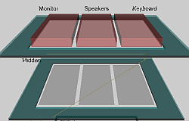
Active maintenance
DistributedNet: interactions between hidden units.
3 objects, 3 features.
If there is an input signal there is activation, but without it
activation vanishes.
CycleOutputData shows all attempts.
Check the effect of weight mean value wt_mean =0.5 parameter, and
wt_var = 0.1, 0.25, 0.4 (weight variance) keeps activation longer but it seems to be random, rarely stays in correct units … there is no attractors in such network.
Net_Type Higher_order – combination of the pairs of features allows to create attractors (monitor, spekaer) ⬄ TV, a self-maintaining feedback loop.
Even a small noise_var=0.01 will destroy it, the state is forgotten.
Weaker recurrent connections will lead to faster forgetting, but making them stronger does not help – strong attractors are needed, and they have to be based on isolated units with positive internal feedback.

Slide 15
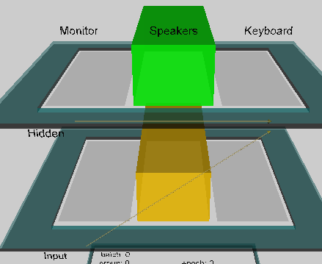
Isolated representations
“Default” returns to standard parameters.
Net_type = isolated
No connections between hidden units, but there is recurrence, activations is maintained.
Noise = 0.01 is still acceptable, but at 0.02 level may destroy the memory.
Try to focus despite the noise; in fact crossmodal stochastic resonance may have positive influence.
Other task for WM: is the input S(t+2) = S(t)?
Parameters: env_type = Maint_updt,
net Isolated, noise level 0.01
Grid_log, Run: there are two inputs, Input 1 i 2,
wt_scale 1=>2, changes the strength of local feedback; allows to switch the network from fast updating to stable maintenance.
Hos is it done in nature and how to do it in the model?
Dopamine and dynamical regulation of reward in PFC.

Slide 16
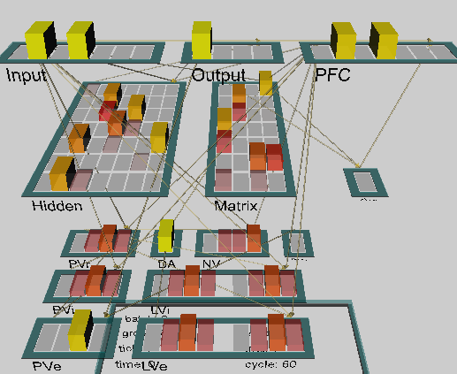
Working memory project
Project pfc_maint_updt.proj
WM requires dynamical gate added to recurrent network and learning based on temporal differences (TD).
Matrix=matrisomes in dorsal straitum; cells called Go/NoGo
SNrThal – gating signal from the basal ganglia, through the matrix.
PV* - reward, LV* - anticipation
Ignore, Store, Recall signals decide what to do with input, randomized.
PFC is the working memory, and adaptive critic represents biological reward system (using dopamine), it controls refreshing of information in the PFC, hidden layer represents the parietal cortex, second hidden layer (matrix) maps to the PFC cortex. AC learns to anticipate future reward, modulating internal strenght of feedback in PFC – are you ready to forget?

Slide 17
PFC model
r.wt: see all connections between inputs, hidden layers and PFC.
Store, Recall, Ignore signals appear in random orther;
A, B, C, D – items to be remembered in WM.
If SNrThal is active then S is memorized in PFC.
If SNrThal is not active (NoGo dominates in matrix), then PFC stores the information.
SNrThal <= Matrix Go/NoGo <=dopamine from PV-LV, that helps to learn what to remember and how to control PFC.

Slide 18
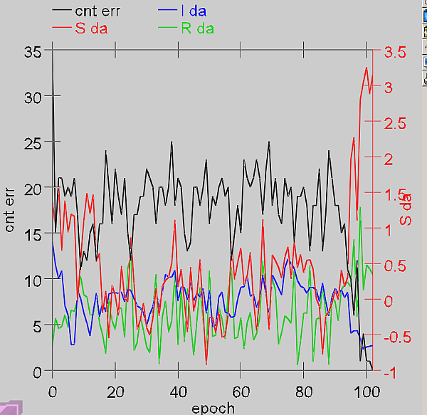
PFC model results
Graphs of EpochOutputData:
cnt_err (black): the number of errors/epoch(100 trials), mostly Recall errors.
S_da (red): average amount of dopamine in the Store, initially it is decreasing (PV/LV releases a lot of dopamine for new stimuli), later it increases when the system starts to work correctly and the number of errors goes down.
I_da (blue): amount of dopamine for Ignore foes to 0, there is no reward.
R_da (green): dopamine in the Recall trials, large fluctuations, shows difference between anticipation and reality.

Slide 19
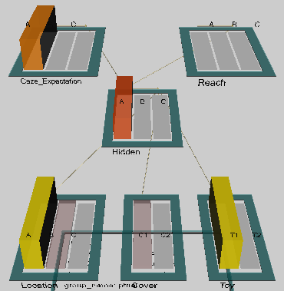
A-not B project
A simple model of decision process: information about place and objects is separated in the dorsal and ventral input streams, so this information is given as input: place A, B, C, two kinds of toys T1 or T2 and a lid C1 or C2.
Synaptic memory is trained using standard conditional Hebbian (CPCA) learning, active memory is maintained by lateral connections in the hidden layer.
Output layers: gaze expectation and reach direction.
Gaze direction is always active in all trials but reaching is less often, because the baby has to wait for the box to be moved closer to reach, so hidden-reach connections should not be so large as the hidden-gaze connections, and are not trained so strongly.
Project a_not_b.proj.
Initial bias: gaze and reach direction towards A (weight 0.7). All inputs are connected to the hidden layers with weights=0.3.

Slide 20
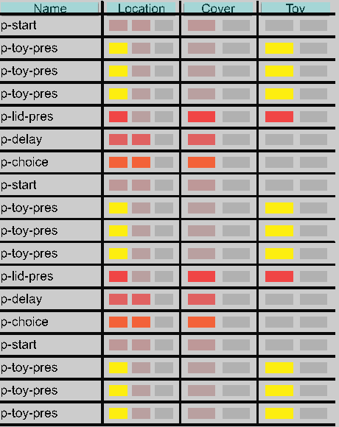
Experiment 1
rect_ws =0.3 determins the strenght of recurrent activations in the hidden layer (working memory), change of this parameter is correlated with the age of the baby.
View Events: 3 kinds of events, initial show 4x, them presentation of A 2x, and B 1 x.
Event has 4 time segments:
1) start, pretrial – boxes are covered;
2) presentation, hiding toy in A; lid on A
3) delay – toy in A;
4) reaching choice.
RecurrentCons wts mean controls recurrent connections, or persistence of WM;
0.6 should be sufficient to avoid errors.
ABInput_Delay5 simulates longer break, errors may arrive again.

Slide 21
More experiments
Activity in the hidden layer spreads towards representation associated with A.
rect_ws 0.3 => 0.75 for older child.
Although synaptic memory did not change better working memory enables correct actions.
Try also rect_ws = 0.47 and 0.50.
What happens? There is no action – perhaps hesitation?
Results depend also on the delay time, fro short delay there are less errors.
Try Delay 3=>1 and test it for rect_ws = 0.47 and 0.50.
What happens for a very young baby?
rect_ws = 0.15, delay = 3;
Weak recurrence, weak learning even for A.

Slide 22
Q7.1
Please answer these questions given here for each unit.
Development and Interaction of Memory Systems: The A-not-B Task
Question 9.13
(a) Describe what happens to the network's internal representations and output (gaze, reach) responses over the delay and choice trials. You should observe the network making the A-not-B error.
(b) Explain why the network is performing as it is in terms of the interactions between the weights learned from prior experience on 'A' trials, and the recurrent activity within each representation.
Hint: increase the RecurrentCons wts mean parameter in the PanelTab.ControlPanel to .6 from the default of .4, and Init,
Run and then scroll the table (if needed) so as to see the B trial again.

Slide 23
Q7.2
Please answer these questions given here for each unit.
Hippocampus and the AB-AC Task
Question 9.7
(a) Report the total number of rmbr responses from your TrialTestOutputData for the AB, AC, and Lure tests, after each epoch of training on AC.
(b) Do you find evidence of any interference from learning AC on the testing results for AB?
(c) Compare and contrast the performance of this hippocampus model with that of the cortical model and the human data of this same basic task from section 9.2.2 (AB-AC List Learning), paying particular attention to both interference and number of epochs necessary to learn.

Slide 24
Q7.3
Please answer these questions given here for each unit.
AB-AC Paired Associate List Learning and Interference
Question 9.2.
(a) Report the average testing statistic (mean_test_cnt_err) for a batch run of 5 simulated subjects.
(b) How do these results compare to the human data presented in figure on “Learning AB-AC lists” slide?
(c) Looking at the .T3Tab.EpochOutputDataGraph, roughly how many epochs does the network take to reach its maximum error on the AB list after the introduction of the AC list?

