Slide 1
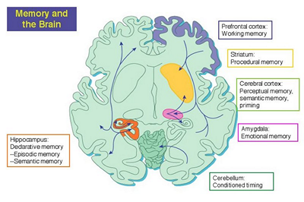
Advanced Topic in Cognitive
Neuroscience and Embodied Intelligence
Week 7
Memory
CE7427

Slide 2

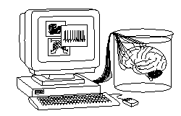
What it will be about
Memory: types, functions & neural implementation.
Memory-based cognitive architecture.
Active memory and priming
Catastrophic forgetting.
Episodic memory hippocampus model.
Short-term memory.
Working memory.
Synaptic-dynamic memory interactions.
Semantic memory.

Slide 3
What is memory?
Any external or internal activity may leave a trace changing the brain and influence behavior; such traces are memories, impressions of brain activations formed through neuroplasticity in the substrate of the brain.
There is no separate memory subsystem, it is rather the ability to change, memory cannot be separated from other functions.
Division by senses: visual, auditory, tactile, olfactory, taste, motor.
By functions: spatial, object, recognition, episodic, semantic, procedural vs. declarative, or implicit vs. explicit, associative, working memory.
By time: buffer memory (very short), short, middle, long term
Mechanisms: passive memory based on synaptic plasticity (long term), active dynamic memory based on priming on short or longer time scales.
Semantic and procedural memory result from slow “digesting” of many processes, internal and external.

Slide 4
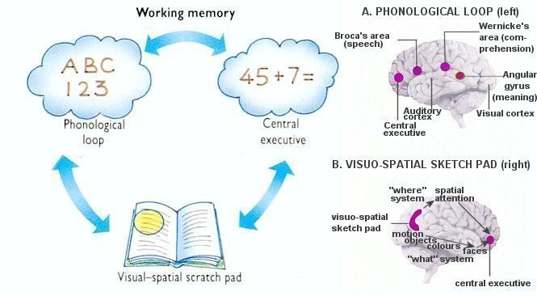
Working and ST Memory
Basic subdivisions.

Slide 5
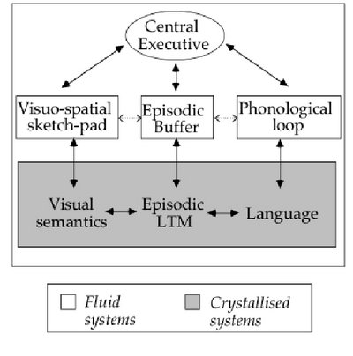
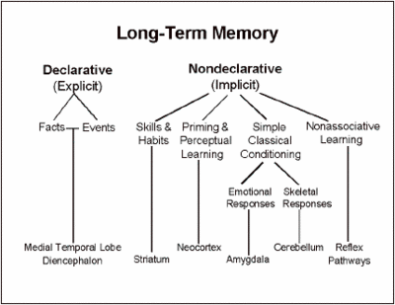
Working and LT Memory
Basic subdivisions.

Slide 6
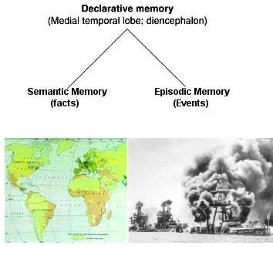
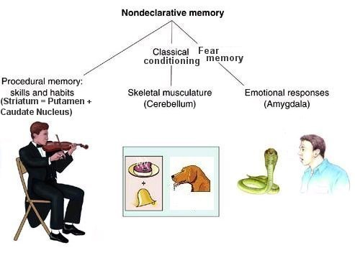
Non-declarative and declarative
Semantic & episodic vs. procedural and conditioning memory.

Slide 7
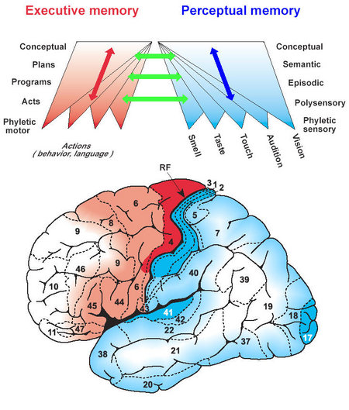
Executive/perceptual memory
Another functional division: action and perception or executive/perceptual memory, roughly frontal/posterior brain areas.

Slide 8
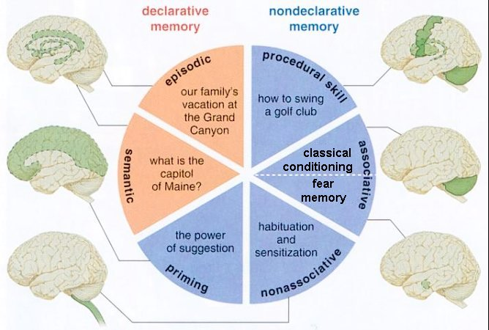
Memory types
Declarative-nondeclarative subdivisions.

Slide 9
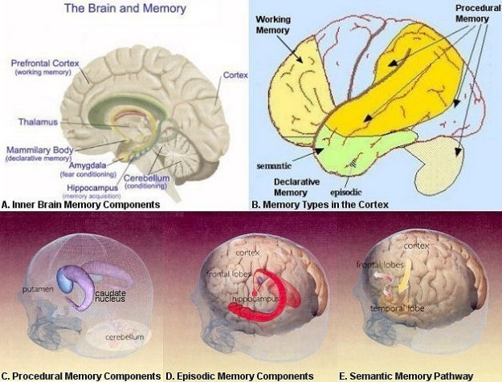
Memory in the brain

Slide 10

Memory in the brain
Emotional memory: see Joseph LeDoux lab and books.

Slide 11
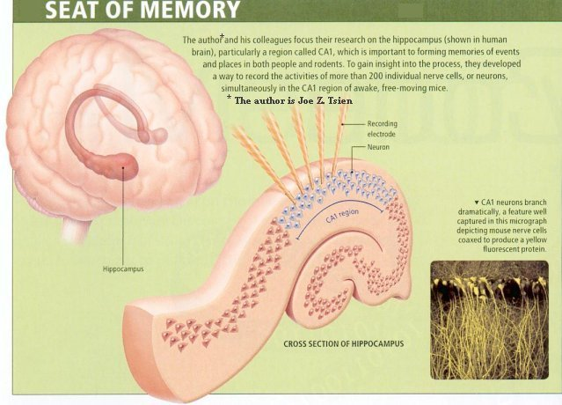
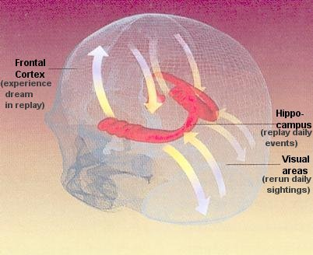
Spatial memory
Hippocampus plays a major role in memory consolidation and in spatial memory required for orientation.

Slide 12
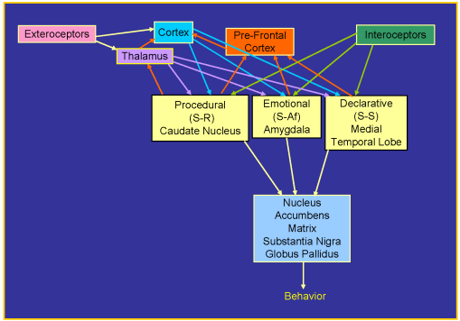
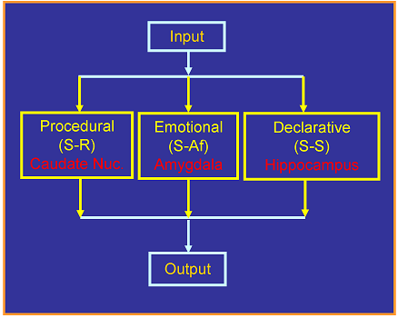
Memory interactions

Slide 13
Controlled/automatic action
Automatic: routine, simple, low level, sensory-motor, conditional reflexes, associations – easy to model with a network (but emotional memory and phobias have not been modeled).
Controlled: conscious, elastic, requiring sequences of actions, selection of elements from a large set of possibilities – usually realized in a descriptive way with the help of systems of rules and symbols.
Models postulating central processes: like in a computer, working memory with a central monitor, having influence over many areas.
Here: emergent processes, the result of global constraint fulfillment, lack of a central mechanism.
The prefrontal cortex can exert control over the activity of other areas, so it's involved in controlled actions, including the representation of "me" vs. "others", social relationships etc.

Slide 14
Other distinctions – consciousness role
Declarative vs. procedural knowledge
Declarative: often expressed symbolically (words, gestures). Procedural: more oriented towards sequences of actions.
Explicit vs. implicit knowledge
Controlled action relies on explicit and declarative knowledge.
Automatic actions rely on implicit and procedural knowledge.
Consciousness => states existing for a noticeable period of time, integrating reportable sensory information about different modalities, with an influence on other processes in the brain.
Each system, which has internal states and is complex enough to comment on them, will claim that it's conscious.
Processes in the prefrontal cortex and the hippocampus can be recalled as a brain state or an episode, can be interpreted (associated with concept representation).

Slide 15
What it will be about
Memory: types, functions & neural implementation.
Memory-based cognitive architecture.
Active memory and priming
Catastrophic forgetting.
Episodic memory hippocampus model.
Short-term memory.
Working memory.
Synaptic-dynamic memory interactions.
Semantic memory.

Slide 16
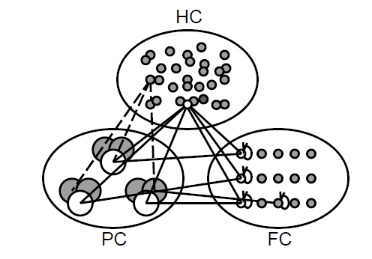
3 main memory subsystems
Posterior cortex (PC): includes
rear parietal cortex and motor cortex; sensorymotor actions, specialization, distributed representations.
Frontal cortex FC – prefrontal cortex, higher cognitive behaviors, isolated representations.
Hippocampus HC – hippocampus and related structures, memory, rapid learning, sparse representations.
These are 3 main regions but more are needed to implement other types of memory: recognition, procedural, semantic.

Slide 17
Why 3 subsystems?
Stability-plasticity dilemma!
Learning must be slow in order to grasp statistically important relationships, and to precisely analyze sensory data and control motions, but we also need a mechanism for rapid learning.
Compromise: slow learning in the cortex – stable world view - and rapid learning in the hippocampus – new important facts quickly memorized.
Retaining active information and simultaneously accepting new information in a distributed system, avoiding interference.
Ex. Penguins are birds, but cannot fly! Do not change the typical bird category.

Slide 18
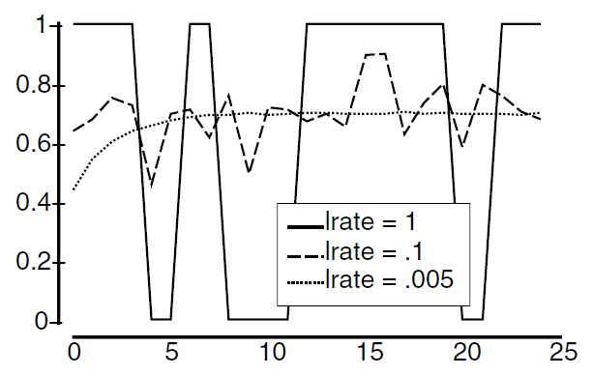
Slow/rapid learning
A neuron learns conditional
probability, the correlation
between desired activity and
input signals; the optimal value
of 0.7 is reached quickly only
with a small learning constant
of 0.005
Every experience is a small
fragment of uncertain,
potentially useful knowledge about the world => stability of one's image of the world requires slow learning, integration leads to forgetting individual events.
We may learn important new information after one exposure.
Lesions of the hippocampus trigger follow-up amnesia.
The system of neuromodulation reaches a compromise between stability and plasticity.

Slide 19
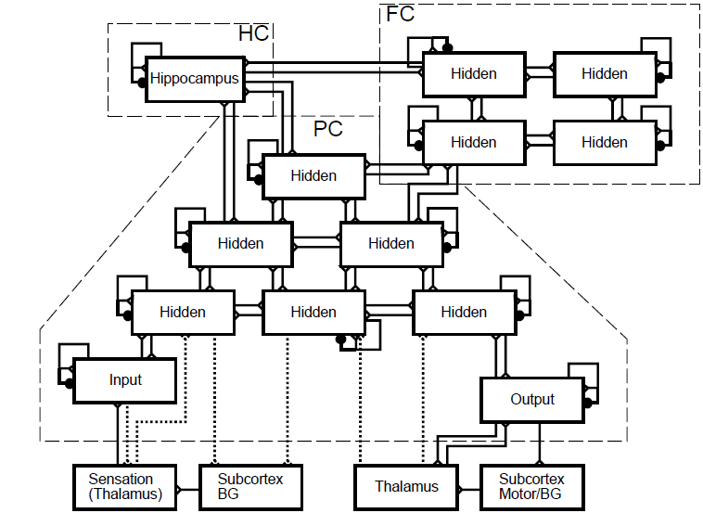
Cognitive architecture
Hierarchical structure for processing of sensory data:
recurrence in FC facilitates recording the context.

Slide 20
PC/FC/HC roles
Parietal cortex: learns slowly, creates extensive, overlapping representations in a densely connected network.
Dynamic PC states are short-term memory, mainly of spatial relations, quickly yielding to disorder and disintegration.
Frontal cortex: learns slowly, stores isolated representations, activation of memory is more stable, the reward mechanism dynamically switches its activity, allowing a longer active memory.
The hippocampus learns quickly, creating sparse representations, differentiating even similar events.
This simplified architecture will allow the modeling of many phenomena relevant to perception, memory, using language, and the effects of the interaction of different areas.

Slide 21
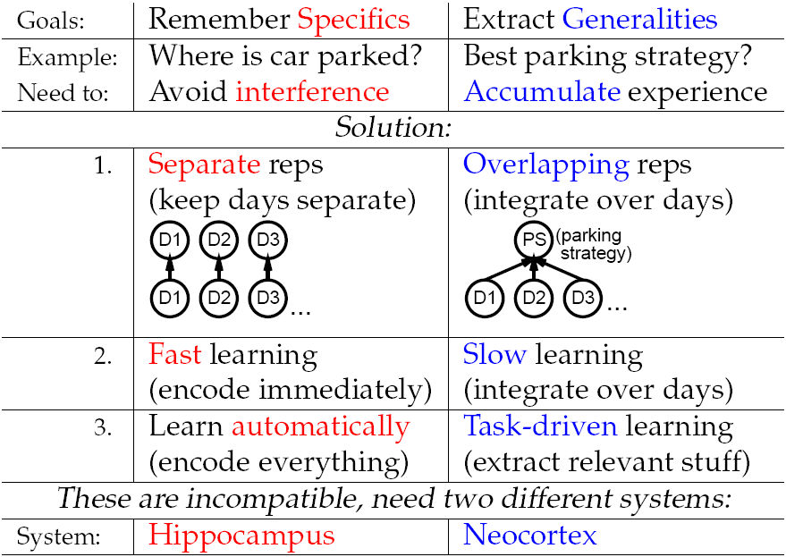
PC/FC/HC roles

Slide 22
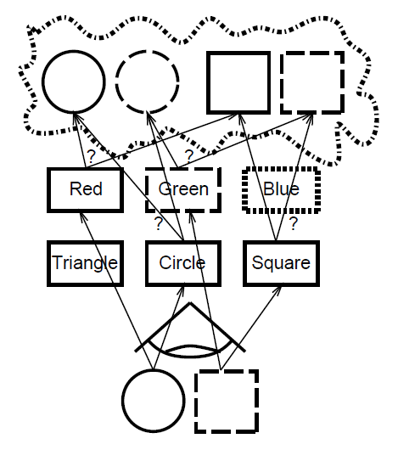
Problem of integration
Binding problem: we perceive the world as a whole, but information in the brain, after initial processing, doesn't descend anywhere.
Likely synchronization of distributed processes.
Attention is a control mechanism selecting areas which should be active in a given moment.
Encoding relevant combinations of active areas.
Simultaneous activity = dynamic synchronization, partial reconstruction of the brain state during an episode.
Integration errors happen often.

Slide 23
Other potential problems
There are easy things, for which simple models will suffice, and difficult things requiring detailed models.
Many misunderstandings: MLP neural networks are not brain models, they are only loosely inspired by a simplified look at the activity of neural networks; an adequate neural model must have appropriate architecture and rules of learning.
Example: catastrophic forgetting of associations from lists, much stronger in MLP networks than in people => appropriate architecture, allowing for two types of memory (hippocampus + cortex) doesn't have a problem with this.
Human cognition is not perfect and good models allow us to analyze the numerous compromises handled by the brain.
Brains are fairly plastic, although they mostly base their actions at short time scales on the representation of specific knowledge about the world.
Recent (Aug. 2011) news: there is a strong activity-dependent epigenetic regulation in the adult nervous system via DNA methylation.

Slide 24
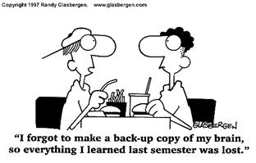
Back-up your memory!

Slide 25
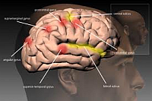
What it will be about
Memory: types, functions & neural implementation.
Memory-based cognitive architecture.
Active memory and priming
Catastrophic forgetting.
Episodic memory hippocampus model.
Short-term memory.
Working memory.
Synaptic-dynamic memory interactions.
Semantic memory.

Slide 26
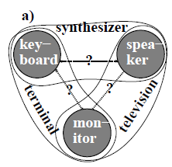
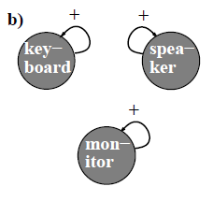
Active memory
Distributed overlapping representations in the PC can efficiently record information about the world, including associations (Fig. a), but...
too many associations and connections decreases the possibility of precise discovery of information,
it can also blur it with the passage of time.
FC – prefrontal cortex, stores isolated representations; greater memory stability (Fig. b).
Inhibition => active memory must be selective, in effect focusing attention, priming for fast action.
Attention is not a result of the activity of separate mechanisms connected with the will, it's an emergent process resulting from the necessity of fulfilling many constraints simultaneously, and estimation of saliency.
Many types of priming are possible:
short (activation based) – long (synaptic based),
sensory – lexical, association – repetition.

Slide 27
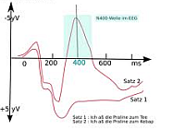
Semantic priming
Typical experiments: one to many mapping in stem completion task.
After studying the list of words a list of stems is given to participants, ex. rea---, and they have to fill missing part. If the word list contained “reason” it is usually selected (there are at least 17 possibilities, can you find another one?).
In semantic priming effects are seen even after one hour so it cannot be only active process, it has to involve synaptic changes.
Homophones have the same phonology, different spelling, like: read, reed.
If reed instruments are mentioned people tend to spell r-e-e-d.
Short-time semantic priming completes missing information. Ex, sentence:
It was found that the ...eel is on the (orange, wagon, shoe, meal)
is heard as: "peel is on the orange", or "wheel is on the wagon",
or "heel is on the shoe“, or "meal is on the table".
Noise before … eel is changed into p, wh, h or m, back in time!

Slide 28
Alternatives
reason
reacts
readds
reagan
realer
really
realms
realty
reamed
reamer
reaped
reaper
reared
rearer
reaved
reaver
reaves
reavow

Slide 29
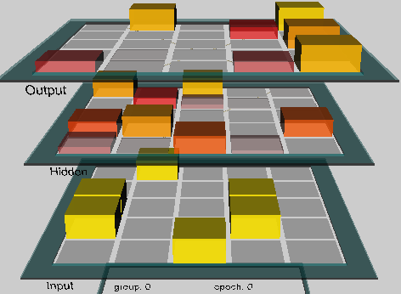
Model of priming
Project wt_priming.proj, chapter 9, simulates one-to-many mapping paradigm by learning to associate 2 different output patterns with a given input pattern.
Small weight changes => preferences for different answers.
Is a single presentation of input pattern sufficient to bias answer based on a long term memory implemented in parietal cortex synaptic connections?
Associations are of A-B, A-C types, for example homophones, although no specific presentation is assumed here.
Network: 3 layers 5x5 each.
Learning: associate A-B₀, A-B₁
After training the network prompted with patter A replies B₀ or B₁ about the same number of times; additional presentation will change it.

Slide 30
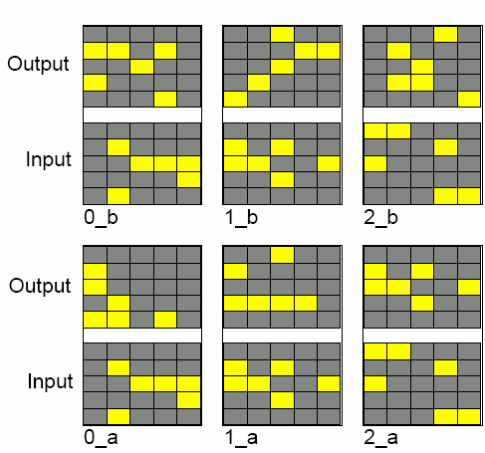
Priming 1
View Events: events have the same input patterns i_a=i_b, but different outputs
i_a, i_b, for i = 0..12.
In total 13 pairs x 2 outputs
= 26 pairs i_a – i_b.
Leaning: Leabra needs about 45 epochs.
Why it can learn it? BP will blend the two outputs, but a combination of kWTA + Hebb + CHL is able to learn it.
A small noise (random activations) added to the membrane potential is added to break impasses, decreasing the stability of memorized pattern associations.
After training the network selects one of the two answers randomly.

Slide 31
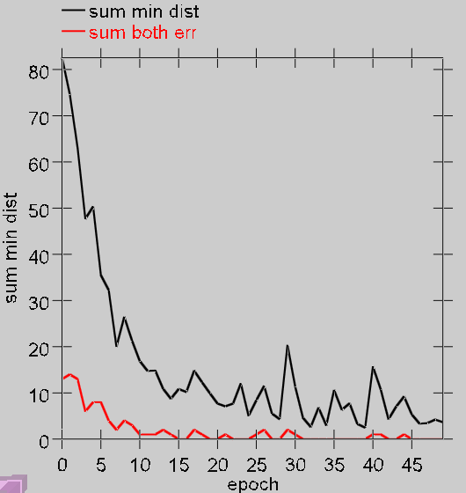
More on the priming model
Evaluation of the training results:
Check the minimal distance to the closest pattern, sum this over all 13 patterns (black line, sum min dist). Decreasing distance shows convergence.
Error=0 if one of the two possible outputs is selected, 1 if another one is selected (red line, sum both err), reaches zero before the distance is zero.
Test_logs: check if there are some biases already, then check if there is any bias after a pair (i_a, i_b) has been presented.

Slide 32
What it will be about
Memory: types, functions & neural implementation.
Memory-based cognitive architecture.
Active memory and priming
Catastrophic forgetting.
Episodic memory hippocampus model.
Short-term memory.
Working memory.
Synaptic-dynamic memory interactions.
Semantic memory.

Slide 33
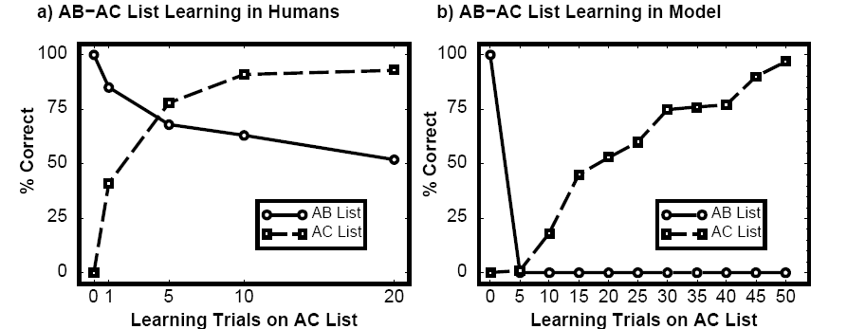
Learning AB-AC lists
People can remember two different associations lists, A-B, and A-C, ex.
wind-mind
bike-trash
....
a potem:
wind-train
bike-cloud
In real psychological tests interference is gradual and relatively small, AB and AC list are recalled. Networks trained with error correction only will exhibit catastrophic forgetting of the first list after exposition to the second list!
Interference results from attempt to use the same connection weights to learn different associations – use context unit to distinguish them.

Slide 34
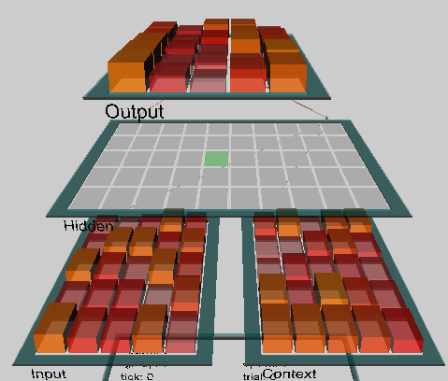
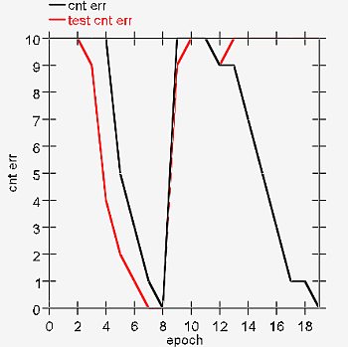
AB-AC Model
Project ab_ac_interference.proj, chap. 9
View Events_AB, Events_AC,
Output: B or C, but the context variable
= list 1 or list 2 helps to remember.
Context = change of 1 or 2 patterns.
Catastrophic forgetting:
Results: EpochOutputDataGraph,
black line = errors during AB/AC training,
red line = test on AB list after each epoch.
10 patterns, batch will repeat it 5 times.
This test shows that after learning AC (8 epochs) the network has completely forgotten associations AB, because many hidden units take part in learning of both lists.

Slide 35
AB-AC Model
BatchOutputData shows, that when AB list has been learned and AC is being learned the number of errors goes to 10 each time, everything is forgotten.
Can one learn both lists?
Perhaps less hidden units should be active at the same time?
Changing hid_kwta 12=>4 does not help, still there is catastrophic forgetting.
Changing variance of initial values wt_var 0.25=>0.4
Stronger influence of contex fm_context 1=>1.5
Stronger Hebbian learning hebb 0.01=>0.05
Slower learning, decreasing learning rate lrate => 0.1, Batch
Although the catastrophe may be a bit weaker it does not work …
Clearly another system is needed for fast learning:
one fast and one slow, and this is based on the cortex and hippocampus.

Slide 36
What it will be about
Memory: types, functions & neural implementation.
Memory-based cognitive architecture.
Active memory and priming
Catastrophic forgetting.
Episodic memory hippocampus model.
Short-term memory.
Working memory.
Synaptic-dynamic memory interactions.
Semantic memory.

Slide 37
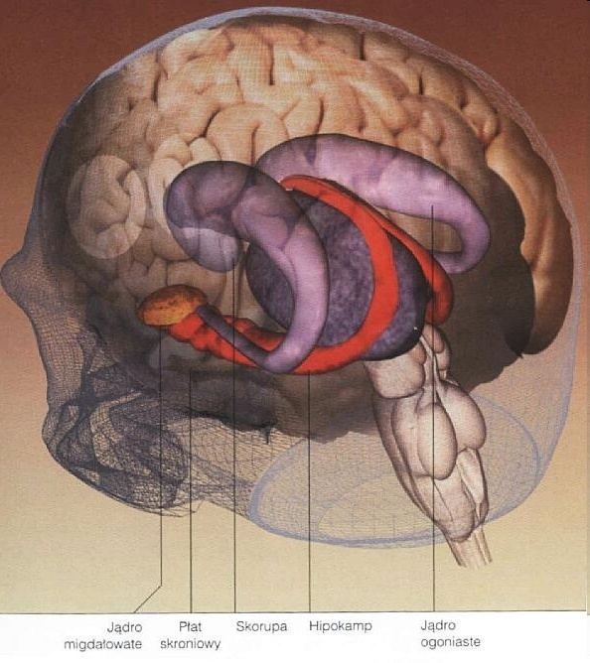
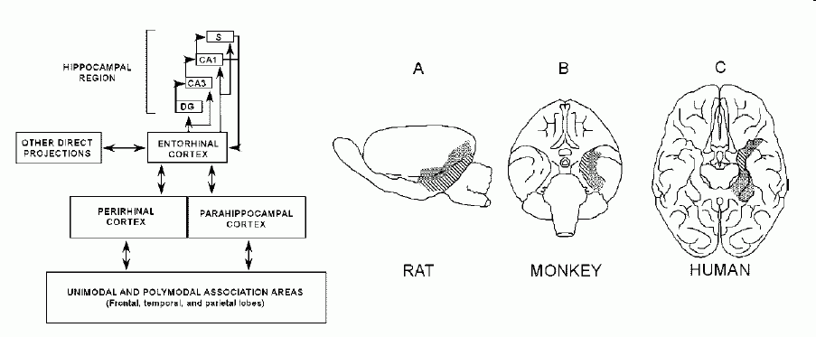
Hippocampus
Hippocampus formation anatomy and connectivity: signals reach many uni- and multi-modal association areas through the entorhinal cortex (EC) and perirhinal and parahippocampal cortex.

Slide 38
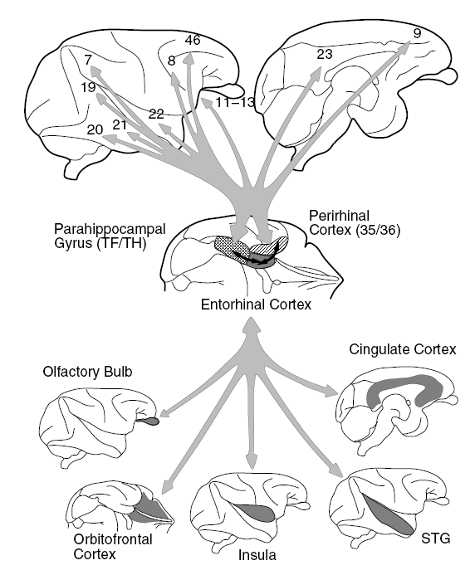
More anatomy
Through the entorhinal cortex hippocampus has
bidirectional connections with
5 major structures.
It receives and sends projections to many Broadmann areas.

Slide 39
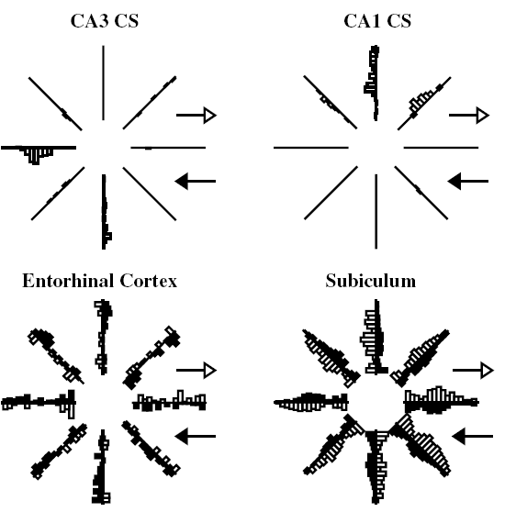
More anatomy
Fig. shows activity of neurons in hippocampus and parahipocampal regions when a rat moves in a maze in different directions.
CA3 and CA1 contains representations that are focused on specific stimuli.
In parahippocampal regions representations are strongly distributed.

Slide 40
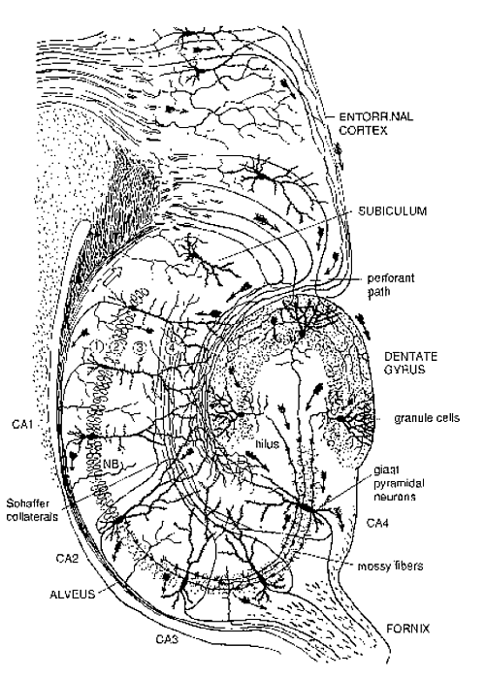
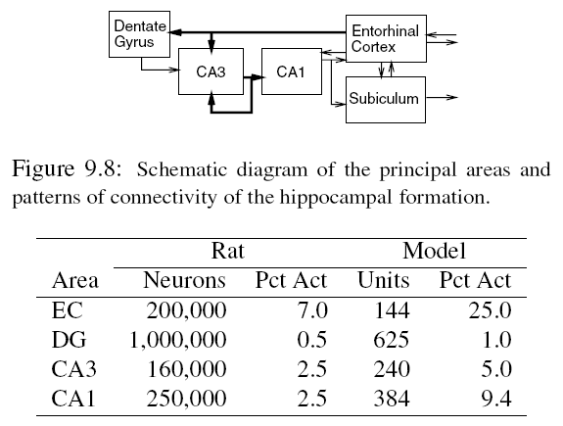
Hippocampal formation
Memory model includes:
Dentate Gyrus (DG),
CA1 and CA3 areas,
Entorhinal Cortex (EC).
Pct Act = % of active neurons (inhibition).

Slide 41
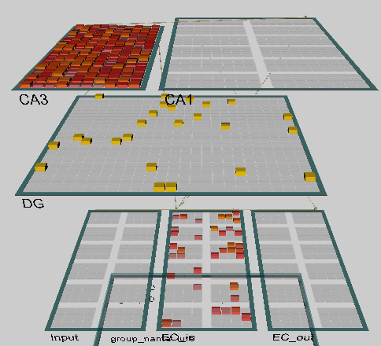
Hippocampus model
Project hip.proj, chap. 9
Input signals pass through the EC_in (entorhinal input), to the DG (dentate gyrus) and to CA3 part of hippocampus.
DG has also influence on CA3, with sparse representations, that allow for clear discrimination of input signals.
CA3 has strong recurrent connections.
CA1 has more distributed representations with output to => EC_out.
EC: 144 el = 4*36; all 1/4 gets activated.
DG: 625 el, CA3: 240 el
CA1: 384 el = 12 kol * 32 el
CA3 discriminates, in CA1 columns conjunctions of features from 3 EC columns

Slide 42
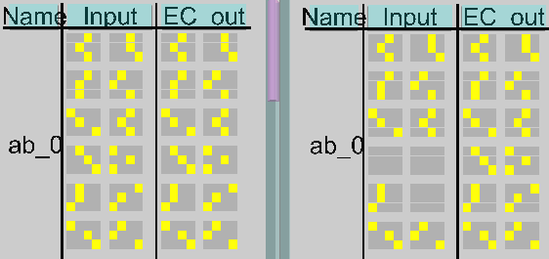
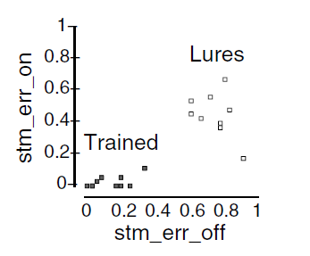
Training data
This model should enable fast learning of AB – AC lists without interference.
Autoassociation: EC_in = EC_out, invertible transformations
+ completion of B, C in association tests.
BuildNet, View_Train_Trial_Log shows statistics.
Input includes information about input and output patterns (A-B or A-C) and the context (which list is used for training).
Input consists of 2x6 groups of activations: context is in the upper half, left lower 3 elements code A concept, upper B; for test B is empty. Next B is replaced by C. Confabulation (phantasy recall) is rare, lures are not recognized.

Slide 43
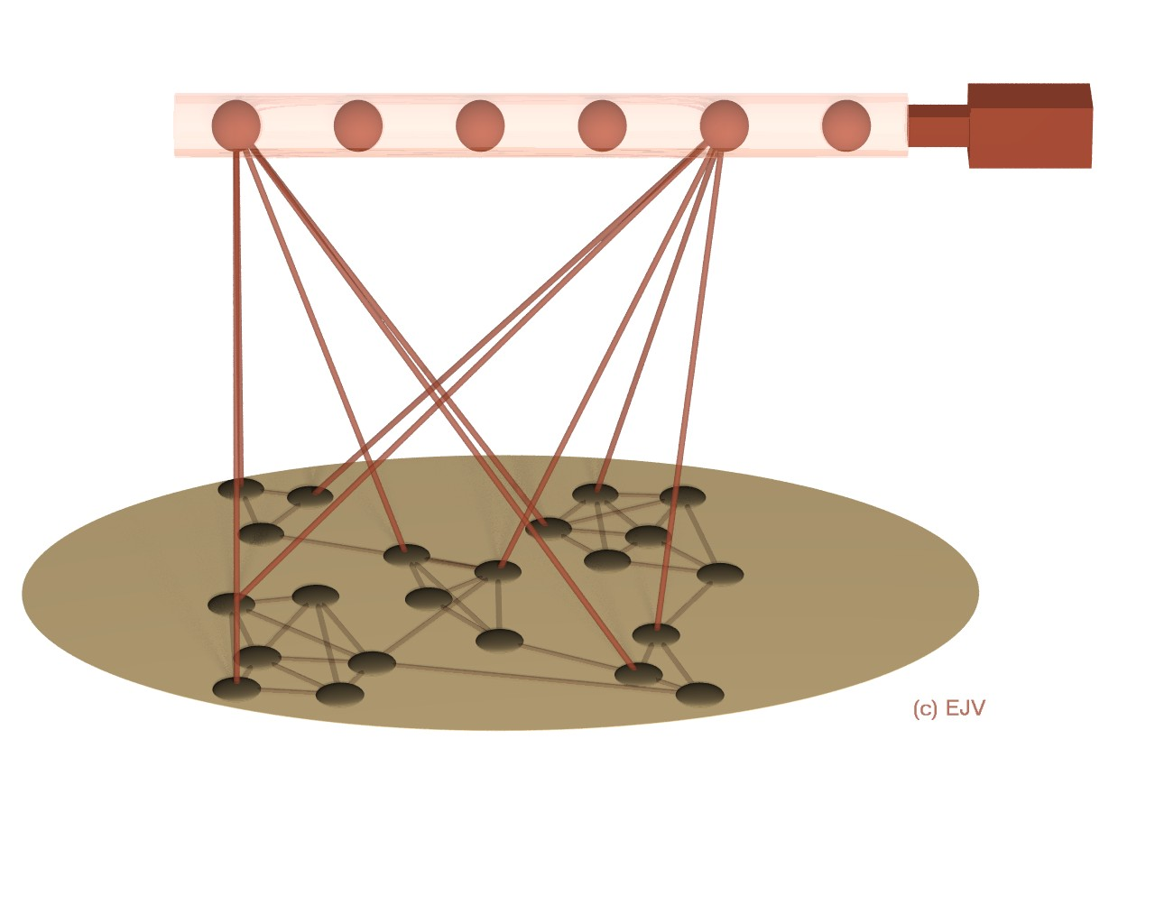
Trace-link model (J. Murre)
Link system (hippocampus)
Neuromodulation
Trace system
(neocortex)
Hippocampus may recreate activation of the cortex => episodic memory.
Brain stem and emotion-related areas (nucleus accumbens, amygdala) provide increase plasticity. This model explains many features of amnesia.

Slide 44
Summary
Hippocampus model may learn fast, learn AB – AC associations sequentially without strong interference, using only constructive Hebbian rule, conditional PCA and appropriate architecture.
Interference results from using the same units, in CA3 area separation of the same inputs is possible because they are used for training in another context. Learning similar things use different context!
Pattern separation makes associations and similarity-based reasoning difficult, and this is needed for efficient coding of high-dimensional information.
It does not seem to be possible to handle in one system very different requirements. This suggests a complementary role for hippocampus, allowing for enhancement of slow synaptic learning in the cortex.
Hippocampus may remember episodes that help in spatial orientation, create conjunctive representations combining together various stimuli faster than the cortex is able to do.
Hippocampus itself is too small to provide permanent memory storage at a longer time scales – it may only point to cortex, recreating its activation.

Slide 45
What it will be about
Memory: types, functions & neural implementation.
Memory-based cognitive architecture.
Active memory and priming
Catastrophic forgetting.
Episodic memory hippocampus model.
Short-term memory.
Working memory.
Synaptic-dynamic memory interactions.
Semantic memory.

Slide 46
Short-term memory
Several papers show now that internal changes in neurons may decrease or increase the activation threshold for some time, facilitating synchronization of subnetworks responsible for short term memory.
Fast synaptic changes are not necessary, neurons in the prefrontal cortex (PFC) may be highly active during gaps between stimuli and activity that follows later. Depolarization of these neurons results from internal changes resulting from bursts of neural activity, without the need for recurrent activation.
Depolarization may be the result of dopamine D1 receptor stimulation
(a whole family of receptors).
Important discoveries:
Sidiropoulou, et al, Dopamine modulates an mGluR5-mediated depolarization underlying prefrontal persistent activity.
Nature Neuroscience 26.01.2009
Erickson, Maramara, Lisman, A Single Brief Burst Induces GluR1-dependent Associative Short-term Potentiation: A Potential Mechanism for Short-term Memory. J Cognitive Neuroscience 22, 2530-2540, 2010

Slide 47
Active short term memory
Short term priming: attention and shorter reaction times.
Except for short time memory content and effects resulting from stimulus similarity are similar to the long term priming.
Project act_priming.proj.
Stem completion or homophony, but without training, just residual activations.
Network is trained on associations of i_a=i_b with o_a and o_b.
Test has a series of patterns and outputs A and B, when show A at the input,
the network should respond with A; after presenting pattern B, with only feedforward information transmitted, the network will respond sometimes with A, and sometimes with B, so the statistics of A/B answers may be estimated.
Correlations of previous A - B answers depend on the time of activation decay;
if act_decay 1 => 0 activation does not immediately vanish and there is a bias towards A left, and if the decay is fast there will be random change.
Test_log contains information that will show it.

Slide 48
Active memory maintenance
Project act_maint.proj: active maintenance of information in working memory for a short time is possible regardless of distractions, providing fast access without the need for synaptic changes.
Requires recurrent network with large basin of attraction, stable despite noise.
Analysis of incoming perception is continuously controlled by the incoming data so this type of processing is not required.
Neural activation should spread quickly facilitating associations and reasoning. This is sufficient as long as there is constant external input, for example is intermediate results are written on paper or activity results are experienced.
Without external activation we have to rely on actively maintained representations in working memory, and the capacity of working memory has serious limitations, 7±2 objects (G. Miller 1956), or only 4±2 for complex objects.
Simulations: first memory without attractors that requires external signals, then distributed representations but shallow attractors, sensitive to noise; finally deep but localized attractors that prevent making associations.
Stability-plasticity dilemma here becomes precision-association.

Slide 49
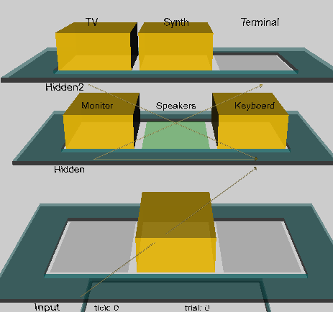
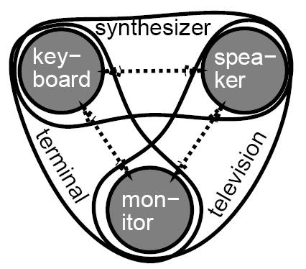
Memory maintenance model
Project act_maint.proj.
3 objects, 3 elements (features).
We want to compare various situations observing the network after presentation of input stimuli: can it still remember if the input vanishes? Does it have imagery or inner life?
There are 3 networks here: distributed, with input and output and lateral connections between elements in each layer; network with additional hidden layer, and network with isolated representations.

Slide 50
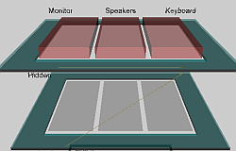
Active maintenance
DistributedNet: interactions between hidden units.
3 objects, 3 features.
If there is an input signal there is activation, but without it
activation vanishes.
CycleOutputData shows all attempts.
Check the effect of weight mean value wt_mean =0.5 parameter, and
wt_var = 0.1, 0.25, 0.4 (weight variance) keeps activation longer but it seems to be random, rarely stays in correct units … there is no attractors in such network.
Net_Type Higher_order – combination of the pairs of features allows to create attractors (monitor, spekaer) ⬄ TV, a self-maintaining feedback loop.
Even a small noise_var=0.01 will destroy it, the state is forgotten.
Weaker recurrent connections will lead to faster forgetting, but making them stronger does not help – strong attractors are needed, and they have to be based on isolated units with positive internal feedback.

Slide 51
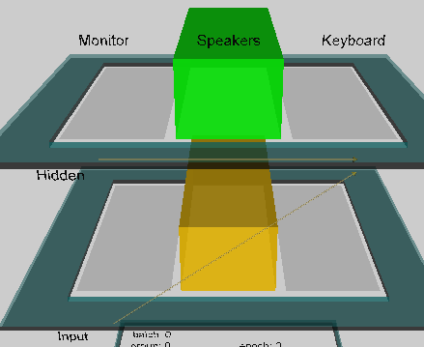
Isolated representations
“Default” returns to standard parameters.
Net_type = isolated
No connections between hidden units, but there is recurrence, activations is maintained.
Noise = 0.01 is still acceptable, but at 0.02 level may destroy the memory.
Try to focus despite the noise; in fact crossmodal stochastic resonance may have positive influence.
Other task for WM: is the input S(t+2) = S(t)?
Parameters: env_type = Maint_updt,
net Isolated, noise level 0.01
Grid_log, Run: there are two inputs, Input 1 i 2,
wt_scale 1=>2, changes the strength of local feedback; allows to switch the network from fast updating to stable maintenance.
Hos is it done in nature and how to do it in the model?
Dopamine and dynamical regulation of reward in PFC.

Slide 52
What it will be about
Memory: types, functions & neural implementation.
Memory-based cognitive architecture.
Active memory and priming
Catastrophic forgetting.
Episodic memory hippocampus model.
Short-term memory.
Working memory.
Synaptic-dynamic memory interactions.
Semantic memory.

Slide 53
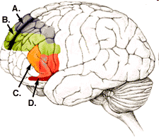
Working memory
Prefrontal cortex plays central role in maintaining active working memory and has the required properties: isolated self-activating attractor networks with broad attraction basins.
Neuroanatomy, connectivity and minicolumns in PFC predispose it to be a specialized area for active memory.
Human PFC has a number of areas that specialize in different types of WM”
A. PR – spatial relations.
B. PR – spatial for volitional, self-ordered tasks.
C. PR – spatial, objects, verbal, volitional actions and analytical thinking.
D. PR – objects, analytical thinking.
Typical experiments are done on macaques (multi-electrode direct recordings) and humans (fMRI), involve delayed choice requiring WM maintenance.
They show differences between PFC maintaining representations for a long time, and PC and IT, able to sustain activity only for a short time.

Slide 54
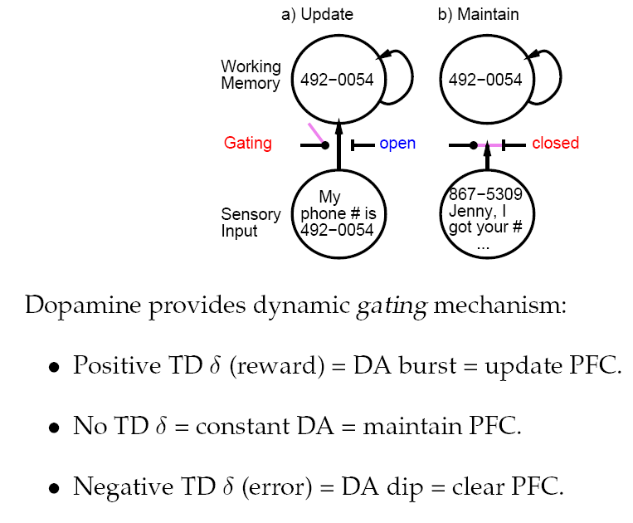
The role of dopamine
Dopamine blocking has bad influence on WM, but enhancing dopamine strengthen WM.
Dopamine in PFC come mostly from the Ventral Tegmental Areas (VTA) in midbrain.
DA amplifies the influence of external inputs, regulating access to the working memory, providing
dynamic gating.
VTA shows sudden changes of activity.
Basal ganglia have also influence on the PFC.

Slide 55
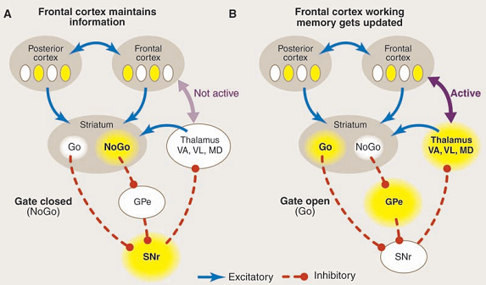
Dynamic gating
Dynamic gating idea (OReilly, R.C, Biologically Based Computational Models of High-Level Cognition. Science, 314, 91-94, 2006).
Striatum: large subcortical structure, including caudate nucleus, putamen nucleus, part of larger basal ganglia system, important for procedural memory (also cerebellum is strongly involved in procedural memory).

Slide 56
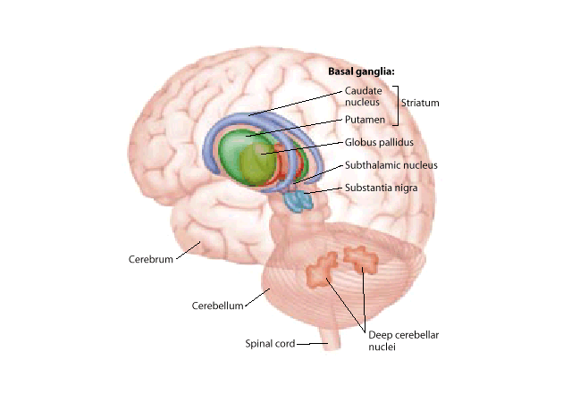
Basal Ganglia
Thalamo-striato-cortical activity loops involve basal ganglia.
Basic BG structures: GP – Globus Pallidus Putamen and Substantia Nigra

Slide 57
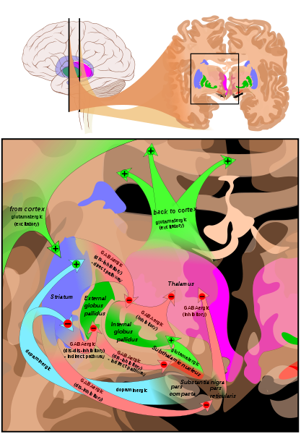
Basal ganglia circuits
From Wikipedia:
Overview of the main circuits of the basal ganglia. Striatum is shown in blue. Upper part shows coronal slices superimposed to include the involved basal ganglia structures.
+ and - signs at the point of the arrows indicate respectively whether the pathway is excitatory or inhibitory in effect. Green arrows refer to excitatory glutamatergic pathways, red arrows refer to inhibitory GABAergic pathways and turquoise arrows refer to dopaminergic pathways that are excitatory on the direct pathway and inhibitory on the indirect pathway.

Slide 58
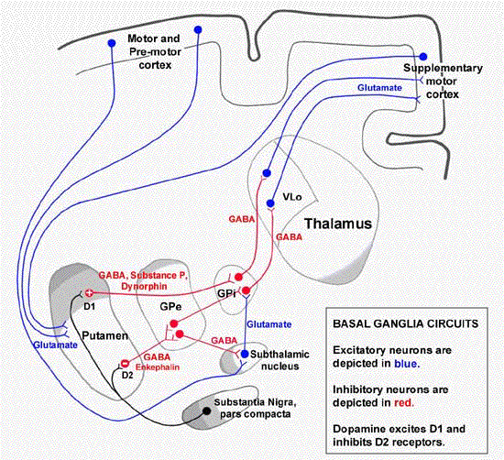
Basal ganglia loops
More detailed view of the thalamo-striato-cortical loops.
Red lines = inhibitory connections, using mostly GABA neurotransmitters.
Blue lines: excitatory connections, mostly glutaminian transmitter.
Black lines: dopamine, mostly inhibition, some excitation.
Dysfunctions of these loops lead to Parkinson, Huntington and many other disease.
Major large structures: GP – Globus Pallidus and Putamen;
deeper structure releasing dopamine: Substantia Nigra.

Slide 59

Basal ganglia loops
More detailed view of the thalamo-striato-cortical loops.
Red lines = inhibitory connections, using mostly GABA neurotransmitters.
Blue lines: excitatory connections, mostly glutaminian transmitter.
Black lines: dopamine, mostly inhibition, some excitation.
Dysfunctions of these loops lead to Parkinson, Huntington and many other disease.
Major large structures: GP – Globus Pallidus and Putamen;
+ deeper structure releasing dopamine: Substantia Nigra.

Slide 60

Working memory project
Project pfc_maint_updt.proj
WM requires dynamical gate added to recurrent network and learning based on temporal differences (TD).
Matrix=matrisomes in dorsal striatum; cells called Go/NoGo
SNrThal – gating signal from the basal ganglia, through the matrix.
PV* - reward, LV* - anticipation
Ignore, Store, Recall signals decide what to do with input, randomized.
PFC is the working memory, and adaptive critic represents biological reward system (using dopamine), it controls refreshing of information in the PFC, hidden layer represents the parietal cortex, second hidden layer (matrix) maps to the PFC cortex. AC learns to anticipate future reward, modulating internal strenght of feedback in PFC – are you ready to forget?

Slide 61
PFC model
r.wt: see all connections between inputs, hidden layers and PFC.
Store, Recall, Ignore signals appear in random orther;
A, B, C, D – items to be remembered in WM.
If SNrThal is active then S is memorized in PFC.
If SNrThal is not active (NoGo dominates in matrix), then PFC stores the information.
SNrThal <= Matrix Go/NoGo <=dopamine from PV-LV, that helps to learn what to remember and how to control PFC.

Slide 62

PFC model results
Graphs of EpochOutputData:
cnt_err (black): the number of errors/epoch(100 trials), mostly Recall errors.
S_da (red): average amount of dopamine in the Store, initially it is decreasing (PV/LV releases a lot of dopamine for new stimuli), later it increases when the system starts to work correctly and the number of errors goes down.
I_da (blue): amount of dopamine for Ignore foes to 0, there is no reward.
R_da (green): dopamine in the Recall trials, large fluctuations, shows difference between anticipation and reality.

Slide 63
What it will be about
Memory: types, functions & neural implementation.
Memory-based cognitive architecture.
Active memory and priming
Catastrophic forgetting.
Episodic memory hippocampus model.
Short-term memory.
Working memory.
Synaptic-dynamic memory interactions.
Semantic memory.

Slide 64

A-not B
Active and synaptic memory compete and interact: weights may have changed but active memory maintains old state: which one will win?
Such interactions are especially seen in the behavior of ~8 month babies (Piaget 1954), people and animals with brain lesions.
Toy or food is hidden in the box A and after a short break it is shifted towards the baby (or animal), who tries to pull it out. After a few repetition of hiding the toy in A it is put in the second place B; babies see it but still open A.
Active memory does not work in babies as well as synaptic memory that is adding 1-2 million new connections every second!
PFC lesions in adult humans and in monkeys lead to similar effects.
Less errors are made by babies in the gaze direction than in the reaching direction.
The A-not B phenomenon has been experimentally investigated with many variants of experiments and explanations.

Slide 65

A-not B project
A simple model of decision process: information about place and objects is separated in the dorsal and ventral input streams, so this information is given as input: place A, B, C, two kinds of toys T1 or T2 and a lid C1 or C2.
Synaptic memory is trained using standard conditional Hebbian (CPCA) learning, active memory is maintained by lateral connections in the hidden layer.
Output layers: gaze expectation and reach direction.
Gaze direction is always active in all trials but reaching is less often, because the baby has to wait for the box to be moved closer to reach, so hidden-reach connections should not be so large as the hidden-gaze connections, and are not trained so strongly.
Project a_not_b.proj.
Initial bias: gaze and reach direction towards A (weight 0.7). All inputs are connected to the hidden layers with weights=0.3.

Slide 66

Experiment 1
rect_ws =0.3 determins the strenght of recurrent activations in the hidden layer (working memory), change of this parameter is correlated with the age of the baby.
View Events: 3 kinds of events, initial show 4x, them presentation of A 2x, and B 1 x.
Event has 4 time segments:
1) start, pretrial – boxes are covered;
2) presentation, hiding toy in A; lid on A
3) delay – toy in A;
4) reaching choice.
RecurrentCons wts mean controls recurrent connections, or persistence of WM;
0.6 should be sufficient to avoid errors.
ABInput_Delay5 simulates longer break, errors may arrive again.

Slide 67
What it will be about
Memory: types, functions & neural implementation.
Memory-based cognitive architecture.
Active memory and priming
Catastrophic forgetting.
Episodic memory hippocampus model.
Short-term memory.
Working memory.
Synaptic-dynamic memory interactions.
Semantic memory.

Slide 68


Semantic Memory Models
Endel Tulving „Episodic and Semantic Memory” 1972.
Semantic memory refers to the memory of meanings and understandings.
It stores concept-based, generic, context-free knowledge.
Permanent container for general knowledge (facts, ideas, words etc).
Hierarchical Model
Collins Quillian, 1969
Semantic network
Collins Loftus, 1975

Slide 69


SM & neural distances
Activations of groups of hidden neurons defines similarity relations for feature based vector representation preserving similarity of objects (from McClleland, McNaughton, O’Reilly, Why there are complementary learning systems 1994).

Slide 70


Similarity between concepts
Left: MDS on vectors from neural network.
Right: MDS on data from psychological experiments with perceived similarity between animals.
Vector and probabilistic models are approximations to brain processes.
S_{ij} ~ ⟨Ψ(w,Cont)|Ψ(w,Cont) ⟩

Slide 71
Other types of memory
Traditional approach to memory assumes functional, cognitive, monolithic canonical representations of memory states.
Modeling approach shows many brain subsystems that participate in some form of memory, with various characteristics, handling different type of representations and information.
Recognition memory: have you seen it before?
Experiments are done usually with lists of items.
Internal signal „I recognize” is sufficient, recall is not needed.
Model of hippocampus is useful also here, it allows to recall but for recognition memory this is too much, the main role seems to be played here by the old perirhinal cortex, close to the olfactory bulb).
Cued recall requires recognition of memory states with sufficient cues.
Free recall shows various effects of where items are played on the list (those memorized best are at the beginning and the end), and some chunking of information.

