Slide 1
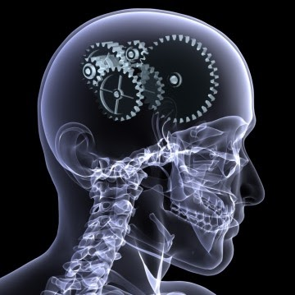
Advanced Topic in Cognitive
Neuroscience and Embodied Intelligence
Week 4
Neocortex Functions and its Working Styles
CE7427

Slide 2

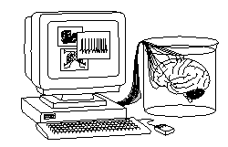
What it will be about
Neocortex and complex cognition.
Primary, secondary and tertiary cortex functions.
Processing information by topographic representations.
Motor control by population coding.
Remarks on the brain information code.

Slide 3
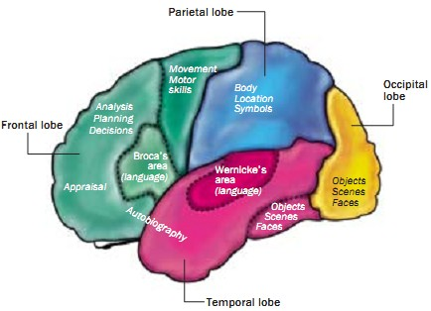
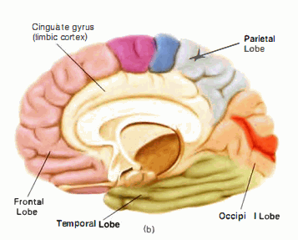
Gross anatomy
Neocortex is responsible for complex cognition, you could live without it but will not survive on your own.
4 major lobes are seen from outside, limbic lobe is hidden in the medial surface, plus insular cortex is hidden between temporal and parietal lobes.
Rough division of functions; cingulate cortex cooperates with limbic system, is involved in representation of the self, in cooperation with the prefrontal cortex (PFC) estimates subjective value of stimuli. Core structures: PFC+pre-motor cortex, temporal, parietal lobe thalamus, basal ganglia, cingulate cortex, insula & V4 visual area.

Slide 4
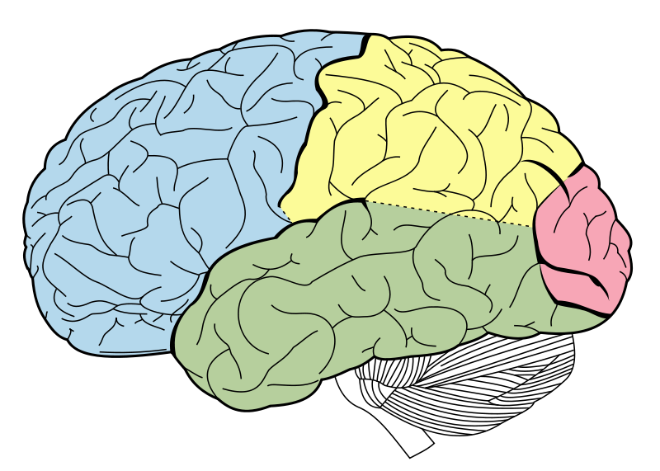
Major lobes – hidden and visible
Four visible lobes of the cortex:
frontal lobe
occipital lobe
parietal lobe
temporal lobe
The frontal lobe is involved in: planning, thinking, memory, willingness to act and make decisions, evaluation of emotions and situations, memory of learned motor actions, e.g. dance, mannerisms, specific patterns of behavior, words, faces, predicting consequences, social conformity, tact, feelings of serenity (reward system), frustration, anxiety and stress.
The occipital lobe is responsible for: sight, analyzing colors, motion, shape, depth, visual associations.

Slide 5
Major lobes – hidden and visible
parietal lobe
temporal lobe
The parietal lobe is involved in: feeling temperature, touch, pain, vibrations; locating sensory impressions, spatial orientation, motion recognition, integration of motion, sensation and sight, grasping (LIP area), understanding abstract concepts including numbers.
The temporal lobe is responsible for: speech, verbal memory, object recognition, hearing and aural impressions, scent analysis.

Slide 6
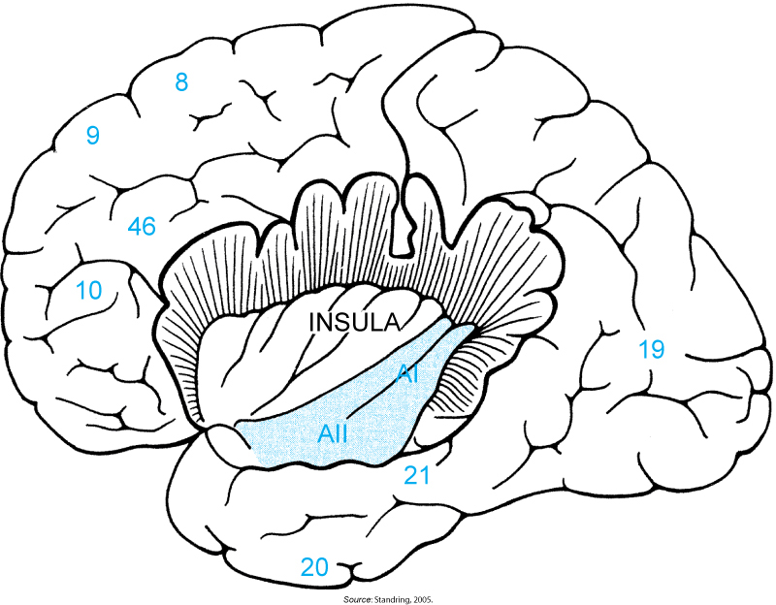
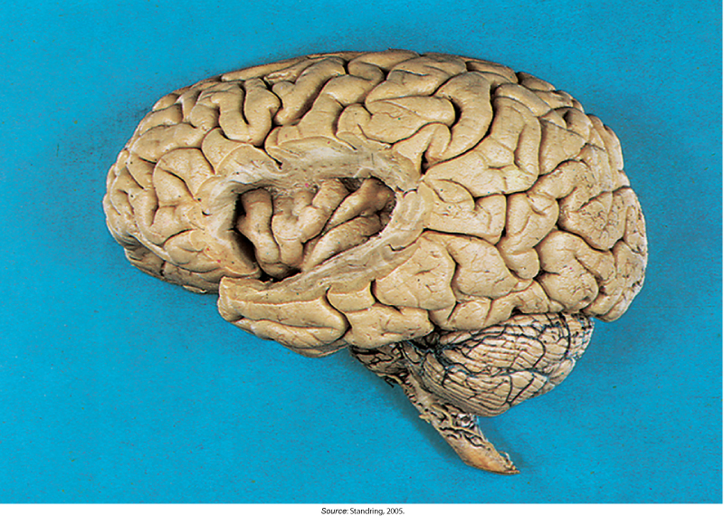
Major lobes – hidden and visible
insula and Sylvian fissure
Insula is responsible for: ‘gut feelings’ like sense of nausea and disgust, interoception (feeling internal organs), emotional awarness.
Sylvian fissure runs between parietal and temporal lobes horizontaly towards junction with occipital lobe. It contains supratemporal plane that hosts primary and secondary auditory cortex and part of Wernicke’s area for speech comprehension.

Slide 7
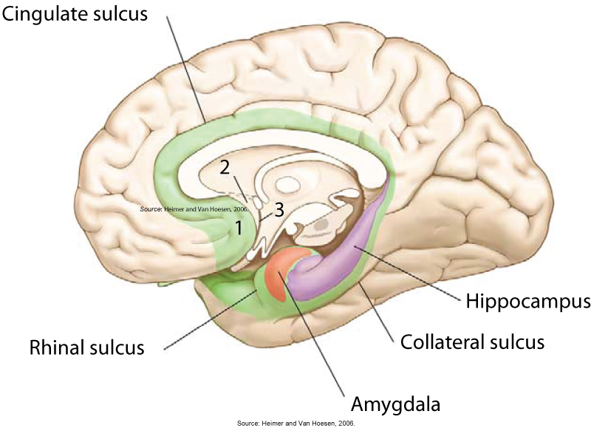
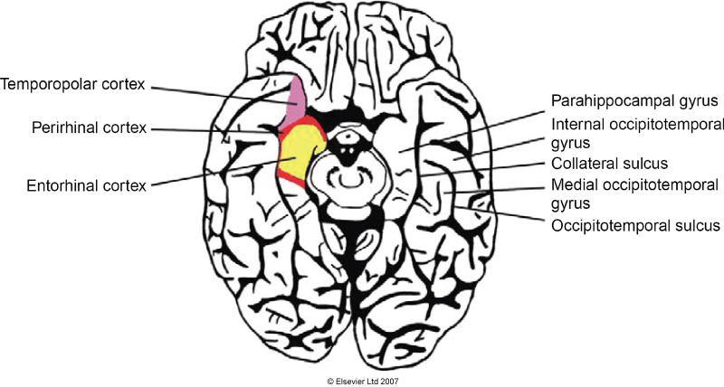
Major lobes – hidden and visible
medial temporal lobe
The medial temporal lobe is a part of temporal lobe but has different anatomy. It contains hippocampi and related regions that are associated with episodic memory. It contains limbic system with cingulate sulcus involved in resolving conflicting situations and rhinal sulcus responsible for smell. It is an older part of cortex with only 5 layers and is sometimes referred to as paleocortex.

Slide 8
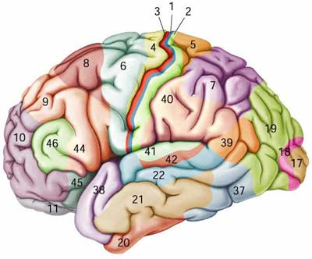
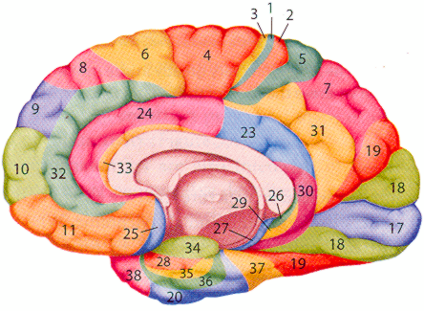
Brodmann regions
Korbinian Brodmann (1909) divided cortex into areas with similar cellular organization into 52 areas (on each side of the brain), his labels are still used although improved map (107 areas) has been published in 1925.
Clickable map of Brodmann areas gives explanation of their structure, connections and functions in sensory, affective and cognitive processing.
Lateral view midline view

Slide 9
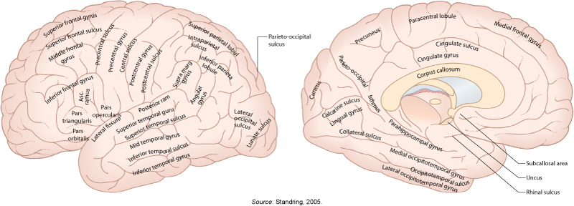
Geography of the brain
Each gyrus and sulcus has some main function, but may participate in many tasks; individual brains have gyri of different size.
Lateral view midline (saggital) view

Slide 10
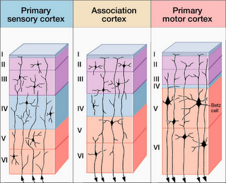
Structure of the cortex
The neocortex has about 600 g, modular laminar structure, is 2-4 mm thick, 1/3 is visible, the rest is in sulci and midline structures, fractal dim=2.8.
In mammals there are 6 major layers, except for paleocortex, including olfactory + parts of hippocampus with 3 (reptiles have such cortex), and other old cortex with 3-5 layers.
Neocortex contains mostly excitatory pyramidal neurons (~80%)
and inhibitory interneurons (~20%).
Layer I: local inputs (dendrites), layer V/VI outputs to thalamus and long white matter connections, layer IV are inputs from intracortical horizontal connections.
Neocortical columns with a diameter of about 0.5 mm respond to a sensory stimulus (tactile, auditory, visual), 1-2 mln such functional units in human neocortex with over 10.000 neurons each, may be decomposed into minicolumns with ~100 neurons , each forming a microcircuit.

Slide 11
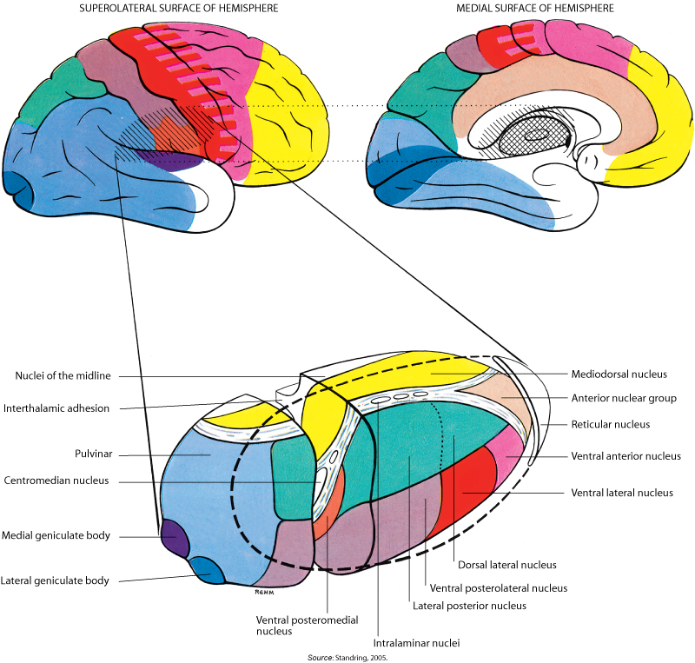
Cortico-thalamic loops
Inputs and outputs to the brain go through thalamus, including some internal communication.
Neocortex controls activity of the thalamus accepting or suppressing sensory data via the thalamo-cortico-thalamic loops at different time scales.
ERTAS, Extended Reticular-Thalamic Activation System interprets and reacts to information from internal stimuli, feelings, attitudes, and beliefs as well as external sensory stimuli by regulating cortical arousal levels.
Mapping of the thalamus to cortical regions

Slide 12
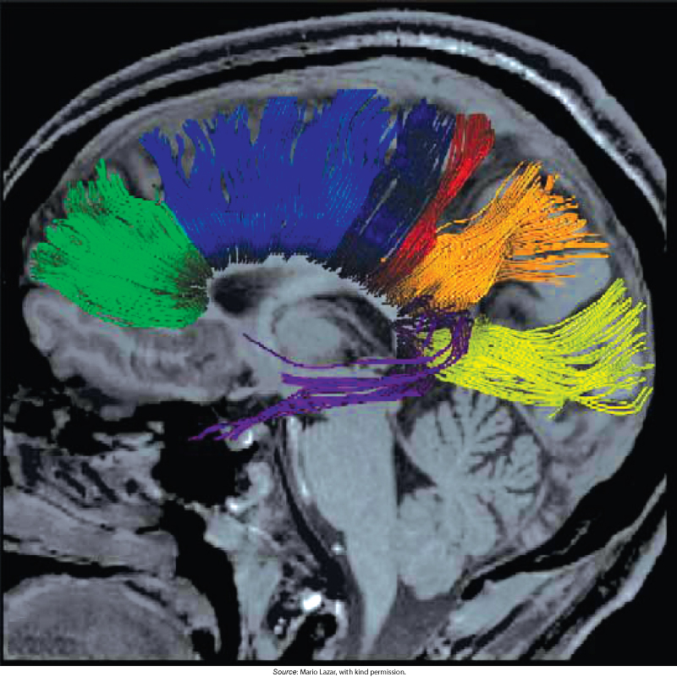
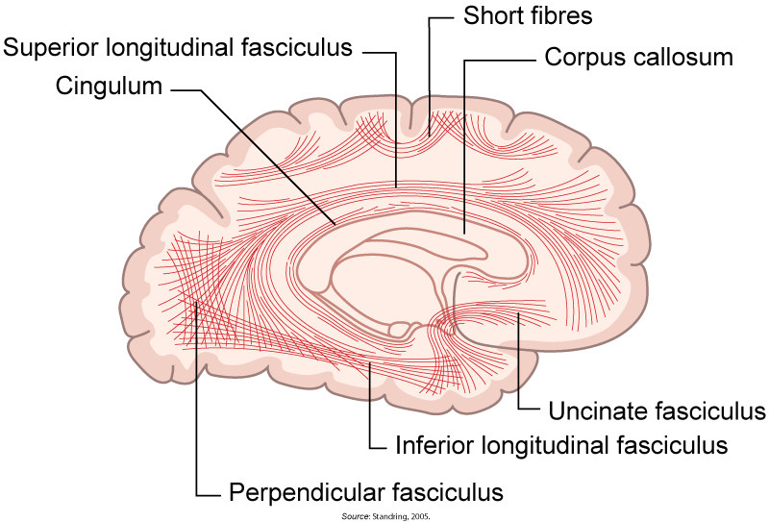
Major fiber patterns in the brain
Fibers from cortical cells spread in every direction between hemispheres, thalamus, and other brain organs

Slide 13
What it will be about
Neocortex and complex cognition.
Primary, secondary and tertiary cortex functions.
Processing information by topographic representations.
Motor control by population coding.
Remarks on the brain information code.

Slide 14
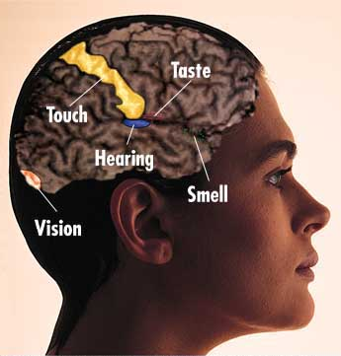
Cortex functions
Cortex has three major functions:
precise analysis of sensory data;
control of movements;
complex cognition: association, planning,
categorization of brain states (including
reflection on the organism state).
All perception and action in the brain has to
be coded by neural activity. Analysis is
possible thanks to segregation of the data flow
in thalamus and then cortex, and specific structure of inputs.
Primary sensory cortex: inputs from receptors=>spinal nerve=>thalamus, expects specific structure of information depending on modality.
Ex: somatosensory system reacts to touch (several mechanoreceptors and chemoreceptors), temperature, proprioception (internal body information), and nociception (pain), receiving it in BA 1-3, knowing where it comes from.

Slide 15
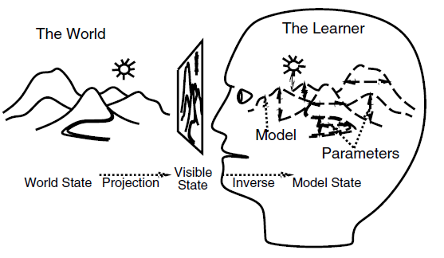
Primary cortex: model learning
The environment supplies a lot of information, sensory stimuli are of poor quality and change rapidly, so without extensive knowledge of what can be expected, narrowing the interpretation of these signals, identification of objects and relationships between them isn't possible.
Chances of survival are greater using model of environmental states, biased for recognition of objects and stimuli and invoking correct behavior.
Recognizing and enhancing correlations between neural activity is a necessary (but not sufficient) condition of finding causal relationships.
Primary sensory cortex should identify useful structures for such model: phonemes, edges, basic quanta that makes perception invariant.

Slide 16
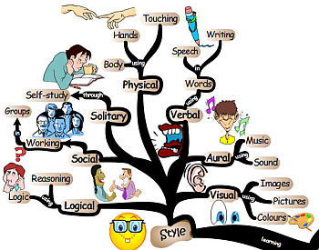
Learning: types
How should an ideal learning system look?
How does a human being learn?
Detectors (neurons) can change local parameters but we want to achieve a change in the functioning of the entire information processing network.
We will consider two types of learning, requiring different mechanisms.
Spontaneous learning of internal models of environment.
Supervised learning of tasks (behaviors).
Combination of both types.

Slide 17
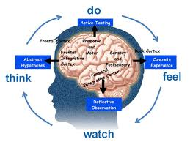
Why to learn a model?
Expectations based on previous experience can simplify adaptation to a new situation.
Example: it's easier to learn a new video game if you've already played other video games and when the designers keep similar game elements.
Parametric models in science and in statistics work better than universal.
Nativists (psychologists who stress genetic influences on behavior) assume that people are born with specified knowledge about the world.
Rough genetic plan of brain connectivity constitutes primary behavioral repertoire: breathe, suck, move, open eyes, cry, smile …
Genes cannot code precisely all information in the brain but can prepare brains to learn in variable environmental niche for each species, so some form of “neural Darwinism” (G. Edelman, 1978) is possible.
Experience (bias) can also be a negative factor, limiting recognition of the need for a new approach when old solutions fail in changing environment.

Slide 18
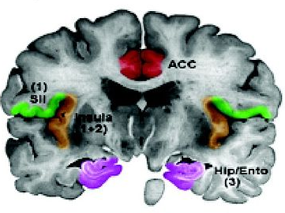
Secondary sensory cortex
Adjacent to primary sensory cortex lies secondary cortex.
understand the meaning of stimuli,
associate and integrate them with other
stimuli and with actions;
somatosensory SII is close to insula, found
only in humans and primates;
integrates info from both sides, enables
transfer learning of tactile recognition.
SII lesions may lead to pain asymbolia, pain is perceived but not interpreted as suffering. SII tells the brain that pain is unpleasant, hurry to stop it!
It may also lead to a chronic severe pain which may respond to biofeedback.
Visual, acoustic, tactile, olfactory and gustatory stimuli are associated with affective qualities of the experience. Lesions of the secondary sensory cortex leads to selective amnesia which is modality-specific, so this is needed for memory and retrieval of behaviorally salient sensory stimuli.

Slide 19
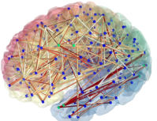
Tertiary cortices
Adjacent to primary and secondary sensory cortex lie
association cortices that integrate information on a larger scale,
including multi-modal information.
In auditory cortex: primary reception areas react to basic features of sound like pitch, secondary extract phonemes, tertiary associate phonetic strings with words and their semantics.
In visual cortex: primary cortex is analyzing edges and other lower level features, secondary cortices shapes, place, movement, colors, while tertiary areas react to various categories of objects and associates them with names.
In the somatosensory stereognosis (tactile gnosis or haptic perception) requires tertiary cortex to perceive and recognize the form of an object using somatosensory information (texture, size, vibration, spatial properties) and prioprioceptive information on hand position. Graphesthesia is the ability to understand what is drawn on your skin.

Slide 20
What it will be about
Neocortex and complex cognition.
Role of the primary, secondary and tertiary cortex.
Processing information by topographic representations.
Motor control by population coding.
Remarks on the brain information code.

Slide 21
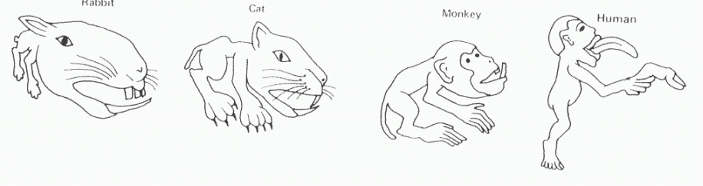
Topographical maps
How can the brain determine where the stimuli occurred, which muscles to move or find how similar stimuli are?
By processing similar stimuli in adjacent areas, i.e. using topographical organization of sensory and motor maps.
More precision requires more computing power = more cortex area.
Rodents devote large part of their brain to analyze signals from their vibrisa and mouth, humans from hands and face.
Primary sensory cortex is topographical organized: auditory, retinotopic and superior colliculus, motor (MI and cerebellum maps), olfactory ….

Slide 22
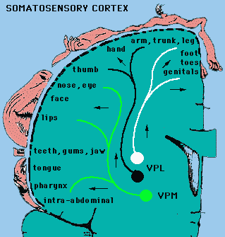
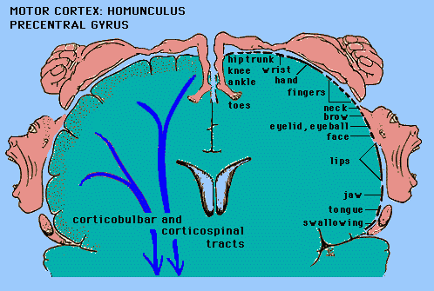
Motor and somatosensory maps
This is a very simplified image, in reality most neurons are multimodal, neurons in the motor cortex react to sensory, aural, and visual impulses (mirror neurons).
Many specialized circuits of perception-action-naming.

Slide 23
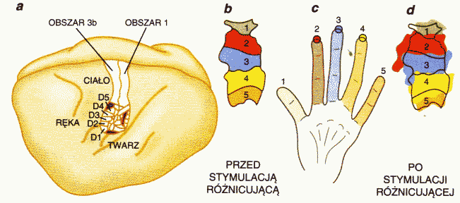
Finger representation: plasticity
Hand
Before
After stimulation
stimulation
Sensory fields in the cortex expand after repeated stimulation;
this happens also in the “phantom limb” phenomenon when people feel amputated limbs and other body parts.
Face
Brains may be overtrained by repeating the same movements (for example typing numbers) and forgetting how to do other movements!
Plasticity of cortical sensory-motor representations is strong.

Slide 24
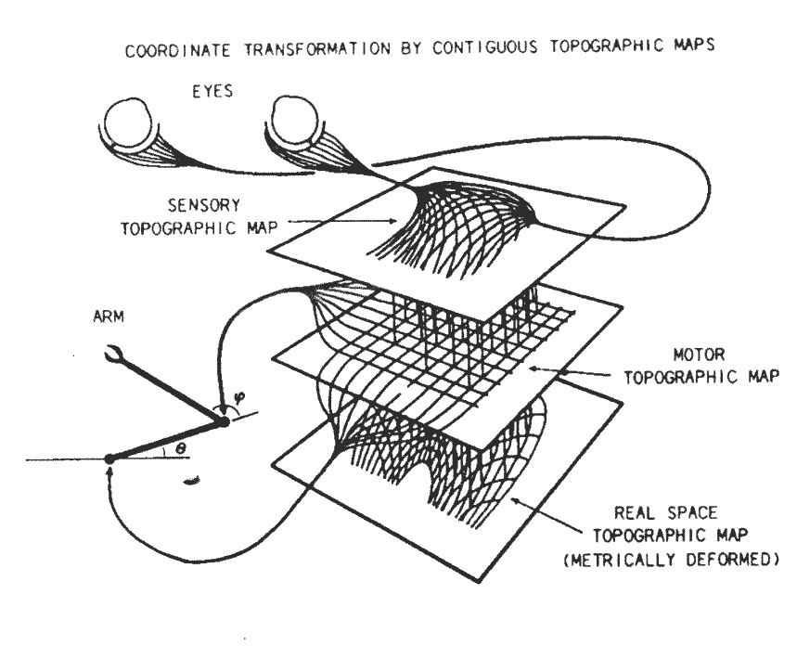
Sensomotor maps
Self-organization is modeled in many ways; simple models are helpful in explaining qualitative features of topographic maps.
Fig. from:
P.S. Churchland, T.J. Sejnowski,
The computational brain.
MIT Press, 1992

Slide 25
What it will be about
Neocortex and complex cognition.
Role of the primary, secondary and tertiary cortex.
Processing information by topographic representations.
Motor control by population coding.
Remarks on the brain information code.

Slide 26
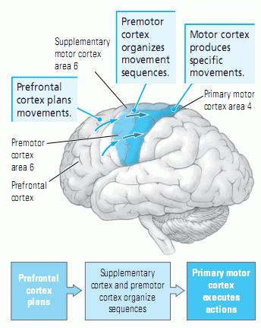
Motor control
On the other side of central fissure, opposite to the SI cortex the primary motor cortex MI has also topographical structure.
Plans for movements are made in the prefrontal cortex;
organized into sequences of primitive movements in the premotor (SMA) cortex with the help of basal ganglia;
MI executes actions and cerebellum adds smooth control to many muscles.
Information is sent to muscles using motoneurons, specialized motor fibers.
To coordinate movement of many muscle units population coding is used.

Slide 27
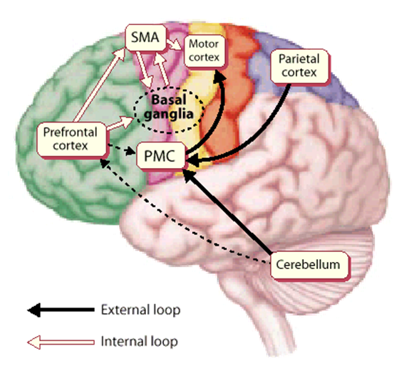
Motor control - overview
Some control information is internal but some comes from external observations!
We know how to act because we have external feedback, not only internal.
How can we learn about ourselves?

Slide 28
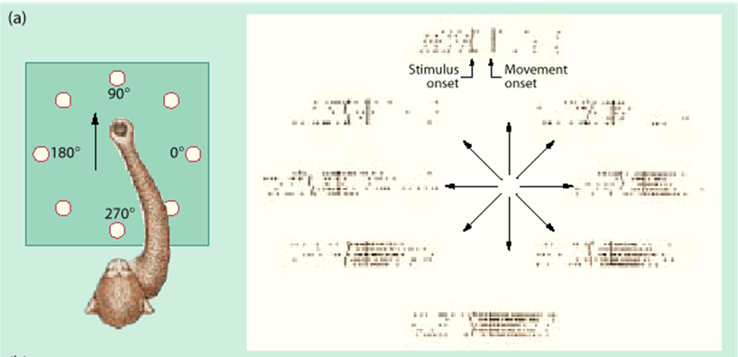
Population coding
Experiments in primates show that motor neurons in MI have preferred direction, with broad tuning curves around this direction.
Summing preferred directions over whole population gives overall direction of real movement (Georgopoulos, Science, 1986).

Slide 29
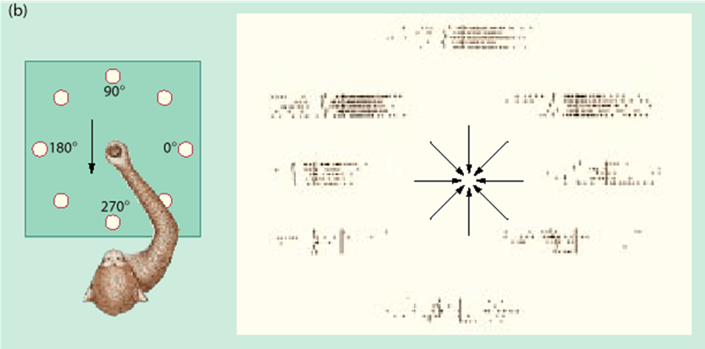
Population coding
Experiments in primates show that motor neurons in MI have preferred direction, with broad tuning curves around this direction.
Summing preferred directions over whole population gives overall direction of real movement (Georgopoulos, Science, 1986).

Slide 30
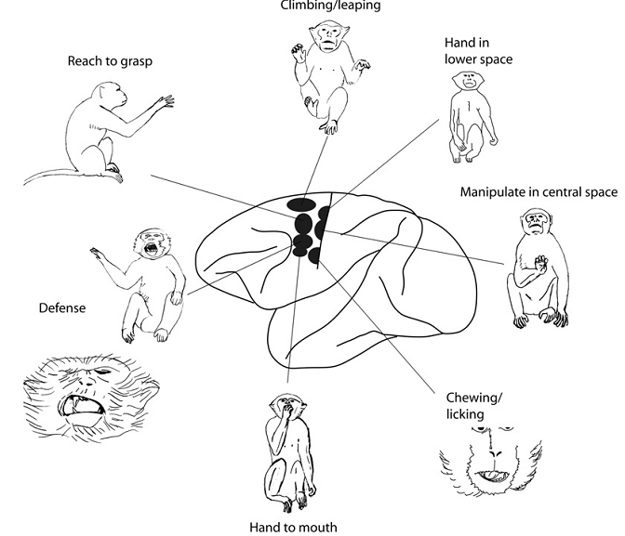
MII motor cortex
More complex movement patterns are in the SMA and premotor areas, and the basal ganglia.
Stimulation with weak currents for 0.5 sec will elicit such movements.
Continuity of similar actions is preserved.
Graziano and Aflao 2007

Slide 31
What it will be about
Neocortex and complex cognition.
Role of the primary, secondary and tertiary cortex.
Processing information by topographic representations.
Motor control by population coding.
Remarks on the brain information code.

Slide 32
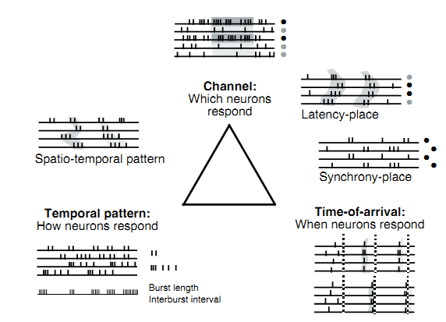
Brain information code
All mental states are just spikes – how is information encoded in spikes?
1) channel-codes (spatial activation patterns),
2) temporal spike patterns
3) spike latency (relative spike timings);
4) rate coding.
Stimulus-driven temporal correlations (phase-locking),
are common in audition, vision, tactile perception.
Intrinsic temporal response structure in all sensory systems.
Particular temporal patterns of electrical stimulation elicit specific sensory experience (picture: Cariani, 2001); we shall used only rate coding.

