Slide 1
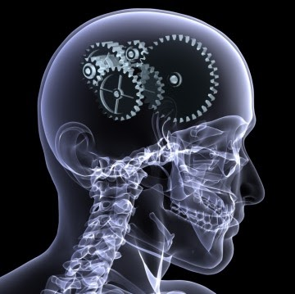
Advanced Topic in Cognitive
Neuroscience and Embodied Intelligence
Week 3
Functional Organization of Brains
CE7427

Slide 2

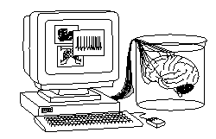
What it will be about
Core ideas and cybernetic explanations.
Information flow in the brain.
Examples of communication breakdown.
Basic brain architecture.
Functions of the brain stem and states of consciousness.
Limbic system and emotions.

Slide 3
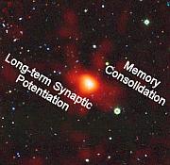
Core ideas
The brain complexity may be overwhelming but to build interesting systems we need only to understand the principles, core ideas. Engineering (functionalist) perspective:
Understanding = building a system and checking that its functions approximate what we want sufficiently well.
William R. Klemm, Core Ideas in Neuroscience (2007, e-book)
lists 75 “core ideas” or basic principles in neuroscience:
Cell Biology, Development – more on biological side.
General ideas, sensory systems, information processing, motor control.
Emotions, learning & memory.
States of consciousness – more on psychological physiology side.
We will take similar approach, oriented more towards engineering and computer simulations of functions.

Slide 4

Cybernetics approach
N. Wiener, Cybernetics, or Control and Communication in
the Animal and Machine (1948): study of the structure of
regulatory systems, information flow & control.
Includes control, information and systems theories, focused on self-organization, autonomous systems, and system-environment interaction.
Cybernetics (biocybernetics) overlaps with many other disciplines and only a few research groups use this name.
Bionics (biomimetics): biological inspirations in design of technical systems.
David Marr (1975) viewed information processing systems at 3 levels:
computational (cybernetic) level: what and why does the system do;
algorithmic/representational level: how does the system do what it does, what representations/processes are used;
implementation level: how is the system physically realized; what neural structures and neuronal activities implement functions.
Marr worked mostly on the visual system and memory (hippocampus).

Slide 5
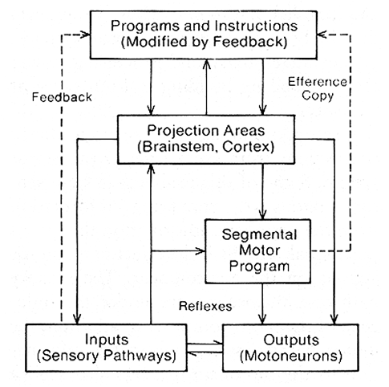
Example: sensorimotor behavior
Action & perception are not separable, perception requires exploration of sensori-motor contingences, affordances (opportunities to act).
Neocortex programs to analyze sensory inputs ask for more information, motor system takes action moving eyes, head, pressing harder, controlling internal
information flow.

Slide 6
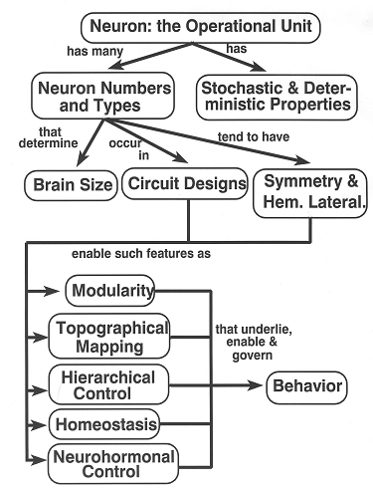
General core ideas
After Klemm (2007), modified:
neuron doctrine
CNS, Central Nervous System, many types of neurons in large numbers
neurons form microcuircuits
and larger specialized areas
composed of modules
controlled in a hierarchical way
using specific mechanisms such as topographical mappings, population coding and associative networks
with hormones enable homeostasis
controlling behavior.
Mixing Marr’s levels: better to start from cybernetic level, and talk about neurons later, but for lab you need neurons … all is needed at once!

Slide 7
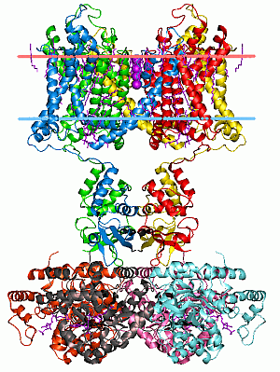
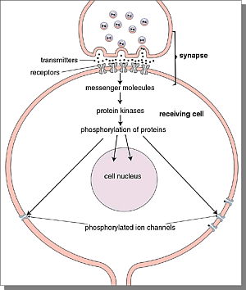
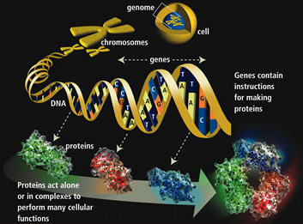
From Genes to Neurons
Genes => Proteins => ion channels, synapses
=> neuron properties, networks
=> neurodynamics => abnormal behavior!

Slide 8
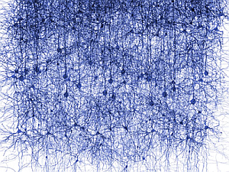
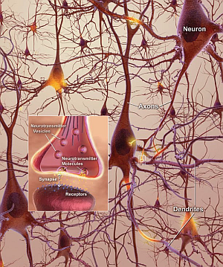


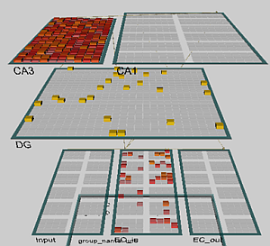
From Neurons to Behavior
Different questions require different level of description, understanding neurodegenerative disease and reaction to drugs requires molecular level.
We will be concerned mostly with cybernetics/simulation level.

Slide 9
What it will be about
Core ideas and cybernetic explanations.
Information flow in the brain.
Examples of communication breakdown.
Basic brain architecture.
Functions of the brain stem and states of consciousness.
Limbic system and emotions.

Slide 10
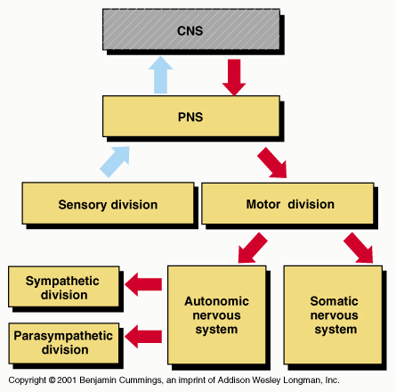
General organization
CNS, Central Nervous System, brain with the spinal cord.
PNS, Peripherial Nervous System, all nerves and ganglia outside CNS, includes sensory neurons (afferent connections) and the motor neurons (efferent connections) as a part of
SNS, Somatic Nervous System, and ANS, Autonomic Nervous System.
Sympathetic ANS: arousal in danger, increases heartbeat, blood pressure, adrenaline, “fight or flight”.
Parasympathetic ANS does the opposite, “rest and digest” responses.
Enteric ANS controls all aspects of digestion, from the esophagus to the stomach, small intestine and colon.

Slide 11
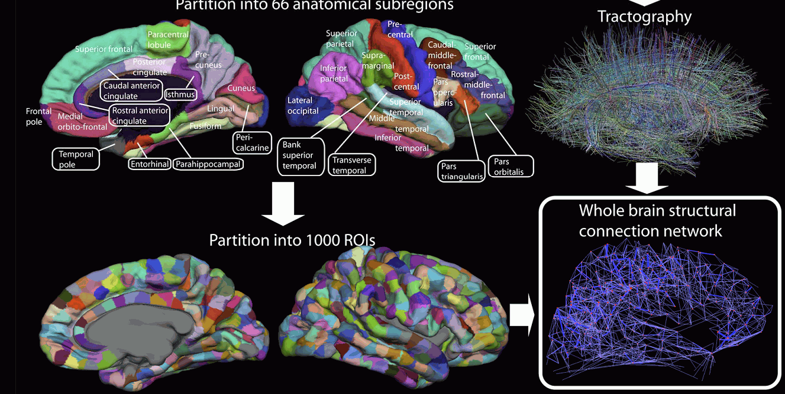
Connectome Project
We do not know the details of information flow, the human connectome project should construct maps of structural and functional neural connections.
But rough connectivity is already known. Check this gallery of the HCP.

Slide 12
Functions and regions
Localized or holistic information flow?
Holistic theories in 19th century have been replaced by localization of some functions, now neuroimaging shows that each region has many functions.
Localized:
each brain area has a fixed function, and each task is implemented by cooperation of active regions.
Holistic:
the whole brain works on each task, regions have functions that may in large degree be exchangeable.
3
3
1
5
5
1
2
6
2
6
4
4

Slide 13

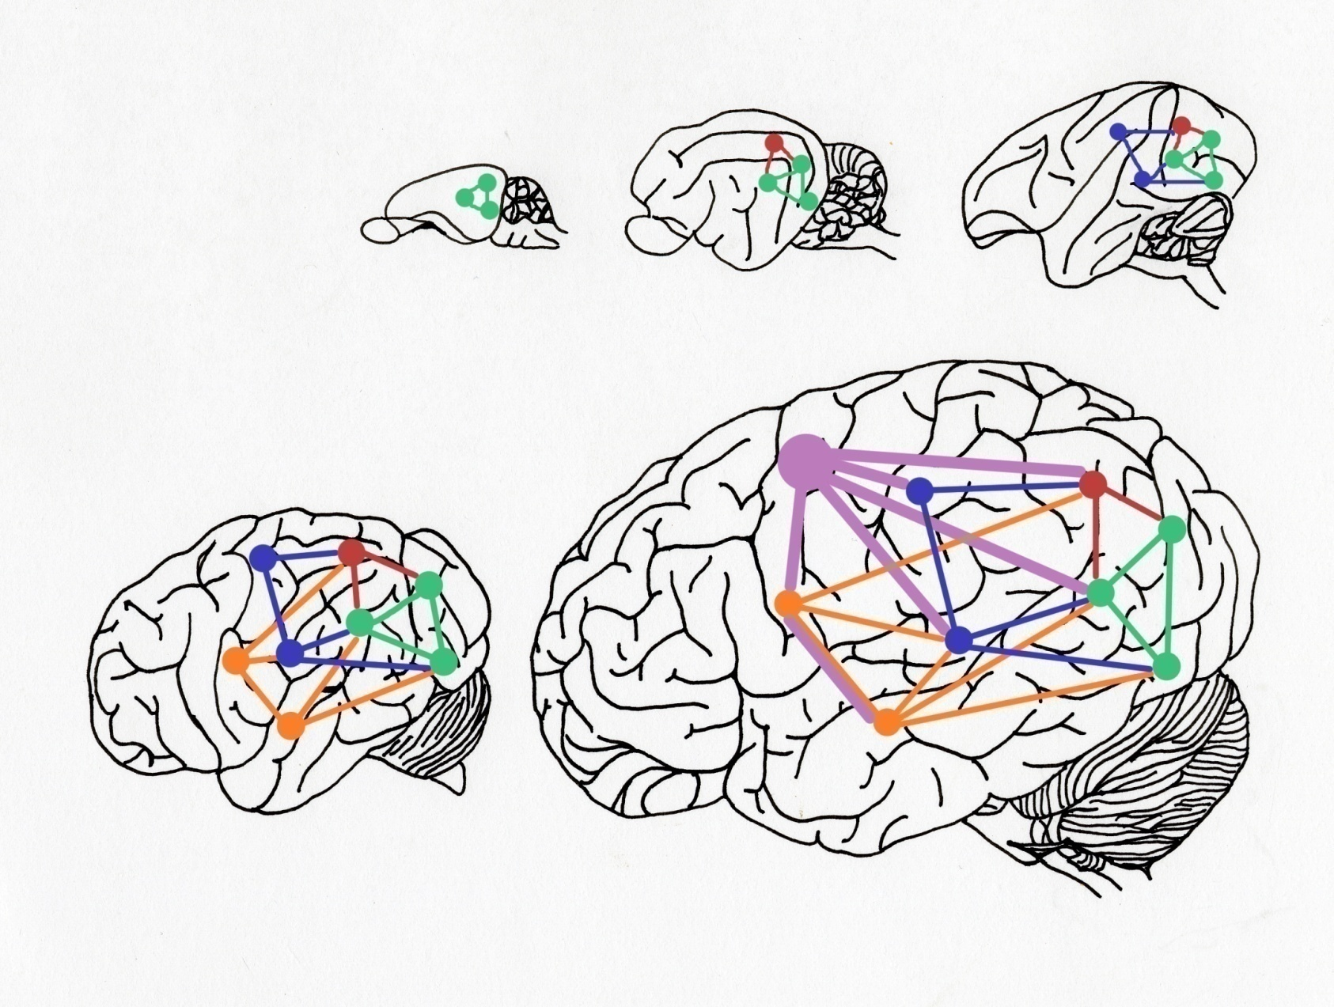
Neural recycling ?
M. Anderson, Neural reuse: a fundamental organizational
principle of the brain. Behavioral & Brain Sci 33, 245–313 (2010)
Central organizational principle: reuse of neural circuitry
for various cognitive purposes.
Brain has a heterarchy of semi-autonomous subsystems, no permanent “supervisor” population of neurons, any subsystem may take the lead
Neural circuits were exapted (exploited, recycled, redeployed) during evolution for different uses, often without losing their original functions.
Brain circuits can continue to acquire new functions without significant local change to circuit structure, functional connections to new partners.
This gives new perspective on brain evolution/development, tool use, human language; modularity/localization of cognitive functions.
It has practical implications in neurorehabilitation, BCI design, cognitive architectures, a bit like object/module reuse in programming.
Based on meta-analysis of 665 experiments in 20 cognitive domains.

Slide 14
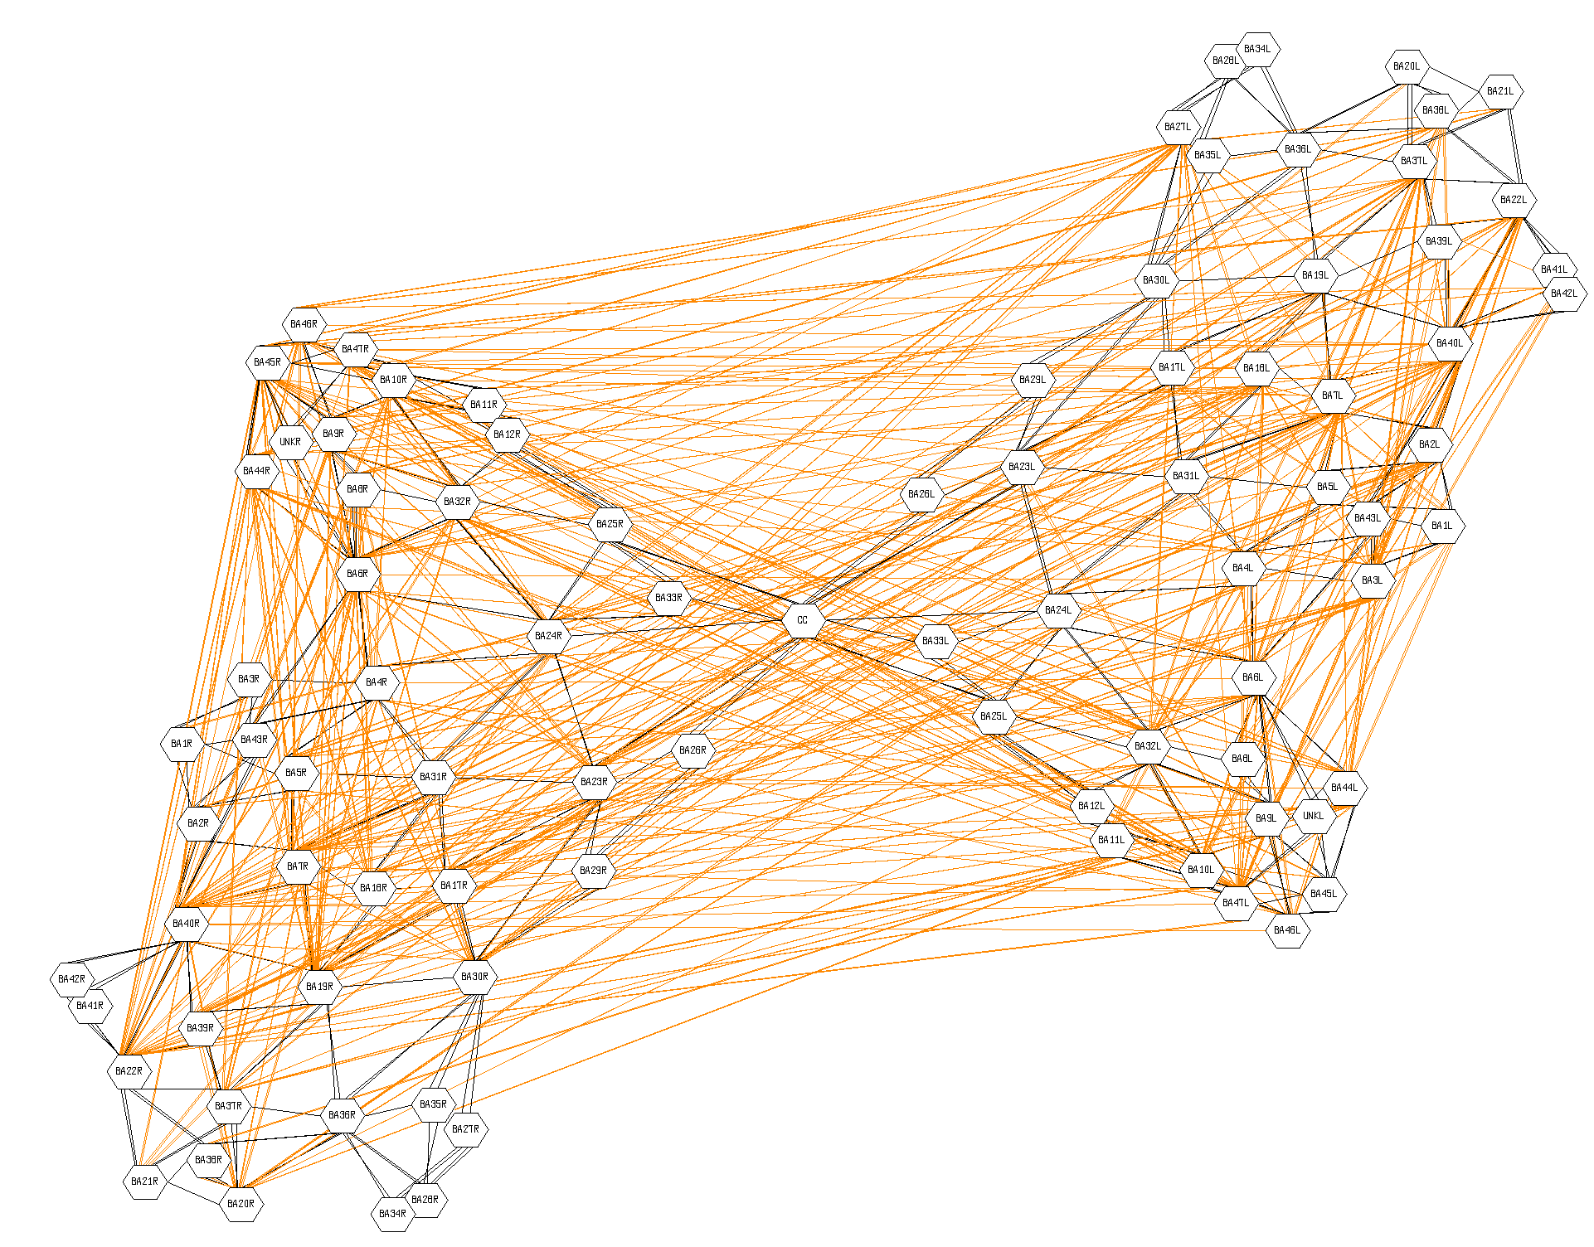
Action (56 experiments)
Notes:
Czarne linie – sąsiednie obszary Brodmana, pomarańczowe – koaktywacja w wielu eksperymentach

Slide 15
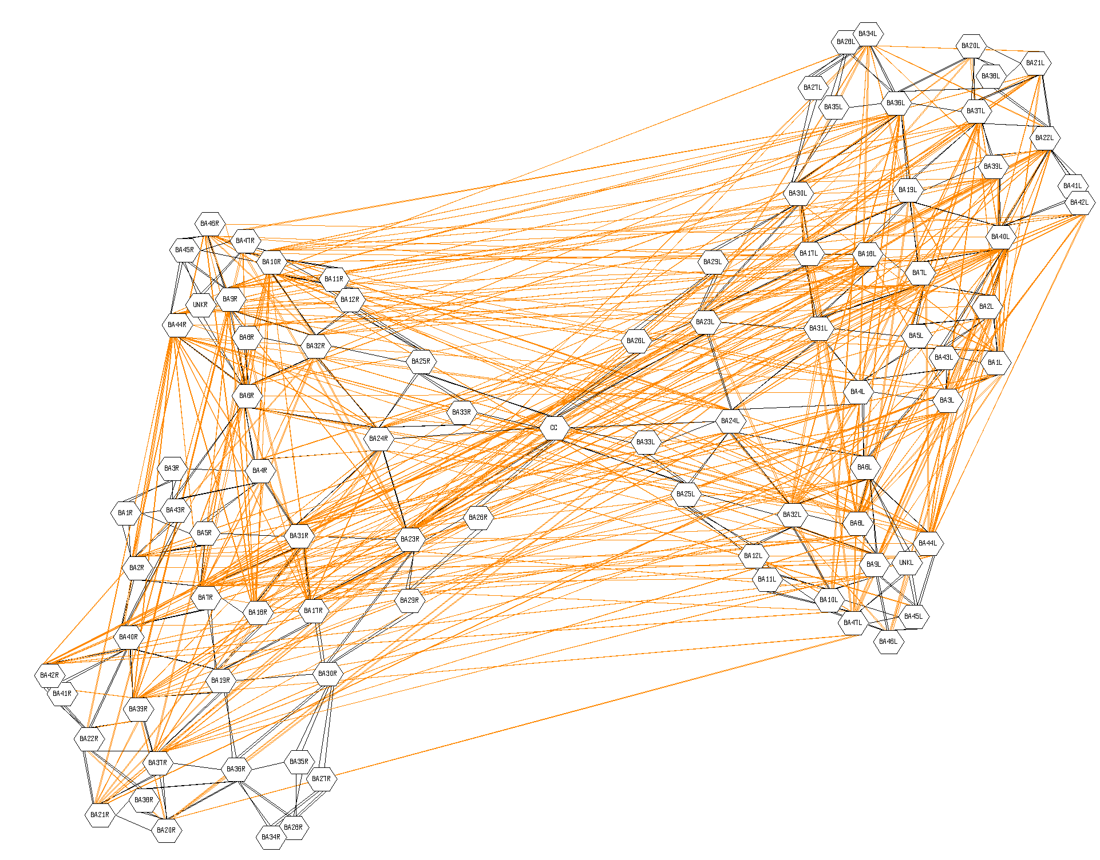
Attention (77 exp.)

Slide 16
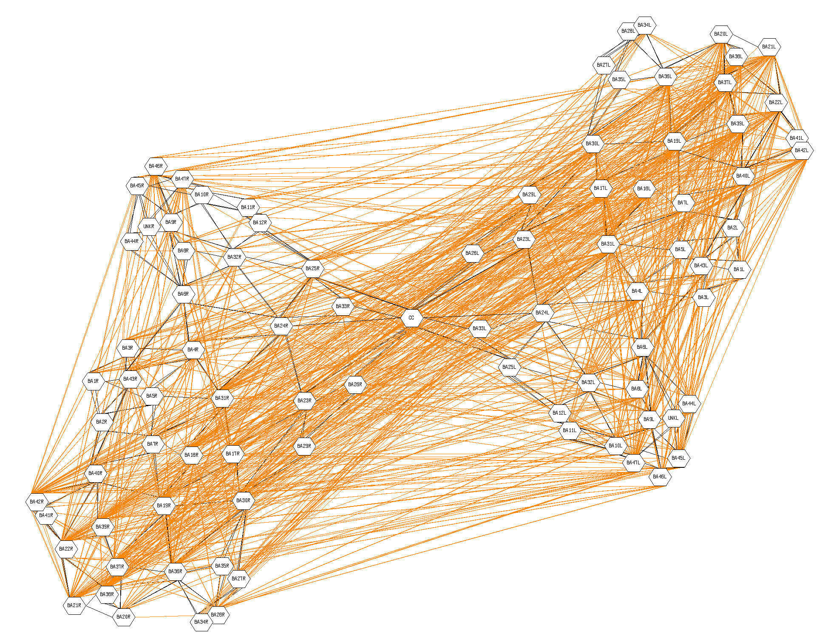
Language (165 exp.)

Slide 17
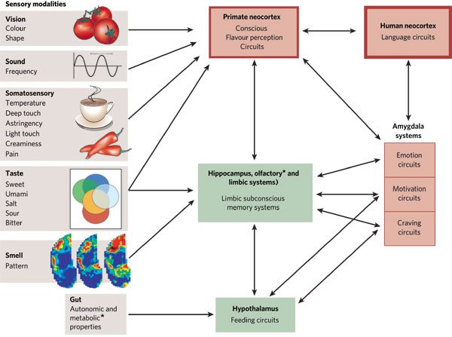
Flavor inputs
Even flavor perception is very complex.
Areas involved in the perceptual, emotional, various memory, motivational and linguistic aspects of food evaluation are mediated by flavor inputs.
Conclusion: all real perception is complex!
It should extract useful information from signal.
From G.M. Shepherd, Smell images and the flavour system in the human brain. Nature 444, 316-321 (2006).

Slide 18
What it will be about
Core ideas and cybernetic explanations.
Information flow in the brain.
Examples of communication breakdown.
Basic brain architecture.
Functions of the brain stem and states of consciousness.
Limbic system and emotions.

Slide 19
Basic modules
Limbic System: emotions, rewards, values, memory.
Neocortex:
Cognitive – Affective
CNS
Thalamus
Brain stem,
Reticular formation
Hypothalamus, ANS, Organism, Homeostasis
PNS,
Sensors/effectors World
What may happen if one of the connections is broken or miswired?
For example neocortex-limbic connection?

Slide 20

Delusional syndromes
What happens if the affective-cognitive link is broken? Values are lost.
Sometimes we recognize a place, person, object but feel strange about it, or sometimes we feel we know but cannot recognize.
DMS, delusional misidentification syndrome: a belief that the identity of a person, object or place has somehow changed or has been altered.
Capgras delusion: delusion that a close relative/spouse has been replaced by an identical-looking impostor.
Reduplicative paramnesia: familiar person, place, object or body part has been duplicated.
Fregoli delusion: delusion that various people met are actually the same person in disguise.
Intermetamorphosis: delusion that people swap identities with each other whilst keeping the same appearance.
Subjective doubles, delusion of a doppelgänger, a double of the person carrying out independent actions.
Mirrored self-misidentification: delusion that one's reflection in a mirror is some other person.
It may happen to you!

Slide 21
What it will be about
Core ideas and cybernetic explanations.
Information flow in the brain.
Examples of communication breakdown.
Basic brain architecture.
Functions of the brain stem and states of consciousness.
Limbic system and emotions.

Slide 22
Different views
10⁻⁴ m Neurons 10⁻³ s
10⁻⁶ m Synapses 10⁻⁴ s
10⁻¹⁰ m Molecules 10⁻¹⁰ s
10⁻³ m Microcircuits 10⁻² s
10⁻² m Maps 10⁻¹ s
0.1 m Brain systems 1 s
CNS/ANS/PNS
1 m, 0.1-10 s
10⁻⁸ m Ion channel 10⁻³ s
Spatiotemporal resolution:
spatial scale: 10 orders of magnitude, from 10⁻¹⁰ m to 1 m.
temporal scale: 10 or more orders of magnitude, from 10⁻¹⁰ s to 1 s.
Architecture:
hierarchical and modular
ordered in large scale, chaotic in small;
specific projections: interacting regions wired to each other;
diffused: regions interact through hormones and neurotransmitters;
functional:
subnetworks dedicated to specific tasks.

Slide 23
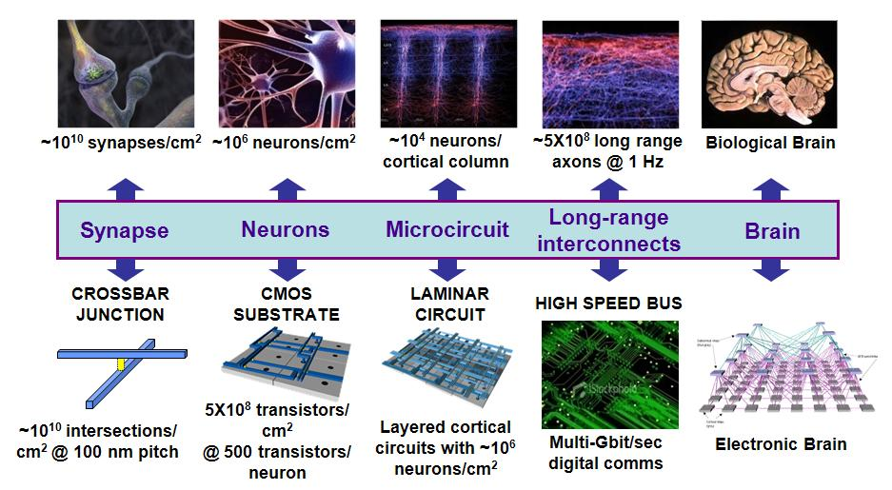
From brains to machines
Source: DARPA Synapse project

Slide 24
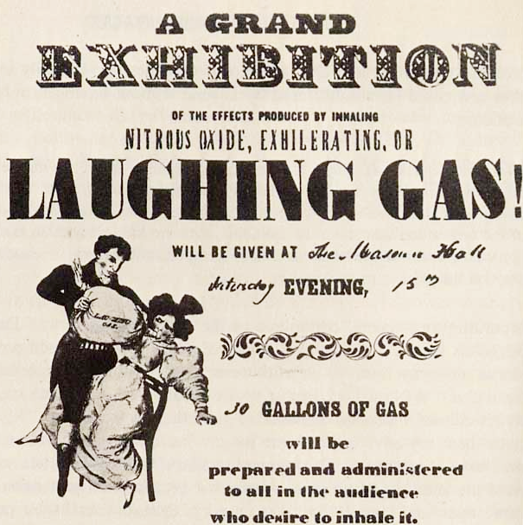
Effects of small molecules
Psychoactive substances are usually found in small quantities in the brain itself:
NO₂, anandamide, endorphins.
“The gas will be administered only to gentlemen of the first respectability. The object is to make the entertainment in every respect a genteel affair”.

Slide 25

Time and structure
S.J. Kiebel, J. Daunizeau, K.J. Friston, A Hierarchy of Time-Scales
and the Brain. PLoS Computational Biology, Vol 4 (11), 2008, e1000209
Free energy principle: adaptive agents (brains) in a dynamic environment minimize their surprise about sensory input => predictive brain, learning regularities in the environment from exposure to sensory input and internally generated signals => slow feature analysis, deep learning.
Brains model entire environment as a collection of hierarchical, dynamical systems (first step: correlation or Hebbian learning).
Slower environmental changes provide the context for faster changes.
There is a simple mapping between this temporal hierarchy and the anatomical hierarchy of the brain.
Explains a wide range of neuroscientific findings by optimization of value.
Reaction time ~ 100 ms is a compromise between the need for fast reaction and brain power needed for planning/perception.

Slide 26
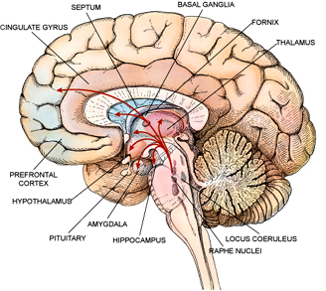
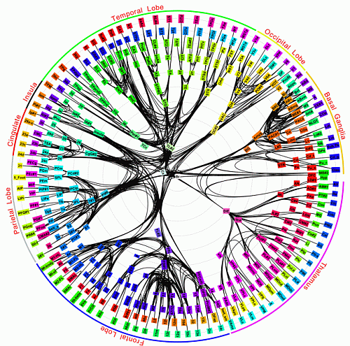
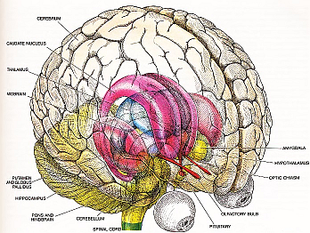
Modules
Connectivity of 383 regions in macaque brain; Modha & Singh, PNAS 2010.

Slide 27
What it will be about
Core ideas and cybernetic explanations.
Information flow in the brain.
Examples of communication breakdown.
Basic brain architecture.
Functions of the brain stem and states of consciousness.
Limbic system and emotions.

Slide 28
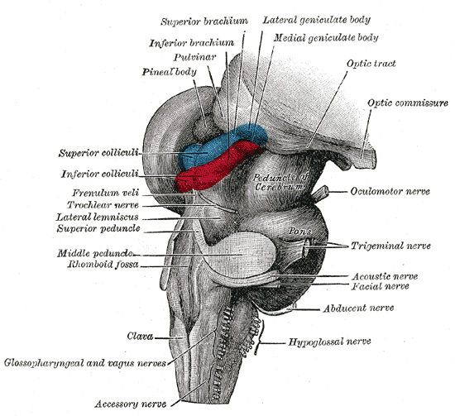
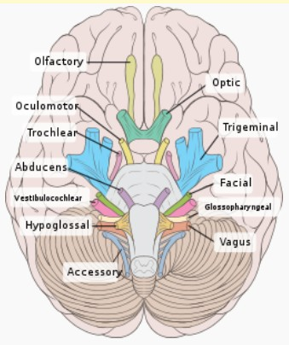
Brainstem main functions
10 cranial nerves pass through the brainstem, transmitting sensory information and controlling eyes, face and speech related movements.
Central pattern generators or neural circuits producing rhythmic activity, in the brainstem and spinal cord enable respiration and locomotion.
Global control of access to sensory input, alertness, emotional states, pain, posture, locomotor reflexes.
Gray’s anatomy (1918): spinal cord, medulla oblongata, pons, mesencephalon, midbrain.

Slide 29
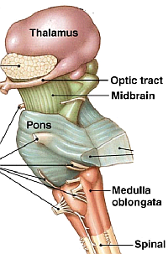
Simple functions
Brainstem is the sensory/motor gateway to the brain:
breaking connections passing through the ventral part of the pons leads to the locked-in syndrome;
patients are almost completely paralised, only eye blinks and breathing are controlled consciously;
Jean-Dominique Bauby, Paris journalist, after stroke become locked-in, film The Diving Bell and the Butterfly (2007) is an adaptation of his story, he dictated it by blinking just one eye!
Medulla oblongata, lower half of brainstem has:
respiration centers – chemoreceptors, O₂/CO₂ level
cardiac center – sympathetic & parasympathetic system.
vasomotor center – baroreceptors, blood pressure.
reflex centers of vomiting, coughing, sneezing, swallowing.

Slide 30
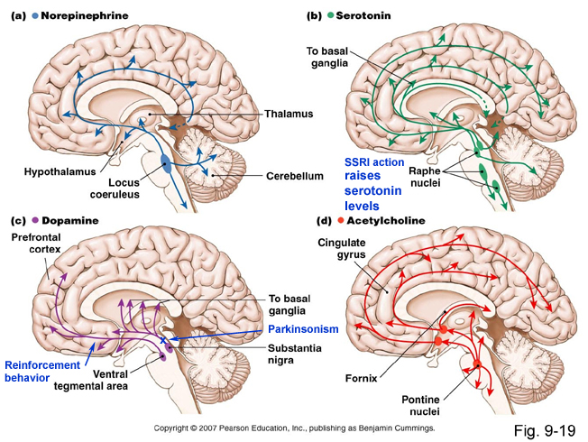
Brainstem neurotransmitters
Brainstem has:
locus coeruleus , norepinephrine, arousal, readiness
9 raphe nuclei, serotonin-mood regulation,
VTA in midbrain,
dopamine, reward and drives
Pontine nuclei, Ach, memory, attention.
J. Parvizi, A. Damasio, Consciousness and the brainstem. Cognition (2001): core consciousness, the feeling of being, representation of current organism state within somato-sensing structures, reflecting the change of organism state caused by interaction with environment.

Slide 31
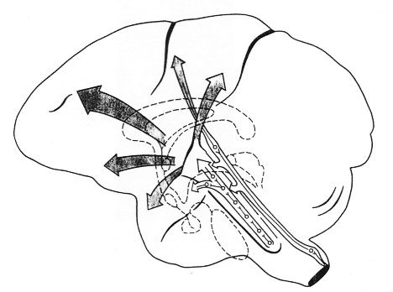
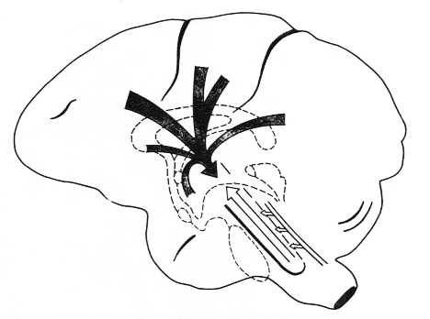
Brainstem activation
Ascending reticular formation wakes the brain up, preparing for perception, mental and behavioral actions: rough control without precise analysis.
Brainstem
reticular
formation
Attention, awareness, cognition
Limbic activations
Affect, learning, memory
Motor activation
Visceral
& neuro-endocrine activation, stress, ANS
Sensory activation, orientation, pain

Slide 32
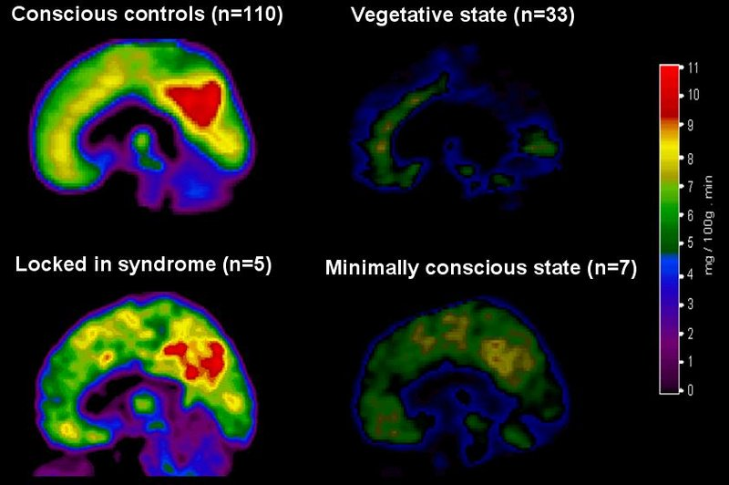
States of consciousness
PET studies; communication with people in MCS is difficult.

Slide 33
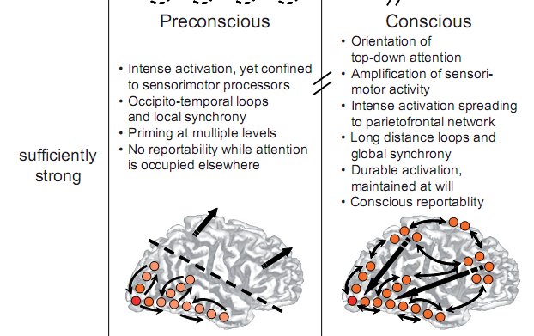
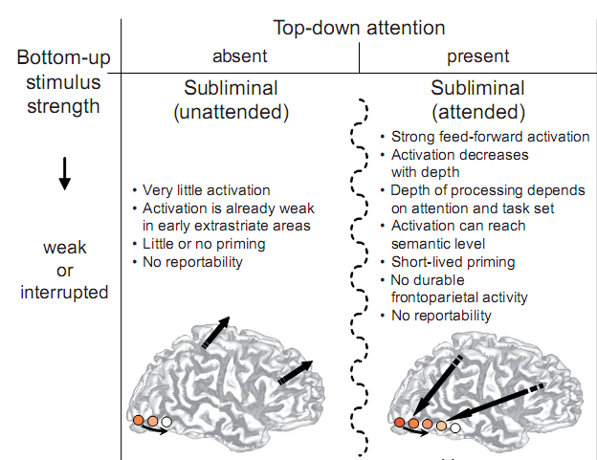
How brains create experience?
Sensory cortex, for example V4 for color, MT for movement.
Bottom-up and top-down activations create resonant states.
What if top-down connections are weak or missing?
C. Gilbert, M. Sigman, Brain States: Top-Down Influences in Sensory Processing. Neuron, Volume 54, Issue 5, Pages 677-696, 2007
Cortical & thalamic sensory lower-level processes are shaped by complex top-down influences, attention, task-related expectations and sensory inputs.
Brain states are determined by the interactions between multiple cortical areas and the modulation of intrinsic circuits by feedback connections.
Disruption of this interaction may lead to behavioral disorders.
Dehaene et al, Conscious, preconscious, and subliminal processing. TCS 2006
Bottom-up strength & top-down attention combined lead to 4 brain states, with both stimulus and attention required for conscious reportability.
Imagery? Electric shock activates auditory cortex through amygdala pathway, same with imagined scary episodes.

Slide 34
What it will be about
Core ideas and cybernetic explanations.
Information flow in the brain.
Examples of communication breakdown.
Basic brain architecture.
Functions of the brain stem and states of consciousness.
Limbic system and emotions.

Slide 35
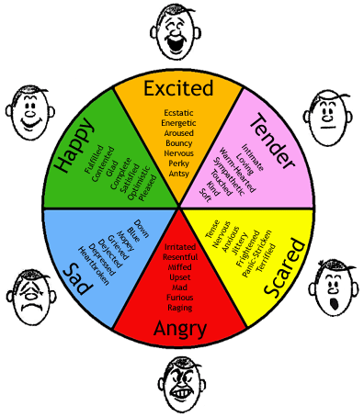
Emotions & drives
Emotions: categories of brain/body states.
Emotions may have many functions; they
involve physiological arousal, expressive behaviors facilitating planning and actions by providing them with value.
Basic emotions are universal and can be recognized on photographs of people independently of their ethnic origin.
Facial Action Coding System is a parametric approach to code facial muscle expressions but the whole body is the canvas for expressing emotional states.
Emotions are associated with mood, temperament, personality and motivation. Drives motivate, direct and energize behavior, emotions provide affective evaluation of motivation, positive or negative.

Slide 36
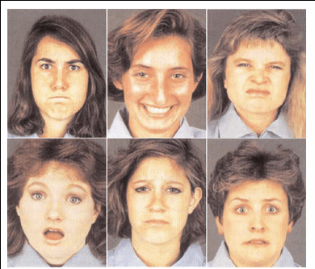
Emotions & drives
Emotions: categories of brain/body states.
Emotions may have many functions; they
involve physiological arousal, expressive behaviors facilitating planning and actions by providing them with value.
Basic emotions are universal and can be recognized on photographs of people independently of their ethnic origin.
Facial Action Coding System is a parametric approach to code facial muscle expressions but the whole body is the canvas for expressing emotional states.
Emotions are associated with mood, temperament, personality and motivation. Drives motivate, direct and energize behavior, emotions provide affective evaluation of motivation, positive or negative.

Slide 37
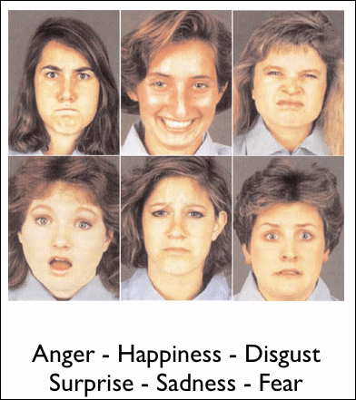
Emotions & drives
Emotions: categories of brain/body states.
Emotions may have many functions; they
involve physiological arousal, expressive behaviors facilitating planning and actions by providing them with value.
Basic emotions are universal and can be recognized on photographs of people independently of their ethnic origin.
Facial Action Coding System is a parametric approach to code facial muscle expressions but the whole body is the canvas for expressing emotional states.
Emotions are associated with mood, temperament, personality and motivation. Drives motivate, direct and energize behavior, emotions provide affective evaluation of motivation, positive or negative.

Slide 38
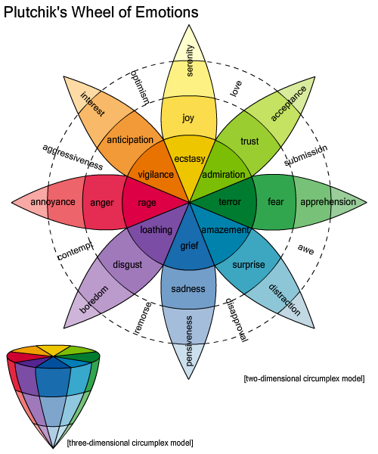
Affective computing
Robert Plutchik created 3D model of emotions based on combination of 2 or 3 basic emotions, although there are great differences in linguistic description of more subtle emotions around the world.
Affect in psychology = how emotions affect behavior.
Affective computing: recognize, interpret, process, and simulate human affects in artificial systems, including speech, facial and bodily expressions.
Emotion Markup Language (EmotionML).

Slide 39
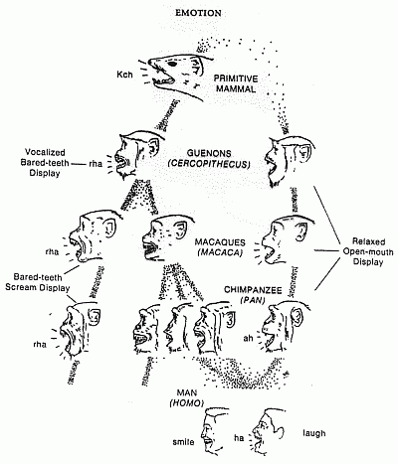
Expression of emotions
Charles Darwin (1872)
The Expression of the Emotions in Man and Animals.
Even rats can laugh when tickled …
Basic emotions are obviously similar in many animals, although higher emotions, like shame or pride, require self-consciousness and thus may be accessible only to humans.
How do we know what is meant by emotions? Saudade? Amae?
Alexythymia: problems with understanding, processing, or describing emotions.

Slide 40
Limbic system
Frontal Cortex … Cingulate Cortex … Sensory Cortex
Context
Recognition
Slower action
Amygdala
Hipocampus
Action
Norepinephrine
Thalamus
Lateral hypothalamus
Locus coeruleus
..... Brainstem ARAS ....
Solitary tract nucleus
Brainstem
nerves
Adrenaline
Emotional
stimulus
ANS:
adrenal medulla (on kidneys)

Slide 41
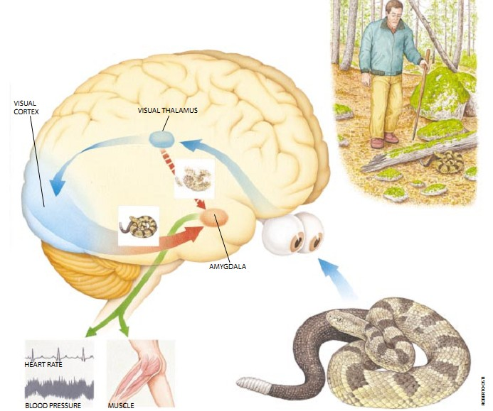
Snake example
Source: Scientific American Mind

Slide 42
What it will be about
Next:
Neocortex and complex cognition.
Role of the primary, secondary and tertiary cortex.
Processing information by topographic representations.
Motor control by population coding.
Remarks on the brain information code.
Hebbian correlation learning in the primary cortex.
Self-organized learning: creating topographic representations.
Error-driven task learning.
Simple associative memory models vs. biologically motivated models.

