Slide 1
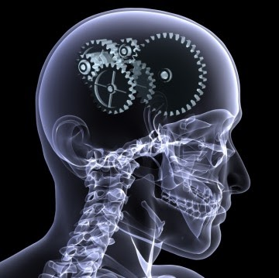
Advanced Topic in Cognitive
Neuroscience and Embodied Intelligence
Week 2:
Brains, Minds, Cognition
& Neurocognitive Informatics
CE7427

Slide 2
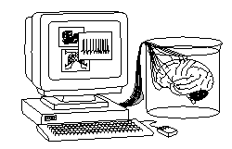
What it will be about
Questions/answers about the brain depends on our purpose.
Why, what and how questions.
A bit of history of brain research.
Brain-related research fields and their methods.
Evolutionary perspective: functions required for survival.
Building on the existing foundations.
Multi-objective optimization requires compromise.

Slide 3
What it will be about
Questions/answers about the brain depends on our purpose.

Slide 4
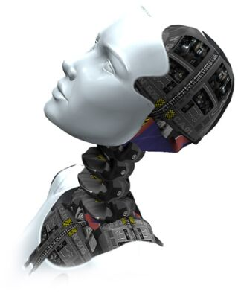
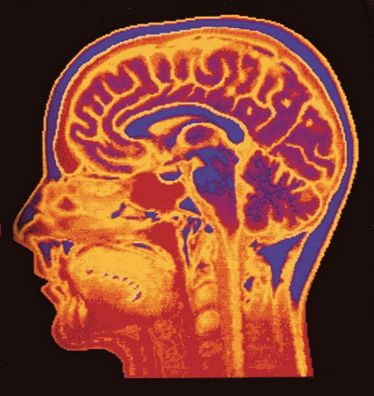
Brains
Brains are the most complex objects in the known universe, providing necessary substrate for mental processes.
Riken Brain Science Institute: 3 areas,
protect, understand, create the brain.
Psychiatry, medicine, pharmacology: needs molecular level to understand brain disease, addiction, influence of drugs.
Brain research: understand through neurophysiology, brain imaging.
Psychology, neuroeconomics: understand behavioral level, decision making.
Engineering perspective: rough understanding of general functions, principles behind perception, memory, control of actions, planning, reasoning based on common-sense knowledge, use of language ...

Slide 5
Creating brains
“Here, we aim to understand the brain to the extent that we can make humanoid robots solve tasks typically solved by the human brain by essentially the same principles. I postulate that this ‘Understanding the Brain by Creating the Brain’ approach is the only way to fully understand neural mechanisms in a rigorous sense.”
M. Kawato, From ‘Understanding the Brain by Creating the Brain’ towards manipulative neuroscience.
Phil. Trans. R. Soc. B 27 June 2008 vol. 363 no. 1500, pp. 2201-2214
Humanoid robot may be used for exploring and examining neuroscience theories about human brain.
Engineering goal: build artificial devices at the brain level of competence.

Slide 6
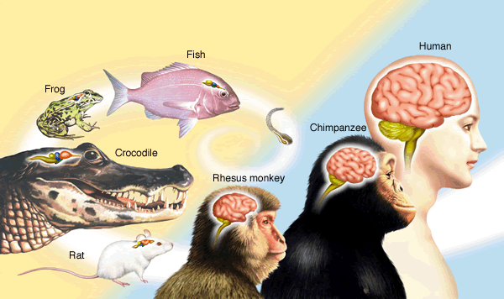
How complex are brains?
Human: mass ~1.4 kg, protein is 130 g, fats 100 g, the rest is water.
2% of body mass, using 20% of oxygen, 25% glucose, about 20-25 Watt.
About 40G neurons (30G in cerebellum), with ~10¹⁴ (100 T) connections.
Naïve estimation: memory 100 T*10 bit/synapse = 1 Petabit.
Speed: < 100 Hz * 100T = 10 Pflops; usually only 1% of neurons γ-active.
Cockroach, bee: 1 M neurons, over 1G connections, highly specialized.

Slide 7
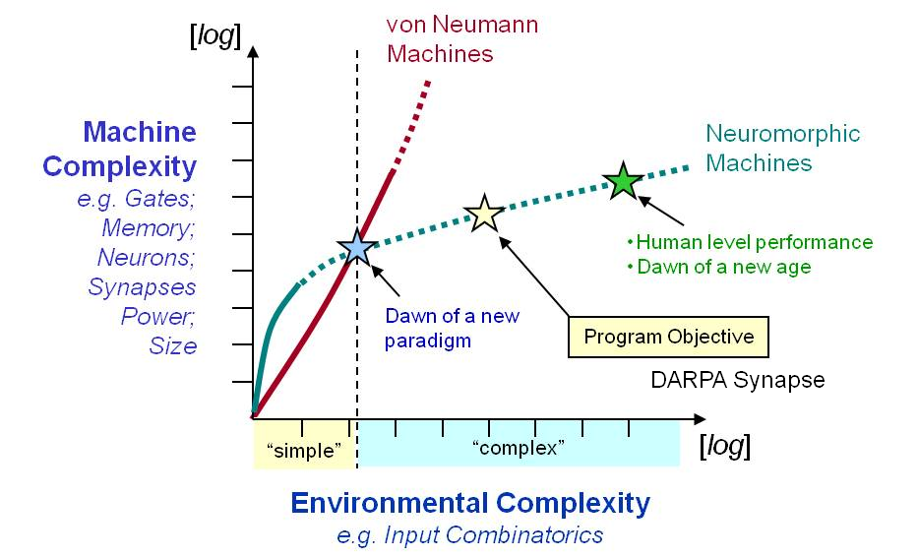
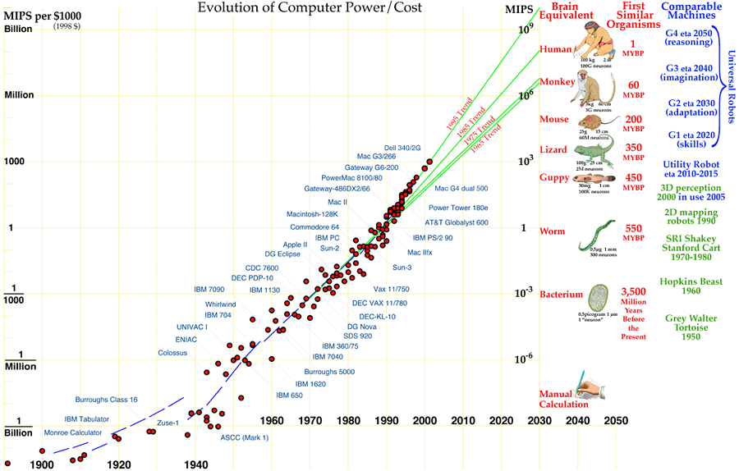
Brains and computers
Can we handle such complexity?
IBM Blue Gene, 2048 processors, needs 80 min. to simulate 1 sec. of activity of V1 cortex covering 9º field, 5000 x slower than real time.
Intel: 80 cores, 1 Teraflop in a PC; CUDA and GPUs with similar speed, but classical computer architectures are not well suited.

Slide 8
Brains and computers

Slide 9
Brains and computers
Can we handle such complexity?
IBM Blue Gene, 2048 processors, needs 80 min. to simulate 1 sec. of activity of V1 cortex covering 9º field, 5000 x slower than real time.
Intel: 80 cores, 1 Teraflop in a PC; CUDA and GPUs with similar speed, but classical computer architectures are not well suited.
Neuromorphic approach: analog hardware neurons.
Neurogrid (Kwabena Boahen, Bioengineering, Stanford 2007): analogue neuromorphic supercomputer on our desktop? Low power, spiking.
A human brain emulation race is starting?
DARPA Systems of Neuromorphic Adaptive Plastic Scalable Electronics (SyNAPSE) program: develop biological-scale neuromorphic electronic systems for human scale brain emulation by 2019.
Europe 1GE human brain emulation project with a target for 2024.

Slide 10
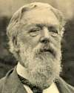
What it will be about
Questions/answers about the brain depends on our purpose.
Why, what and how questions.
These questions cannot sometimes be easily separated.
It is not true that science answers only what and how questions, also “why” questions have good answer.
Everything is the way it is
because it got that way!
(D'Arcy Thompson, On Growth and Form, 1917)

Slide 11
“Why” questions
Examples of why, or what is the role of, questions:
Why do we have hairs in the inner ear and in the retina?
Why the inner ear has 3 bones (ossicles) and such strange structure?
Why there are so many viruses? Bacteria? Diseases?
Why do zebras have stripes? Why peacocks have such big tails?
Why do most species (including plants) have two sexes?
Why homosexuality is so widespread in the animal world?
Why pain exists, why is toothache so strong?
Why some people are altruists and some are egoists?
Why there are sadists and masochists, saints and psychopaths?
Why there are taboos? Are they all irrational?
Many fascinating questions, we known at least partial answers to some of them, but they rarely contribute to the engineering perspective.

Slide 12


Why do zebras have stripes?
Things are the way they are because they have evolved that way.
Why are stripes useful? For many reasons:
Diseases transmitted by tsetse flies kill over 250,000 people per year. Stripes confuse compound eyes of flies from a distance.
Ruxton, G.D. 2002. The possible fitness benefits of striped coat
coloration for zebra. Mammal Review 32(4):237-244.
Lions are color-blind and may also be confused seeing zebra in high
grass from a distance, with similar light reflection as from moving grass.
Stripes may confuse predators as the herd of moving zebras is making it more difficult to pick out the weakest one; lions do not waste energy attacking strong animals, that may jump up quite high.
Patterns of stripes are unique, zebras may probably used them for identification, there are other animals that have unique spots or stripes that are used for that purpose.
Unsupported: stripes are connected with fat patterning serving as a thermo-regulatory mechanism for the zebra.

Slide 13
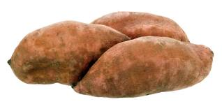
Why taboos?
Taboo or tabu – from “forbidden” in Polynesian
language; taboos are supported by local cults and religions.
In sub-Saharan Africa the area of endemic malaria coincides with the “Yam Belt”, where yam is the staple food for over 100 ethnolinguistic groups, very different cultures/ social organization, but same rituals and beliefs surrounding cultivation and harvest of yams.
New Yam Festival (June-Oct) is preceded by several weeks of a complete ban on yam consumption during rainy season, time of relative hunger. Common belief: yam eating at that time will bring great harm.
Rainy season is the time of maximal mosquito breeding season carrying malaria. Yams contain thiocyanate, substance that significantly decreases deleterious effects of sickle-cell gene leading to sickle-cell anemia (with 30-40% prevalence), but also reduces resistance to malaria.
Taboo on yam consumption during rainy season makes anemic people more resistant to malaria, while eating yams later helps them survive.
Malaria is also correlated with genetic variants in SE Asia.

Slide 14
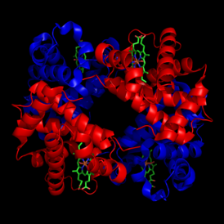
“What” questions
What is the structure, mechanism, function of …
specific gen or protein, like hemoglobin;
bacteria in our bodies;
specific neurotransmitters and neuromodulators;
cells in our body, like blood cells or astrocytes;
hairs in the inner ear, hairs in the retina;
nucleus accumbens, orbitofrontal cortex, brain stem …
What is life? consciousness? reality? good and evil?
Evolutionary thinking may answer some “why” questions, why something has been useful and therefore has evolved increasing the chances of survival.
Science is focused on answering what questions, understanding basic mechanisms, and this is the first step to answer “how” questions.
Some “what” questions do not admit unique answers, refer to vague concepts, and should be left for philosophy, trying to create conceptual basis for understanding of reality.

Slide 15

“How” questions
Engineering perspective deals mostly with “how” questions.
Why – the need, what – understanding, and how – creation.
How does it work? (the skin, the ear, the memory … )
How can we understand it? (the brain, the mind, the society …)
How can we construct it (artificial neurons, vision system … )
How can we make a working model?
How to solve the problem?
First, we need to understand why: there is ecological need for some brain functions, increasing the efficiency of organisms/systems.
Second, we need to understand what: mechanisms and functions, specific brain structures exist for some purpose.
Third, we need to learn how: to build models of brain functions, how evolution had created complex, highly efficient but imperfect solutions.

Slide 16
What it will be about
Questions/answers about the brain depends on our purpose.
Why, what and how questions.
A bit of history of brain research.
How people in the past tried to understand brain functions?

Slide 17
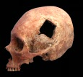
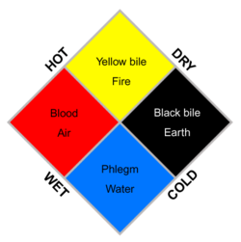
Ancient History
Trepanation of the scull has been practiced in ancient times all around the world, with some sculls being 7000 years old – it is not clear why they did it.
… from the brain, and from the brain alone, arise our pleasures, joys, laughter and jokes, as well as our sorrows, pains, grief's and tears. Through it, in particular, we think, see, hear, and distinguish the ugly from the beautiful, the bad from the good, the pleasant from the unpleasant…
Attributed to Hippocrates, 5th century BC
Hippocrates promoted theory of humors, believed by Greek, Roman and Islamic physicians, that survived until the XIX century. The four humors/characters:
black bile (gr. melan chole), melancholic, despondent, irritable
yellow bile (gr. chole), choleric, bad tempered
white phlegm (gr. phlegma), phlegmatic, calm
red blood (lat. sanguis), sanguine, courageous, hopeful, amorous

Slide 18
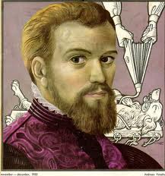
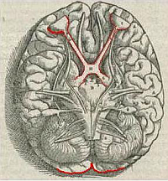
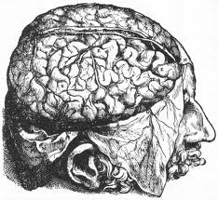
Early History
Galen of Pergamon (129 – 199) was most famous medical researcher, his theories based on dissection of monkeys and pigs dominated for 1500 years, his works were studied even in 19th century! He discovered that brain controls movement through cranial and peripheral nerves.
The Canon of Medicine (1025), encyclopedia of Galenic medicine, compiled by Ibn Sīnā (Avicenna), an example of the great Islamic school of brain surgery.
Andreas Vesalius (1514-1564), a Belgian physician, published 7 volumes of detailed anatomy based on dissections of human body De humani corporis fabrica (1543), correcting Aristotle & Galen errors.
William Harvey, On The Motion Of The Heart And Blood In Animals (1628): mechanism of blood circulation.

Slide 19
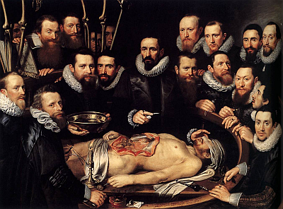
Renaissance
Anatomy lessons (here dr Willem van der Meer by M.J. van Mierevelt) became quite popular in 17th century, students traveled whenever fresh body of an executed criminal was available ...
René Descartes (1596 -1650),
a mathematician and philosopher is considered as the originator of modern philosophy of mind.
He though that animals are automata, only humans can think, have rational souls. His famous statement was: cogito ergo sum ("I think, therefore I am").
The problem of Cartesian dualists: how is the immaterial mind interacting with material body? This has been discussed since antiquity till now.
Antonio Damasio’s Descartes' error. Emotion, Reason, and the Human Brain discussed connections between emotions and cognition, with body as “canvas for emotional expression”, leading to embodied intelligence.

Slide 20
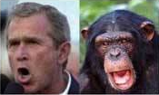

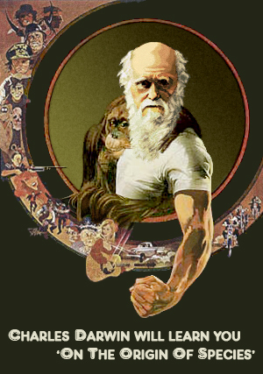
Evolution
Charles Darwin (1809 –1882). Books:
On the origin of species by means of natural selection, or the preservation of favoured races in the struggle for life (London, 1859).
The descent of man, and selection in relation to sex (London, 1871)
Expression of emotions in man and animals (London, 1872) - emotions are not just a cultural invention, they have biological origins => embodiment ideas.
The mood of his time (1873): "The abdomen, the chest, and the brain will forever be shut from the intrusion of the wise and humane surgeon". Sir John Eric Ericksen,
Surgeon-Extraordinary to Queen Victoria.
Psychosurgery started ~ 1935 with lobotomy, cutting thalamus-frontal lobes connections in mentally ill.
Antonio Moniz got Nobel prize (1949) for this bad idea.

Slide 21
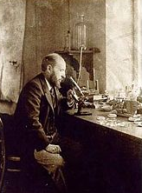
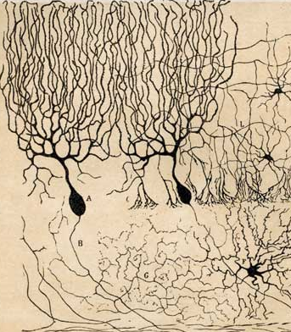
Neurons are coming
In 1838 Theodore Schwann and Matthias Schleiden proposed that organisms have cells, but the brain seemed to have fused cells, a network of tissue, as reticularists believed. The neuronists finally won the dispute, thanks to Santiago Ramon y Cajal (1852–1934) who created Neuron Doctrine drawing and describing various types of neurons stained by Golgi’s method (Golgi was reticularist).
The term neuron was introduced in 1891, synapse between nerve and muscle has been described by Charles Sherrington in 1897.
The Neuron Doctrine:
neurons are functional units of nervous system
neurons are discrete cells composed of
the dendrites, axon and cell body,
information flows along the neuron from the dendrites to the axon, via the cell body.

Slide 22
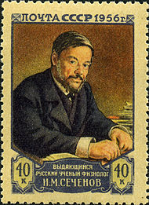
Mind?
In 19th century mental life was considered to be a function of conscious mind, controlled by immaterial soul seated in the brain.
In 1860 neurologist Thomas Laycock in Mind and Brain, or, the Correlations of Consciousness and Organisation had to admit that brains also show reflex action, unconscious reaction to stimuli, like other ganglia in nervous system.
Ivan Mikhaylovich Sechenov published in 1863 Reflexes of the brain (in Russian) and in 1866 Physiology of the nervous system (in Russian), showing link between brain activity and electric currents, introducing electrophysiology, investigating automatic brain reflexes and claiming that mental life comes from sensory stimulation. He was on trial in 1866 for “spreading materialism and debasing of Christian morality”, but not persecuted.
Many British and German scientists came to the same conclusion observing results of brain damage.
Sigmund Freud (1899) created psychoanalysis to understand psychology of unconscious mind, but his theory has never been verified in scientific way.

Slide 23
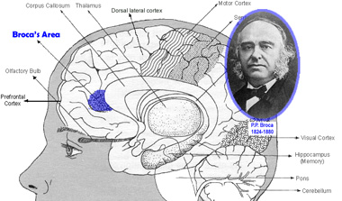
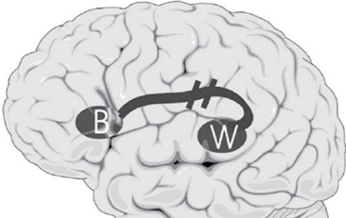
Localization of language
Paul Broca (1824-1880) studying the brains of aphasic patients in 1861 discovered that the damage to left posterior inferior frontal gyrus (called now Broca's area) leads to speech production problems (expressive aphasia, Broca's aphasia).
Localization of complex function in the brain was quite surprising, most people had a holistic view of mental functions, although the pseudoscience of phrenology claimed localization of all functions since 1810.
Carl Wernicke (1848-1905) in 1873 noticed that lesion to the left posterior superior temporal gyrus (Wernicke’s area) leads to problems with understanding and producing meaningful speech, known as Wernicke’s or receptive aphasia.
B & W disconnection => conduction aphasia.

Slide 24
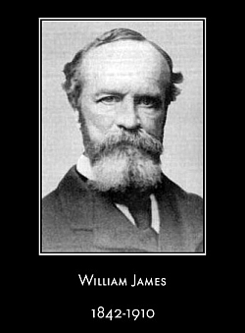
Mind-brain
Psychology was initially understood as the science of mental life, consciousness, psyche+logic.
Introspection, trying to analyze thoughts and mental states in terms of sensations, feelings and images, brought a lot of confusion.
Many scientists (Wundt, Fechner, Helmholtz) developed psychophysics, linking sensory data with percepts.
The Weber–Fechner law describes logarithmic relationship between the physical characteristics of stimuli and its perceived intensity.
Experimental psychology labs started to investigate memory, animal reflexes.
Pavlov experiments with dogs (1900) on classical conditioning convinced psychologists that all behavior can be derived from simple reflexes.
Behaviorists wanted to change psychology into “objective experimental branch of natural science", removing introspection, leaving only measurable data.
For decades research on consciousness and mind became a taboo.

Slide 25

What it will be about
Questions/answers about the brain depends on our purpose.
Why, what and how questions.
A bit of history of brain research.
Brain-related research fields and their methods.
How people try to understand brain functions now?

Slide 26
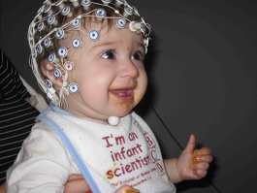
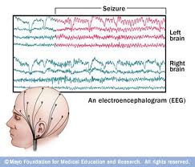
Electrophysiology
1890, Polish physiologist Adolf Beck published an investigation of spontaneous electrical activity of the brain of rabbits and dogs that included rhythmic oscillations altered by light.
1924, German physiologist and psychiatrist Hans Berger recorded the first human EEG and invented the electroencephalogram.
In 1963 Alan Hodgkin and Andrew Huxley won the Nobel Prize in Physiology or Medicine for model of the mechanisms underlying the generation of action potentials in neurons.
Single and multi-unit direct recordings brings important information about neurons and their microcurcuits. Event-related potentials (ERPs) are averaged responses to stimuli revealing brain reactions.
Magnetoencephalography (MEG) records magnetic fields produced by electrical currents.

Slide 27
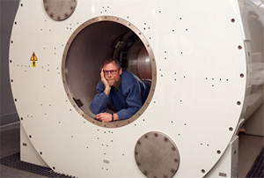
Functional Tomography
Angelo Mosso (1846-1910) observed that pulsation of the human cortex changes during mental activity due to the increase of blood flow to brain regions.
Neuronal activity requires glucose and oxygen, the hemodynamic response indicates neural activity. fMRI measures blood-oxygen-level dependence (BOLD) changes during mental activity.
Magnetic properties of oxygenated and deoxygenated blood are different and Medicine for model of the mechanisms underlying the generation of action potentials in neurons.
Optical tomography based on near-infrared spectroscopy (NIRS-OT) uses infrared lasers to measure BOLD signal.
Positron emission tomography (PET) measures glucose uptake by neurons, using radioactive isotopes with short half-life, such as fludeoxyglucose, glucose labeled with fluorine-18 isotope. PET may measure activity of specific receptors in the brain, for ex. dopamine, serotonin, or opioid receptors.

Slide 28
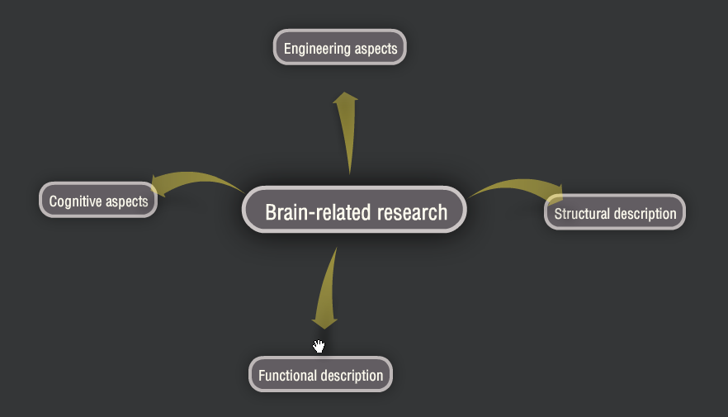
Science branches

Slide 29
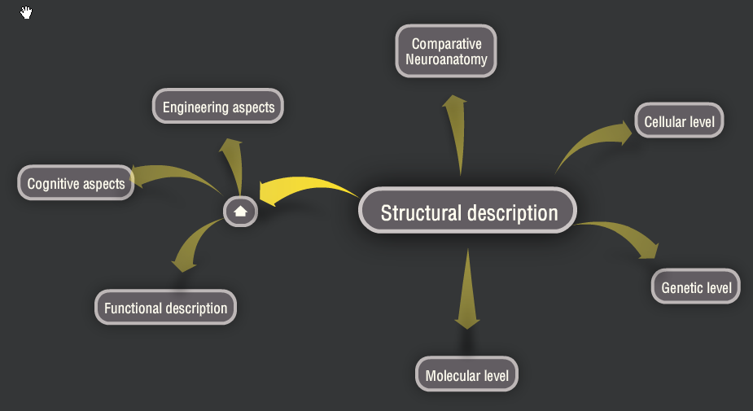
Science branches

Slide 30



Overwhelming …
Annual Meeting of the Society of Neuroscience, 25-30.000 people, more than half presenting papers … Principles of Neural Science textbook (Kandel, Schwartz, Jessell) had over 1400 pages in 2000 ….
Molecular Neuroscience: molecular biology, molecular genetics, neurochemistry, proteomics, signaling pathways, metabolomics, phenomics and other “omics”,neuroendocrinology, neuro(psycho)pharmacology, neuroimmunology ...
Cellular Neuroscience: morphology and physiological properties of neurons and glia cells at a cellular level, neuron receptors, ion channels, neuron membranes, axon structures, generation of action potentials, brain plasticity (learning) …
Developmental Neuroscience: stem cells and neural differentiation, neural growth and migration, synapse formation, apoptosis, embryonic brain development, neurodevelopmental disorders, evolutionary developmental biology (evo-devo), Baldwin effect, animal models …

Slide 31



More overwhelming …
Systems neuroscience: motor system and sensory systems neuroscience, early perception, types of sensory receptors (chemo, electro, mechano, visual), sensory fibers/nerves, specific functions, affective neuroscience ..
Neuroanatomy: comparative neuroanatomy, brain regions, microcircuits, connectomics at different levels…
Clinical neuroscience: disease and disorders, neurology, neuropsychiatry, neurodegeneration, movement disorders, neurodevelopmental disorders, addictions, clinical neurophysiology, neurovirology, psychiatric genetics, neurocardiology, neurooncology, neuroradiology, neurogastroenterology, neuroendocrinology, neuro-ophthalmology, neuropathology, pain, neuroepidemiology, neurosurgery, neurointensive care …
Behavioral Neuroscience: or biological psychology, biopsychology, or psychobiology: behavior as a function of genetic, physiological, and developmental processes, chronobiology, motivations, drives, emotions, language, volition, decisions, reasoning, consciousness.

Slide 32
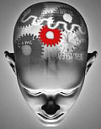
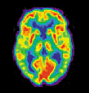
and more overwhelming …
Neuropsychology: psychological effects of neural activity, close to experimental and behavioral psychology, clinical psychology, psychoterapy, neuro-psychoanalysis, neurophenomenology.
Social neuroscience: neurosociology, neuroeconomics, neuropolitics, neuromarketing, neuroeducation, neuroergonomics, neuroethics, neurolaw, neuroanthropology and neuroculture, neuroesthetics, neurotheology, neurophilosophy …
Neuroengineering: sensory substitution, sensory enhancement, neuroprosthetics, brain–computer interfaces, neurorobotics, …
Neuroimaging (EEG, MEG, MRI, FMRI, PET, NIRS, SPECT …) and
brain stimulation (TMS, current flows).
Computational Neuroscience: cognitive neurodynamics, human cognome project, neurophysics, neurocognitive informatics.

Slide 33
What it will be about
Questions/answers about the brain depends on our purpose.
Why, what and how questions.
A bit of history of brain research.
Brain-related research fields and their methods.
Evolutionary perspective: functions required for survival.

Slide 34
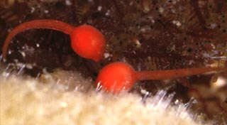
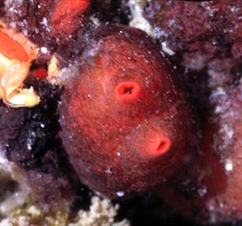
Why do animals need brains?
Real challenge for robotics: survive in a hostile environment.
Animals that survived are well adapted for particular ecological niche.
Tunicates (Ascidians, called also sea squirts):
Larval forms resemble small tadpoles,
swim moving a tail, have a simple eye
and balancing organ, controlled by a cerebral ganglion (primitive brain).
Grown form cements itself to a rock, frequently in a large colony.
Brain is no longer needed and is digested! Tunicates feed by filtering water.
Birds also change their brain in the mating season.
Brain is needed to control movement of large organisms, unicellular organisms also move.
Movement helps to find more nutrients.

Slide 35
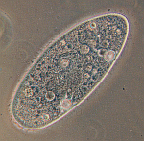
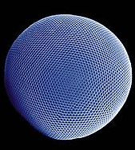

Orientation: receptors
Unicellular organisms (like Paramecium) move towards chemical
gradients of nutrients, bacteria, algae, small cells.
Such organisms may learn by altering biochemical cycles.
Reaction to light is quite useful and photoreceptive proteins were relatively easy to create, ex. eyespot apparatus in green algae that can swim towards or away from light, or snails eyes.
10 forms of eyes have evolved from that, based on
common genetic mechanisms, with matrices of eyespots,
to compound eyes of flies and shrimps, to vertebrate eyes
and more perfect cephalopod (octopus) eyes.
Other useful receptors:
Chemical sensors, leading to taste, olfaction, thirst and hunger, craving for specific food and substances.
Mechanical sensors, enabling body orientation and equilibrium, vibration detection, pressure, hearing.

Slide 36
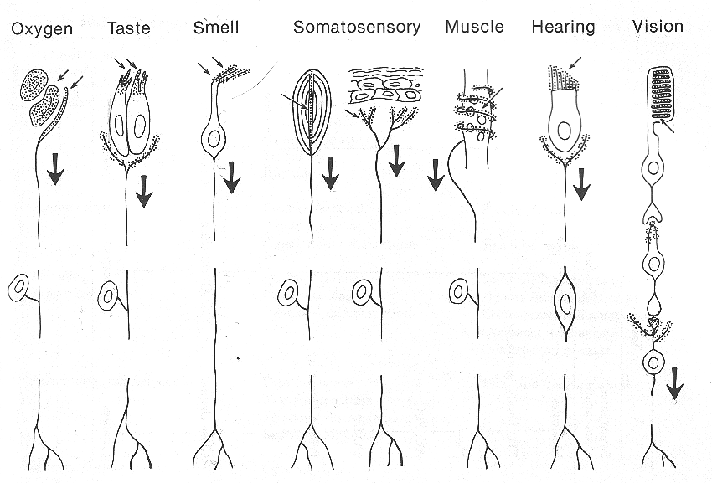
Varieties of receptors

Slide 37

To survive requires …
Homeostasis to regulate basic metabolic functions and
internal environment, controlling concentration of
chemicals derived from nutrients, air, thermal and light energy.
Complex organisms need cooperation of endocrine system and autonomous nervous system.
Drives, motivations and instincts to undertake actions that lead to homeostasis, with some reward mechanisms.
Sensors/effectors for fast affective reactions: avoiding dangerous situations, pursuing opportunities for feeding/mating.
Requires specialized sensors and attentional systems to discover patterns, associate them with values, and activate motor control system.
Basic cognition: spatial orientation and memory, learning through associations and simple planning, perceptual learning.
Complex cognition: imagery enabling prediction of action results, long-term goals, representation of self, understanding of causal connections.

Slide 38
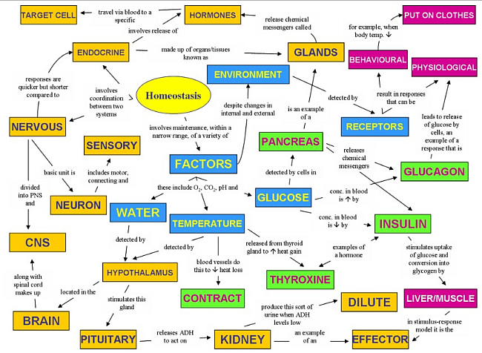
Homeostasis
What in this map is still missing? And what do we need for robots?
From https://worldofbiology.wikispaces.com/homeostasis+concept+map

Slide 39
What it will be about
Questions/answers about the brain depends on our purpose.
Why, what and how questions.
A bit of history of brain research.
Brain-related research fields and their methods.
Evolutionary perspective: functions required for survival.
Building on the existing foundations.

Slide 40
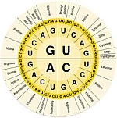
Evolution rarely looks back
Genetic inventions are preserved in more complex organisms.
A part of human genome useful in the past, evolved in quite different circumstances, may not be useful or even harmful today: it is called evolutionary baggage.
During the Ice Age variation in the human leukocyte antigen (HLA) genes lowered the freezing point of the blood by reducing production of insulin, keeping blood sugar levels high: now many Scandinavians who descend from these northern populations suffer from type I diabetes.
Evolutionary medicine explains how and why bacteria, viruses, microbes, parasites adapt to resist antibiotics, how pathogens learn to cheat the immune system, how organisms evolved to escape from these attacks by inventing sex and evolving faster (see the Red Queen hypothesis).
Hiccoughs have been connected to the expression of gill ventilation in frogs, originating pattern generators for suckling or regular breathing.
Freezing behavior: common to many animals (insects) when frightened.
Left-right crossed connections in the brain: coiling in worms.

Slide 41
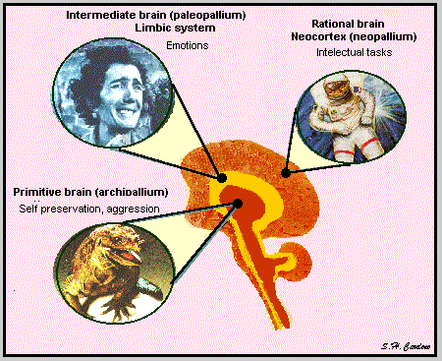
Triune brain
Paul D. MacLean (Neurophysiology lab director, NIMH) formulated this very simplified model of the brain in 1960s, and popularized in The Triune Brain in Evolution 1990 book.
Reptilian complex, brain stem, midbrain, basal ganglia responsible for instinctual behaviors involved in aggression, dominance, territoriality, and ritual displays.
The paleomammalian complex
(limbic system), including the amygdala, hypothalamus, hippocampal complex, and cingulate cortex responsible for motivation, emotions, reproductive behavior, parental behavior.
Neomammalian complex (neocortex), for complex cognition abilities.
These structures were sequentially added to the forebrain in the course of evolution – but got integrated and changed, so it is very rough description.

Slide 42
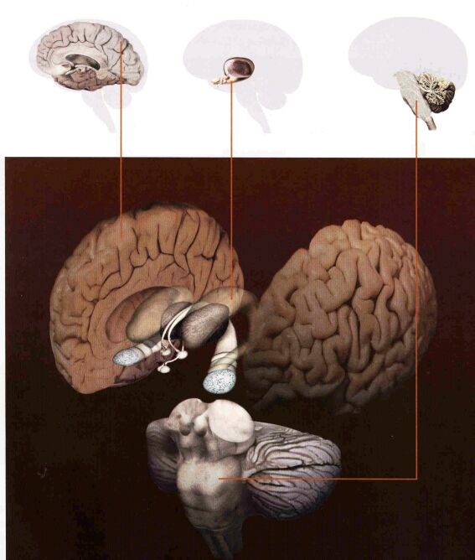
3 brains
All brain structures have to collaborate and are rather tightly integrated.
Brain stem is responsible for homeostasis,
limbic structures for emotions, values, motivations, drives and instincts, and the neocortex for complex cognition.
The structure is strange, shared with primitive animals, showing its evolutionary roots .

Slide 43
What it will be about
Questions/answers about the brain depends on our purpose.
Why, what and how questions.
A bit of history of brain research.
Brain-related research fields and their methods.
Evolutionary perspective: functions required for survival.
Building on the existing foundations.
Multi-objective optimization requires compromise.

Slide 44
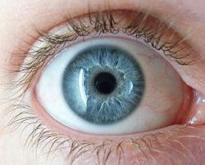
Compromises & Solutions
Evolution is not perfect but can find almost optimal
comprises. Vision should allow:
1) To see in the dark and to see in a bright light.
In camera aperture is changed, in the eye iris controls the size of the pupils. It can change quickly when eyes focuses on objects with different brightness, reaching dynamic contrast 1:10⁶ (20f-stops) with static only 1:100; in camera HDR is a poor approximation to this mechanism combining globally under and overexposed images into one image.
Two kinds of light-sensitive photoreceptor are used: 6 mln cones for bright light and 120 mln rods for weak light, and a molecular switch between.
2) To see in broad angle and to maintain sharpness.
Acuity differs in different retina region, complex control system focuses the image on the fovea region of retina, seeing 2º with very high acuity.
Lower computational demands for peripheral vision processing saves energy; attention mechanism have to orient saccades towards salient areas, integrating information from all senses, need head position invariance.

Slide 45
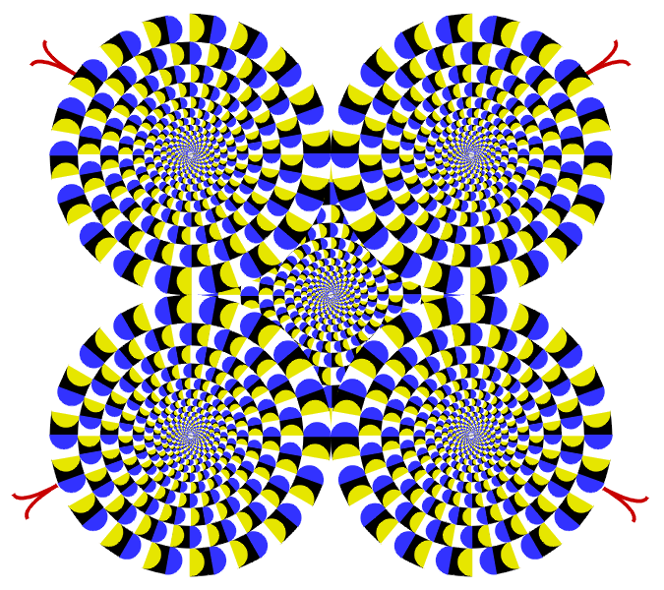
Illusions due to saccades
Each solution has some imperfections.
Akiyoshi Kitaoka moving circles …
Look with one eye, squint, the movement should stop.

Slide 46
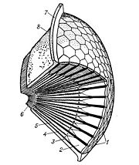
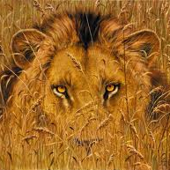
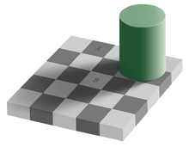
More compromises
3) See all around and see depth to estimate distance.
This is difficult and requires more than a pair of eyes.
Many eyes are found in arthropods, insects, crustaceans,
but only one pair of these eyes is compound, other are simple, maybe due to the limited brain processing power.
Predators have eyes in front to estimate depth/distance,
their victims have eyes on the sides to see around.
Head turning is rather slow, owls turn 180º.
4) See the same color in all light conditions.
Color constancy allows to see at sunset and in the middle of the day the same colors, ex. a red or yellow fruit, although the light
reaching the eye is quite different.
Although a lot of local processing in the retina is done
color constancy requires primary visual cortex to compute
transformaitons.

Slide 47
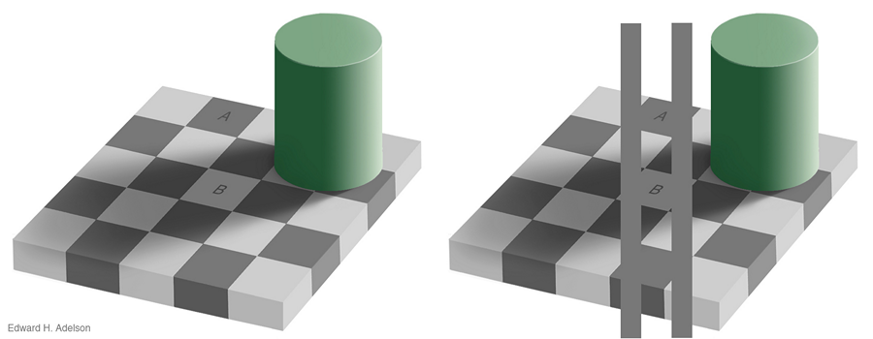
& more illusions
It is good to have color constancy but it is not perfect …
Compromises are always needed if optimization has many contradictory objectives. Evolution tries to stay at the Pareto front.

Slide 48
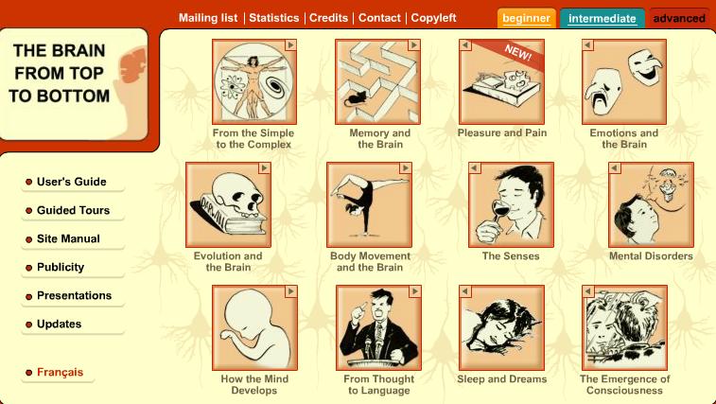
Great introductory resource
http://thebrain.mcgill.ca/flash/index_a.html

